Slide 1



Technology and Parkinson’s disease: Challenges and Promises
Alberto J. Espay, MD, MSc
James J and Joan A Gardner Family Center for Parkinson’s disease and Movement Disorders
UC Neurology Grand Rounds, August 12, 2015

Slide 2
Disclosures
Research: NIH (K23MH092735), Great Lakes Neurotechnologies, and the Michael J Fox Foundation
Consultant/scientific advisory board: Abbvie, Chelsea Therapeutics, TEVA, Impax, Merz, Pfizer, Acadia, Cynapsus, Solstice Neurosciences, Eli Lilly, Lundbeck, and USWorldMeds
Honoraria: Abbvie, UCB, Acadia, USWorldMeds, Lundbeck, the American Academy of Neurology, and the Movement Disorders Society
Royalties: Lippincott Williams & Wilkins and Cambridge University Press

Slide 3

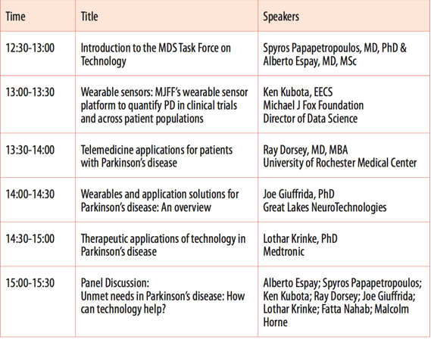
Alberto Espay MD, MSc (Chair)
Spyros Papapetropoulos MD, PhD (Co-Chair)

Slide 4

MDS Task Force on Technology
Formed in October 2014
Goal: Keep abreast of technologies as they apply to patient evaluation, diagnostics and treatment (review, build consensus, propose best practices)
Full-day symposium within the next MDS congress:
Notes:
Before we move to the agenda, I would like to thank everyone for attending, MDS officers for their support, the MDS Team for making this happen, MJFF for their leadership in supporting technology our speakers and last but not least our sponsors: Global Kinetics
Great Lakes Neurotechnologies, Impax Pharmaceutical, Lundbeck, Medtronic, Teva
I would also like to extend my gratitude for the group of about 50 colleagues who have contributed to our efforts son far either through the workgroup for technology-enable objective measures and the taskforce directly.
Our goal is to keep abreast of technologies as they apply to patient evaluation, diagnostics and patient treatment and drive consensus in a field full of opportunity.
We would like to extend an open invitation to any colleague interested to join our efforts
Over the next year we will be authoring position and consensus building papers in different areas of Movement Disorders and we will be preparing for our full day event in Berlin. Please stay tuned as more information will become available soon

Slide 5
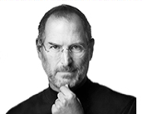
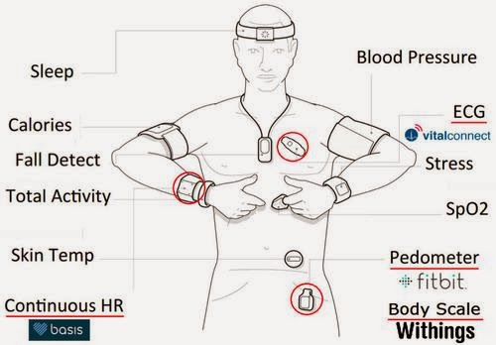
Digital Health – Technology in Medicine
“The biggest innovations of the 21st century will be at the intersection of biology and technology. A new era is beginning.”
Steve Jobs, Co-Founder of Apple
“Movement Disorders is a unique disease platform for technology measures due to the diversity of motor and non-motor features”
Notes:
Why is the combination of technology and biology important? Because Steve Jobs said it is!
According to Steve Jobs, “The biggest innovations of the 21st century will be at the intersection of biology and technology”
He talked about a new Era, the era of digital health revolution.
There are many elements that enabled the start of this revolution;
An important contributor is the widespread use of smart devices and the ability to collect and transmit large amount of data wirelessly through networks that are subsequently stored in large data farms for further analysis. Thousands of apps promise solutions and patient engagement and some have actually started to shown that their use can improve outcomes
Another significant breakthrough is the progress in the sensor technology with multiple instruments that can measure anything from sleep to activity to saturation and the list goes on…
The digital health revolution was enabled by the widespread use of smart devices and the ability to collect and transmit large amount of data wirelessly through networks that are subsequently stored in large data farms for analysis by super computers. One striking example comes through personal experience: my first ms-dos based PC had a memory larger than a dozen MB, my first laptop had a capacity of 4GB, the size of a single movie nowadays.
Another significant breakthrough is the progress in the wearable sensor technology with multople instruments that can measure anything from sleep to activity to saturation and the list goes on…
What is unique with movement disorders is that it offers a platform for detection of mulptiple sympotms through the variaty of the symptomatology.
The use of technology to quantify motor symptoms is not new

Slide 6
Measurements
Parkinson’s disease
Therapeutic applications

Slide 7
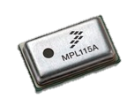
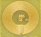
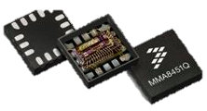
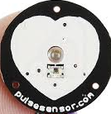
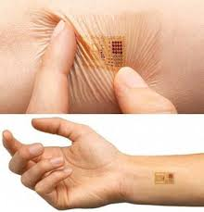
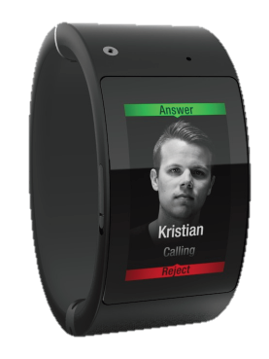
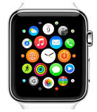
Categories of technology-based objective measures
8
Type: Monitoring, diagnostic, therapeutic
What is being measured: Motor, non-motor
Collection paradigm: Continuous, on-demand, active, passive
Site of data collection: outpatient, inpatient, remote
Validation: regulatory clearance, clinical grade, consumer grade
Technology used
Notes:
Type: Monitoring, diagnostic, therapeutic
What is being measured:
Motor (bradykinesia, tremor, rigidity, gait, voice, eye movement), function tests
Non-motor symptoms (cognition, dysautonomia, sleep)
Collection paradigm: Continuous, on-demand, active, passive
Site of data collection: outpatient, inpatient, remote, everywhere
Validation: regulatory clearance, clinical grade, consumer grade
Technology used: motion detection, pressure detection, touch, voice recognition, electrophysiology, 3D detection, temperature, other

Slide 8
Barriers for technology-based outcome measures in Parkinson’s disease clinical trials
Evaluation Criteria | Description
Validation | Does the device measure what is supposed to measure?
User Interface | Is the device easy to wear, clean, use, sync, charge by PD subjects ?
Test methodology | Is there standard methodology for administration of technology based tests?
FDA Clearance/Regulatory precedent | Has the device received clearance? Is it safe? Can the measure be used as a regulatory endpoint?
Ease and Automation of data transmission | What infrastructure is needed to allow data transmission? How is data managed and analyzed?
Real-time access and actuation | Does the sensor provide real-time or near real-time data in order to make clinical decisions? How can these decisions be made?
Price | What is the price? How does it compare to standard measures?
Purchase channels | How are the sensors sourced and supported (channels, BYOD, etc.)?

Slide 9
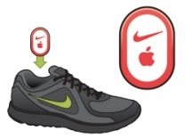
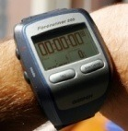
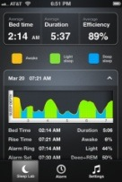
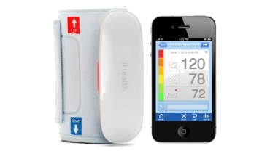

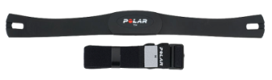
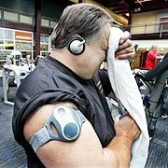
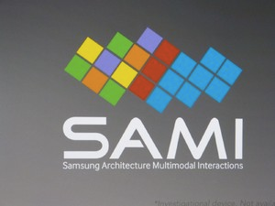
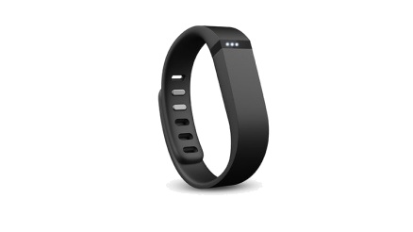
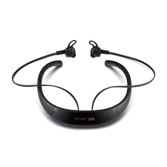
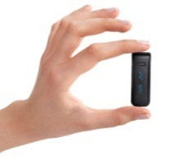
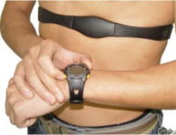
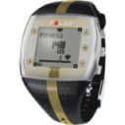
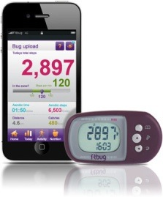
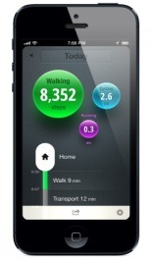
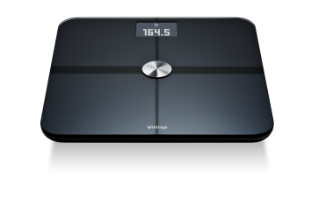
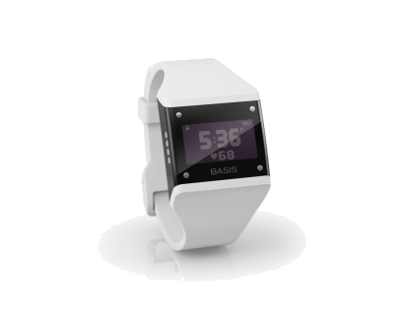
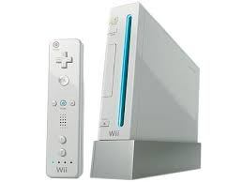
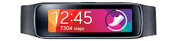
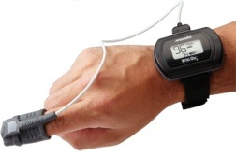
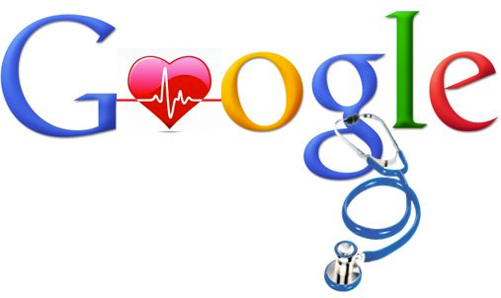
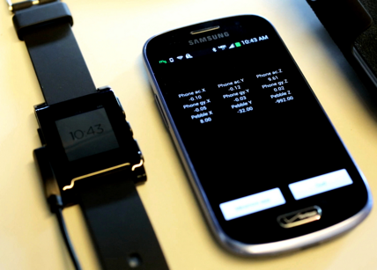
The evolution in the sensor and data analytics industry has been rapid the last few years
Wireless vital signs monitors
Integrated solutions/ smart-devices
GPS
Wrist/arm activity trackers
Heart Rate
Chest Straps
Armband
Calorimetry
Activity Trackers
Mobile
Tracking Apps
1990
2000
2006-9
2010
2012
2013
2014-5
Notes:
The evolution in the sensor and data analytics industry has been rapid the last few years.
In 2.5 decades we moved from chest straps to integrated solutions that allow continuous multiple-symptom monitoring.
Next slide

Slide 10
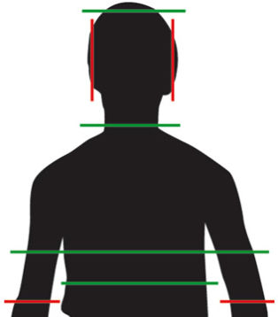
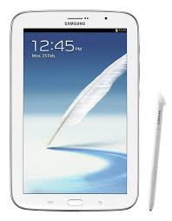

Smartphones, Wearable Devices and Health Sensors are capable of quantifying health and disease
Wearable
On SMART device
Non-wearable
Common
Pedometer
Gyroscope
Accelerometer
Geomagnetic
Sleep activity
Heart rate
Activity (steps)
Climbing/elevation
Gyroscope
Ambient light sensor
Accelerometer
Gesture
Proximity
Tracking chip
RGB light sensor
Barometric pressure
Outdoor Temperature
Humidity
Voice
Gait
Urine analysis
Weight
Glucose
Water quality
Infrared
Outdoor temperature
Voice
Ocular pressure
Other
Specialty
Pulse oximetry
Sun exposure
ECG, EEG, EMG
Respiratory rate
Heart Rate Variability
Pulse rate
Stress
Brain Activity
Sweat
Blood pressure
Skin temperature
Skin conductance
Notes:
The combination of monitoring different environmental and human channels including activity, positioning, proximity, ambient light, temperature, humidity, voice, skin conductance, cardiac and muscle activity to name a few provides a unique opportunity improve human health.

Slide 11
Clinical Validation Workflow
Start with Controlled Environment
Include Broad Range of Severities
Compare Versus Traditional Gold Standard (Video)
Demonstrate Correlations, Sensitivity, and Test-Retest Reliability
Move to Unconstrained Environment and Tasks That Mask or Mimic Symptoms

Slide 12
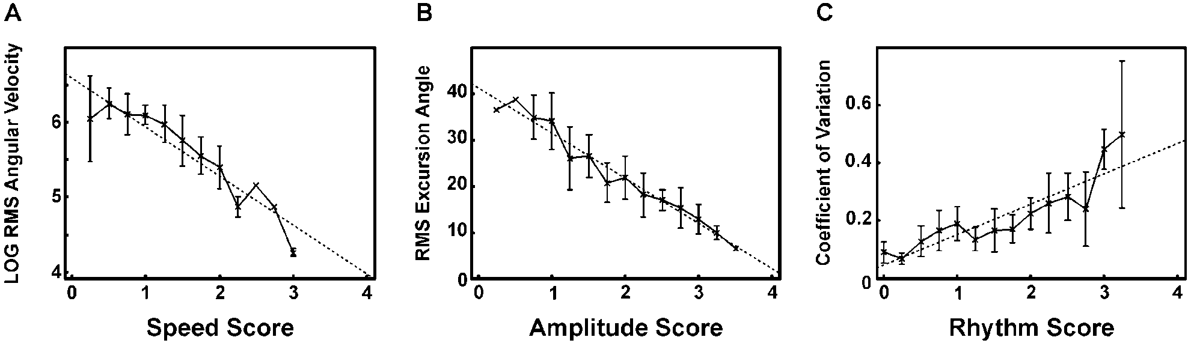
Discrete Bradykinesia Assessment
Objective Quantification
  Kinematic features are highly correlated to clinician MBRS scores
  Heldman DA… Espay, AJ. The Modified Bradykinesia Rating Scale for Parkinson’s disease: Reliability and Comparison with Kinematic Measures. Movement Disorders. 2011.

Slide 13
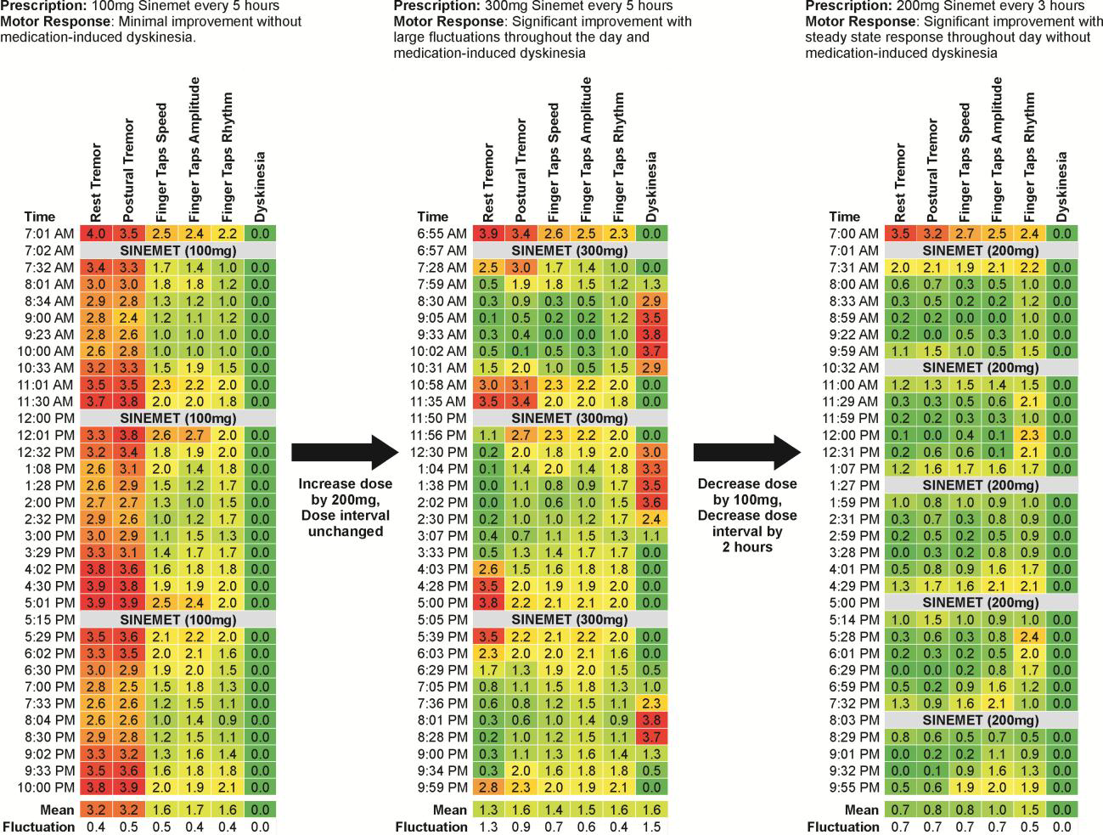
Task-Based Motor Assessments

Slide 14


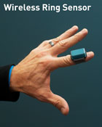
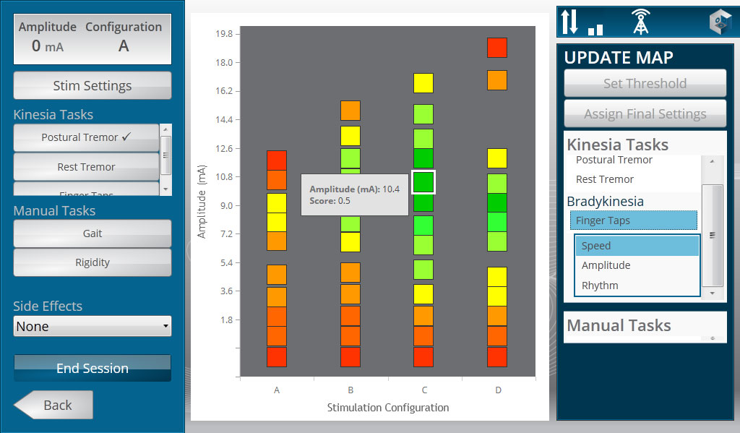
Application into treatment algorithms

Slide 15
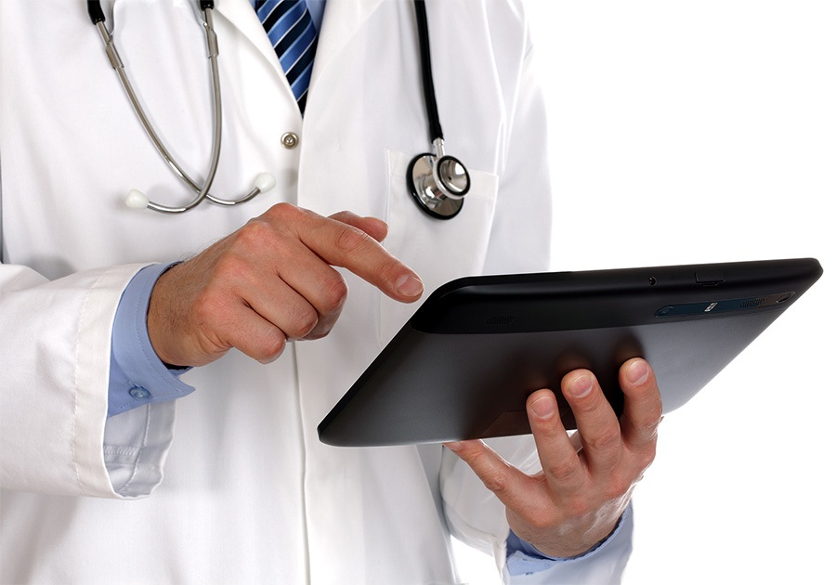
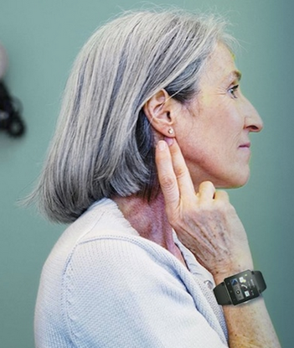
The adoption of technology creates news opportunity in clinical research
Data accuracy, sensitivity
Improved protocol patient compliance, less missing data
Greater flexibility with user inputs
A new avenue to connect with Investigators, study personnel and subjects
Real-time quality tracking
Decrease in-person clinic visits, while maintaining high quality care and engagement
Reduce study costs
Enable new type of research protocols if combined with eVisits
Notes:
Technology holds the promise of better, bigger data
Better research decision making
And Reduced operational burden and significant cost savings
Better, faster, cheaper research.

Slide 16
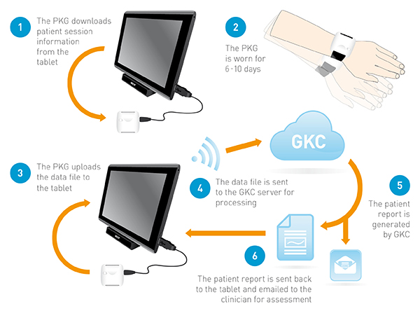
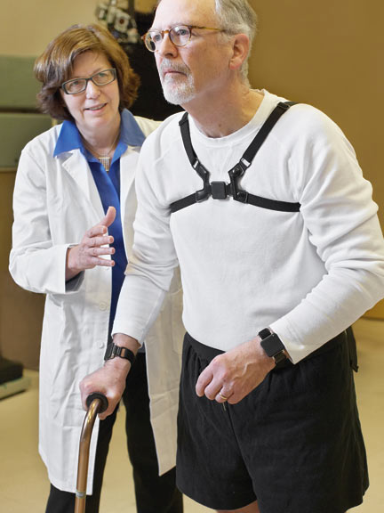
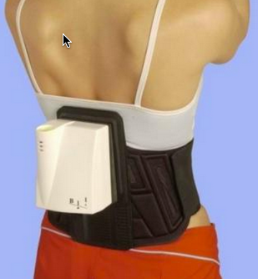
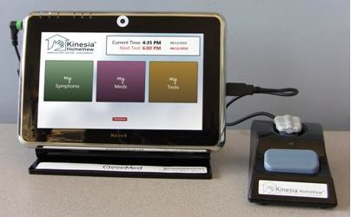
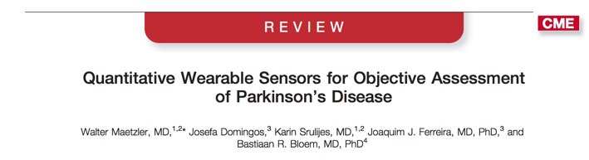
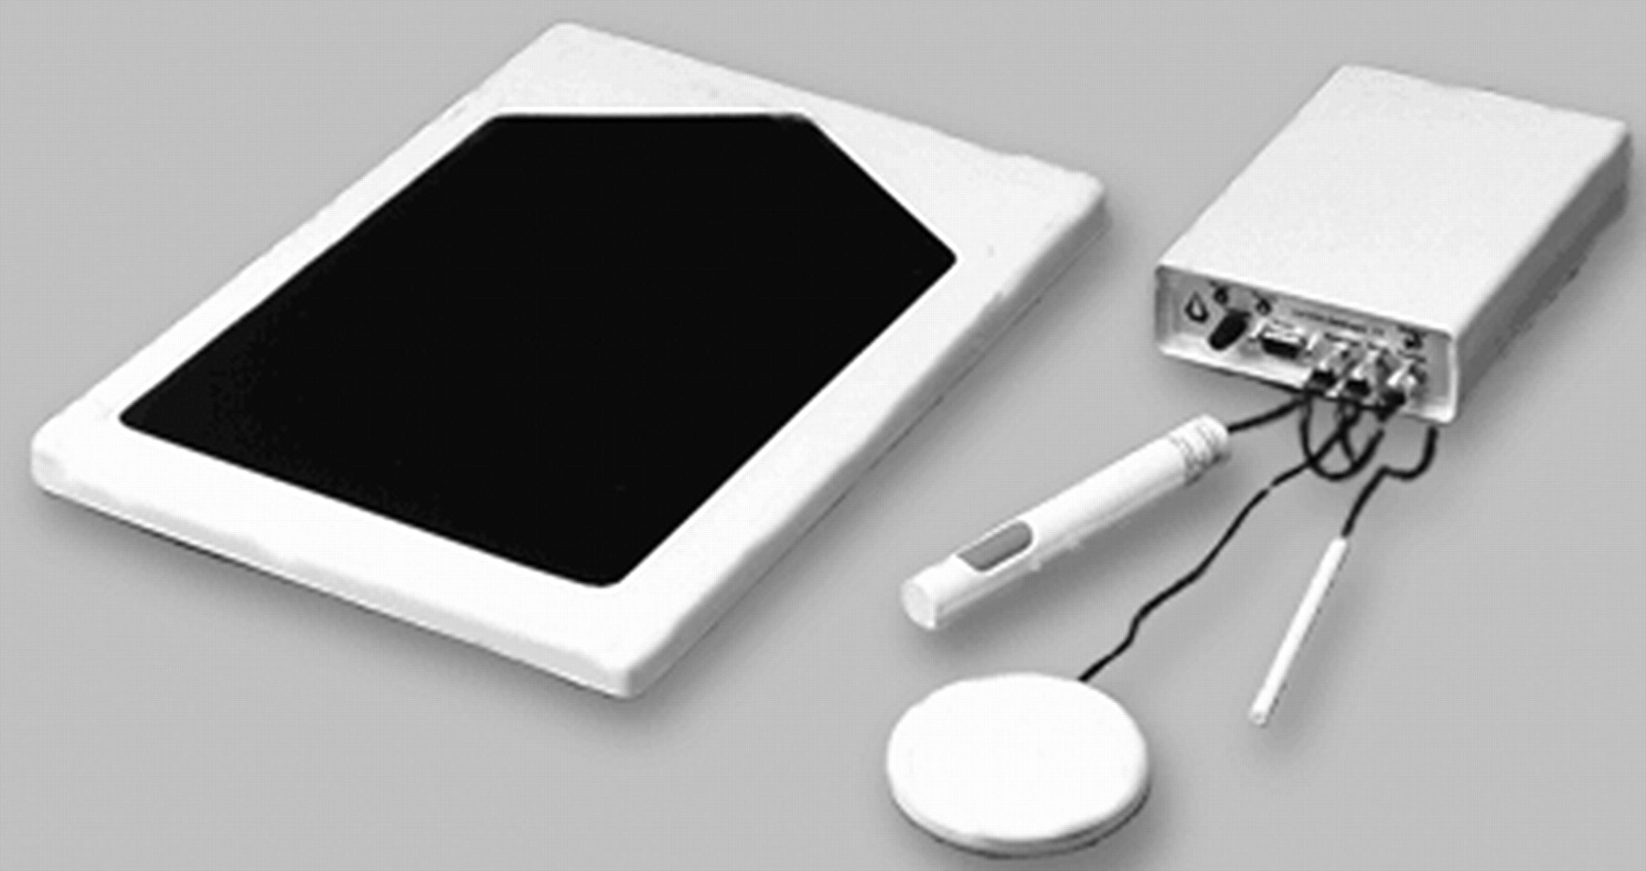
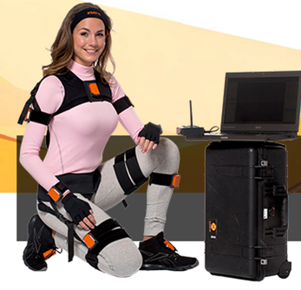
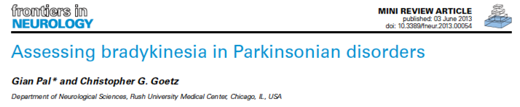
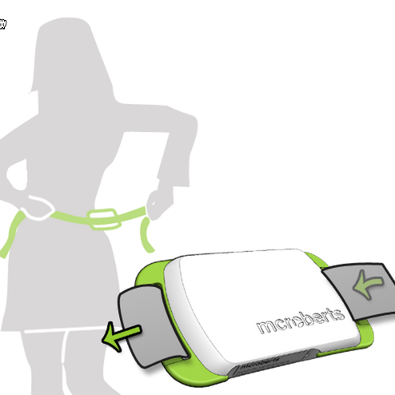
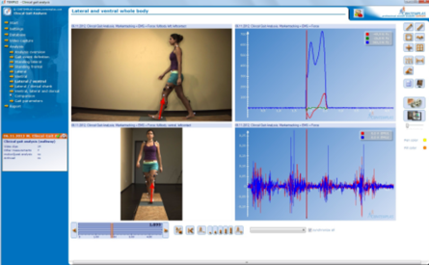
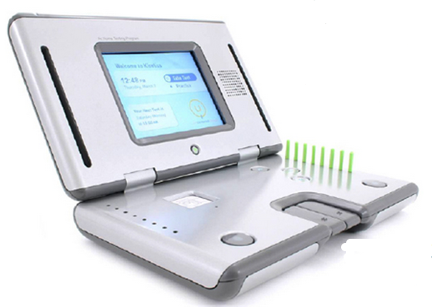
Technology in Movement Disorders: Many Years of Research
KinetiGraph
APMD
Kinesia
SwayStar
CATSYS
Xsense
Kinetics
Foundation
Dynaport
Motus
Notes:
Moving to Movement Disorders

Slide 17













Technology is Changing Fast
Example: The evolution of finger tapping
1980 1990 2000 2010

Slide 18








Pressure to Innovate
Traditional models are being disrupted with new solutions
Notes:
Another key transformation enabler is that health care models are constantly being disrupted with new solutions introduced by traditional and non-traditional healthcare players that are constantly under pressure to innovate.
Healthcare is undergoing reform to a value-based system with major emphasis on outcomes. Technology and sensors are key contributors of data to allow this transformation.
Digital Health companies are constantly coming up with solutions that capture health data.
The number of people engaged in technology is constantly increasing and last but not least players like Apple, Google, Intel and Samsung are seriously thinking about healthcare.
But what is preventing a transformation here and now?
Next slide

Slide 19

Evolution of Healthcare
New technologies support real time, continuous, self care/monitoring
Source: Tectonic Shifts in Healthcare. James R Mault MD, FACS VP & Chief Medical Officer Qualcommm
Notes:
From in clinic, episodic, “rare-care” that is only based on face-to-face interactions using few but expensive sensors to a connected in-home care where patients can monitor their health through technology using connected BP monitors, glucose meters, weight scales. We are at the beginnings of continuous care that is based on wearable sensors collecting big data that can be analyzed to provide personalized care but also provide insights into diagnosis, natural history and effects of health interventions.
Next slide

Slide 20




Spectrum of Care
Nearly 50% of all people have a chronic disease, and more than 75% of the nation’s total medical costs are spent on chronic disease.
Consumers are empowered to manage more of their health and care
Source: adapted from Tectonic Shifts in Healthcare.
Notes:
Health interventions are good examples of how smart technology in transforming healthcare:
Currently we have what we call a “sick care” model: when we notice a specific symptoms of illness we share it with our GP, and we get prescription, or we’re referred for more detailed diagnosis. This classic and dominant “sick care” model focuses on relatively passive way to manage illness “after” it occurs.
Under this current sick-care model, nearly 50% of all people have a chronic disease, and more than 75% of the nation’s total medical costs are spent on chronic disease. An here is how the model works for AD.
In the future we can envision ourselves being empowered by smart devices that track various variables in our daily life (such as heart rate, body temperature, activity levels, mood, diet).
This variables will get combined in sophisticated analysis merged with our medical and genetic data. This will continuously provides us with information about “risk factors” for disease, which will enables patients in turn to act and change their health status to delay or prevent disease. This is what we call a real “preventive care” model of healthcare. Clearly we’re not there yet.
Next slide
Next slide

Slide 21
Sensors and Connected Care
Patient Screening and Diagnosis
24/7 patient optimized therapy
  Responsive Therapy
  Automatic therapy adjustment
Improved patient self management
Remote patient monitoring
Remote patient management
Automatic quantification of outcomes to prove value to payers
Scientific discovery
  Large patient datasets
  Rare events

Slide 22
Opportunities with Chronic Disease Management
As care shifts from episodic to continuous, there is tremendous opportunity to support the management of chronic diseases for all participants:
Patient
  Engagement (real time visualization), empowerment (intelligent automated interventions), and accountability (self care) to increase adherence and improve outcomes.
Payer
  Patient self-management and continuous monitoring increases adherence, reduces costs, and improves outcomes.
Pharma/Tech Industry
  New products
  Patient behavior data provide insights that inform R&D and Marketing.
  Med adherence
Physician/Care Team
  Continuous care data enables exception-based alerts.
  Better manage the complexity of communication among the care team; keep track of
  what everyone on the care team is doing.
Research
  Better, cheaper, faster
Papapetropoulos S, Mitsi G, Espay AJ. Digital Health Revolution: Is it Time for Affordable Remote Monitoring for Parkinson's Disease? Front Neurol 2015 Feb 26;6:34
Notes:
How will the key stakeholders leverage this transformation in chronic disease management? Who will gain from healthcare disruption?
Patients will be more empowered and engaged with their own care and will probably benefit the most
Insurance companies will see improved outcomes and cost reduction
Pharma can leverage the digital revolution to improve existing products with companion apps and wearables and launch new technology products in an expanidng market
The HCPs will benefit from better decision making and time management
Last but not least for the researcher;
Next slide

Slide 23


What are the critical missing features to fully leverage the digital revolution?
1
Source: Endeavour Partners, September 2013
Notes:
There are many reasons but here are 5 that top my list:
Patient engagement with technology is poor: A recent study showed that 32% of users stop using wearables after 6 months, and 50% – after just over a year. Similarly, there is a high drop rate amongst smartphone apps users: 26% of apps being used only once and 74% of apps are not used more than 10 times (although discussion pointed out that we might not need long-term engagement for many interventions).

Slide 24




What are the critical missing features to fully leverage the digital revolution?
2
3
What is measured?
It is not about the technology, it is about the information
4
5
Is it useful to the user?
“Pilotitis”
Adapted from: QSEU14 Breakout: The Future of Behavior Change
Posted on July 15, 2014 by Ernesto Ramirez
Notes:
Second, the majority existing devices for self-tracking lack data validity and reliability. Proprietary closed platforms and limited access APIs make it difficult for researchers to validate how well self-tracking devices measure what they intend to measure.
Another problem highlighted is related to psychological resistance towards smart technologies in our lives, especially in the groups that are not motivated to use wearables/self-monitoring. People need to feel that it is not technology that matters but the information that can be obtained. Technology will evolve but the inforamtion can be applied towards everyone health. This is closely tied to the next point:
In many conversations with patients, the major reoccurring theme was a lack of robust and reliable feedback provided to users. “What is in it for me?” Many patients ask. They are still not convinced.
Finally, it seems clear that we’re piloting, we are suffering from pilotitis. Moving from small scale exploratory studies to large scale explanatory studies could be key to fully leverage the digital revolution

Slide 25


Slide 26


Big Data

Slide 27


Slide 28
Measurements
Parkinson’s disease
Therapeutic applications

Slide 29

Problems with the “PD script”
Low survival
Rapid disability
Early dementia
Long survival
Slow disability
Little dementia

Slide 30

GBA
Parkin
GCH-1
PD as currently envisioned
LRRK2
SNCA
Ubiquitin-proteasome dysfunction
Lysosomal dysfunction
Mitochondrial dysfunction
Alpha-synuclein aggregation
Gastrointestinal dysfunction
Calcium-channel dysfunction
Lewy bodies, neuronal degeneration
Autophagy dysfunction
Alpha-synuclein propagation
The Canard Digérateur or “Digesting Duck” made by Jacques de Vaucanson in the 18th century

Slide 31

PD as a “collection of distinct animals”
Espay, Brundin and Lang, in review

Slide 32

Diagnostic tiers
(Reductionism)
Diagnostic systems
(Integrationism)
Espay, Brundin and Lang, in review

Slide 33
Pitfalls in technologies: measurements
Complexity of what to measure
How many measures are relevant to each patient and responsive to changes over time
  Motor
  Non-motor
How much to measure: single vs. multiple sensors (burden)
How long to measure: intermittent vs. continuous (wearability)
“Big data” unlikely to impact greater understanding of disease subtypes

Slide 34
Measurements
Parkinson’s disease
Therapeutic applications

Slide 35


What can we learn from Cardiac Resynchronization Therapy?
Therapy: Pacing and Shock algorithms
Diagnosis: Fluid Status Monitoring
Patient Management: Remote monitoring system provide fast and easy remote device follow-up
http://www.medtronicheart.com/patients/index.htm

Slide 36



What can we learn from Diabetes?
Therapy: Threshold Suspend, which automatically stops insulin delivery when sensor glucose values reach a preset low threshold.
Diagnosis: Continuous blood glucose monitoring
Patient Management: Patient and Physician reporting on trends
http://www.medtronicdiabetes.com/treatment-and-products/carelink-personal-diabetes-software
http://media.corporate-ir.net/media_files/IROL/25/251324/Images/1292429324533_high_resolution.jpg

Slide 37


What can we learn from Pain Management?
Therapy: AdaptiveStim automatically adjusts stimulation based on the patient's needs and preferences in different body positions
Diagnosis: AdaptiveStim Diary provides objective data regarding patient activity
http://professional.medtronic.com/pt/neuro/scs/prod/restore-sensor/

Slide 38



Sensor-based devices: Selection and optimization of DBS
Quantifying symptom fluctuation for DBS application
1
Technology Goal
Improve patient selection and identify “DBS-ready” patients
Confidence in decision with objective measures
Reduce physician burden and simplify patient follow-up
Sensor-based Quantification
Objective Assessments
Impact to Practice
Patient selection for DBS
Therapy optimization
Quantification of therapeutic benefit
¹Griffiths RI et al. Automated assessment of bradykinesia and dyskinesia in Parkinson's disease. J Parkinsons Dis. 2012;2(1):47-55

Slide 39

Brain sensing = Medtronic Integrated technology
Physiological Brain Modulation enabled by sensing technology and algorithms
Biomarker identification through sensing and closed loop systems are expected to reduce patient management burden and may lead to automated programming
Why sensing?
Basic understanding of Neuroscience
Serendipitous discovery
Monitoring of disease progression and therapy effectiveness
Programming guidance
Automated Programming
Patient personalized stimulation
Sensing Research Status:
A number of physician-sponsored studies ongoing globally
Numerous devices implanted across a range of disease states/conditions
Several manuscripts in progress
Potential long-term impact:
Closed-loop stimulation to deliver patient personalized stimulation
Data file courtesy of Dr. Bronte-Stewart, Stanford, and Dr. Lothar Krinke, Medtronic.

Slide 40
Synchronized STN LFP and angular velocity recordings using wearable sensors
Continuous > 8 min neural and kinematic recordings from a sensing neurostimulator in freely moving PD people. Wearable sensors detect when person moving or stationary
Quinn et al under review
Data file courtesy of Dr. Bronte-Stewart, Stanford, and Dr. Lothar Krinke, Medtronic.

Slide 41

Initial efforts towards closed loop systems based on LFP sensor
Beta oscillations as a biomarker for closed-loop adaptive DBS: personalized treatment with exact amount of stimulation
.
Little S, Pogosyan A, Neal S, et al. Adaptive deep brain stimulation in advanced Parkinson disease. Annals of neurology. 2013;74(3):449-457.
Notes:
Given that, you may say: why don’t we only stim when we see the beta oscillations. Here you see the results from using a closed loop system with externalized leads. Dr. Brown’s team in Oxford.
In short, they used beta – oscillations as a biomarker.
DBS is turned on when the signal is there and off when not.
They used three parameters:
Continuous DBS
Adaptive DBS
And Random bursts
cDBS has a significant improvement over stim off but adaptive stim is even better both in unblinded as well as blinded assessments.
So we are on the path to develop a fully implantable closed loops system so that the patient gets truly personalized treatment with the exact amount of stimulation – no more / no less/

Slide 42




Novel Pulses: From High Frequency Stimulation to Novel Patterns
Today: High frequency continuous stimulation
Tomorrow: Temporal or Waveform modulation to potentially improve therapy outcomes
1
Temporal modulation, e.g.:
Pseudorandom
Burst
Stochastic
Fine tuning stimulation:
Waveform modulation, e.g.:
Square-biphasic
Non-square
Arbitrary
2
¹ J Neurophysiol. 2010 Aug;104(2):911-21. doi: 10.1152/jn.00103.2010. Epub 2010 May 26. Deep brain stimulation alleviates parkinsonian bradykinesia by regularizing pallidal activity. Dorval AD1, Kuncel AM, Birdno MJ, Turner DA, Grill WM.
²J Neural Eng. 2010 Dec;7(6):066008. doi: 10.1088/1741-2560/7/6/066008. Epub 2010 Nov 17. Evaluation of novel stimulus waveforms for deep brain stimulation. Foutz TJ1, McIntyre CC.

Slide 43


Technology Solution = Anatomical field shaping
Potentially better patient outcomes from personalized stimulation
Traditional DBS
Circumferential Stimulation
Future DBS
Field Shaping
Current spreads into adjacent structures especially if lead position is not perfect | Current can be moved away from adjacent structures and focused on target structures
Side effects limit amount of stimulation that can be applied¹ | Potential for higher stimulation with fewer side effects² , leading to better therapy
Limited data available from lead in final placement | Potential to augment interoperative data with directionally-sensed LFP
Burdick AP, Fernandez HH, Okun MS, Chi YY, Jacobson C, Foote KD. Relationship between higher rates of adverse events in deep brain stimulation using standardized prospective recording and patient outcomes. Neurosurgical focus. 2010;29(2):E4
Martens HC, Toader E, Decre MM, et al. Spatial steering of deep brain stimulation volumes using a novel lead design. Clinical neurophysiology: official journal of the International Federation of Clinical Neurophysiology. 2011;122(3):558-566.

Slide 44










TECHNOLOGY SOLUTION = Auto optimization of programming
Tools provided to today’s optometrist:
Tools provided to today’s neurologist:
Can we make an “autorefractor” for the neurologist?
Software identifies lead location in patient’s brain
Automated starting point
Predict the tissue stimulated by a given DBS setting
Assign a “score” based on tissue stimulated (target vs side-effect)
Patient exam,
“subjective refraction”
Conduct smart search to find highest scoring DBS settings
Manual protocol
Automated starting point
tailored to this patient
Effective prescription
Slide courtesy of Dr. Lothar Krinke, Medtronic.

Slide 45

TECHNOLOGY SOLUTION = Auto optimization of programming
Given patient’s anatomy and lead location,
prototype algorithm suggests DBS parameter settings:
Top-scoring parameter settings
(out of > 90,000 possibilities)
Search completed
(on laptop PC)
in 19.485 seconds
Slide courtesy of Dr. Lothar Krinke, Medtronic.

Slide 46
PD: How technology can impact future
Multi-sensors (motor and non-motor channels), external and internal
Streamlining efforts
Closed-loop: diagnostic tools feeding data to pumps or stimulators
Real-time, auto-optimization of delivery of therapies (infusion, stimulation)
From “big data” to “smart data”: subgrouping into PD clusters

Slide 47


THANK YOU!

Slide 48
PD: technology in clinical trials
Greater accuracy, sensitivity of collected data/ efficacy measure
Creating richer data sets through the addition of more contextual information
Improves protocol patient compliance, less missing data, out of window events
Interactive tool that allows connecting between Investigators, study personnel and subjects
Allows real-time quality tracking: Decreases in-person clinic visits, while maintaining high quality care and engagement
Reduces study costs (long-term) by improving signal to noise ratio and reducing sample size
Enables new type of research protocols if combined with eVisits

Slide 49


