Slide 1

Quality Improvement and Practice-Based Research in Neurology Using the EMR
Demetrius (“Jim”) M. Maraganore, MD
Ruth Cain Ruggles Chairman, Department of Neurology
Medical Director, Neurological Institute
NorthShore University HealthSystem
Evanston, Illinois

Slide 2
Conflict of Interest
Funding support
  Agency for Healthcare Research and Quality:1R01HS024057-01 “Quality Improvement and Practice Based Research in Neurology Using the EMR”.
  Auxiliary of NorthShore University HealthSystem: “DodoNA Project: DNA Predictions to Improve Neurological Health”.

Slide 3
Research
Neurology Practice Based Research Network
Quality Improvement Projects (Clinical Decision Support)
Quality Improvement Projects (Baseline Data)
Descriptive Reports (Cohorts)
Data Quality Reports
Subgroup Based Adaptive Assignments
Enrollment Reports
SCDS
Structure
Process
Outcomes
Our Quality Journey

Slide 4
Quality Stages by Disorder
NPBRN
CDS/SUBA
QI (baseline)
Descriptive
Data Quality
Enrollment
SCDS

Slide 5

Dodona was an oracle of ancient Greece, where priestesses interpreted the rustling leaves of a sacred oak tree to predict the future and to guide actions to improve fate.
Just as at DodoNA, we can interpret subtle variations in DNA, the “tree of life”, to predict outcomes and to improve health.
11 longitudinal cohorts
1,000 subjects per cohort
1,000 fields of data per office visit
10 years median follow up
1,000 DNAs per cohort
1 million SNPs per DNA
“CLINOMICS”– integrating genomic and clinical practice data
The DodoNA Project: DNA predictions to improve neurological health

Slide 6
DodoNA Project
2,623 subjects total as of January 24, 2016 (1 million SNP genotypes each)

Slide 7
Stage 1: Structured Clinical Documentation Support (SCDS)

Slide 8
Live Demonstration of Parkinson’s Disease SCDS toolkit

Slide 9
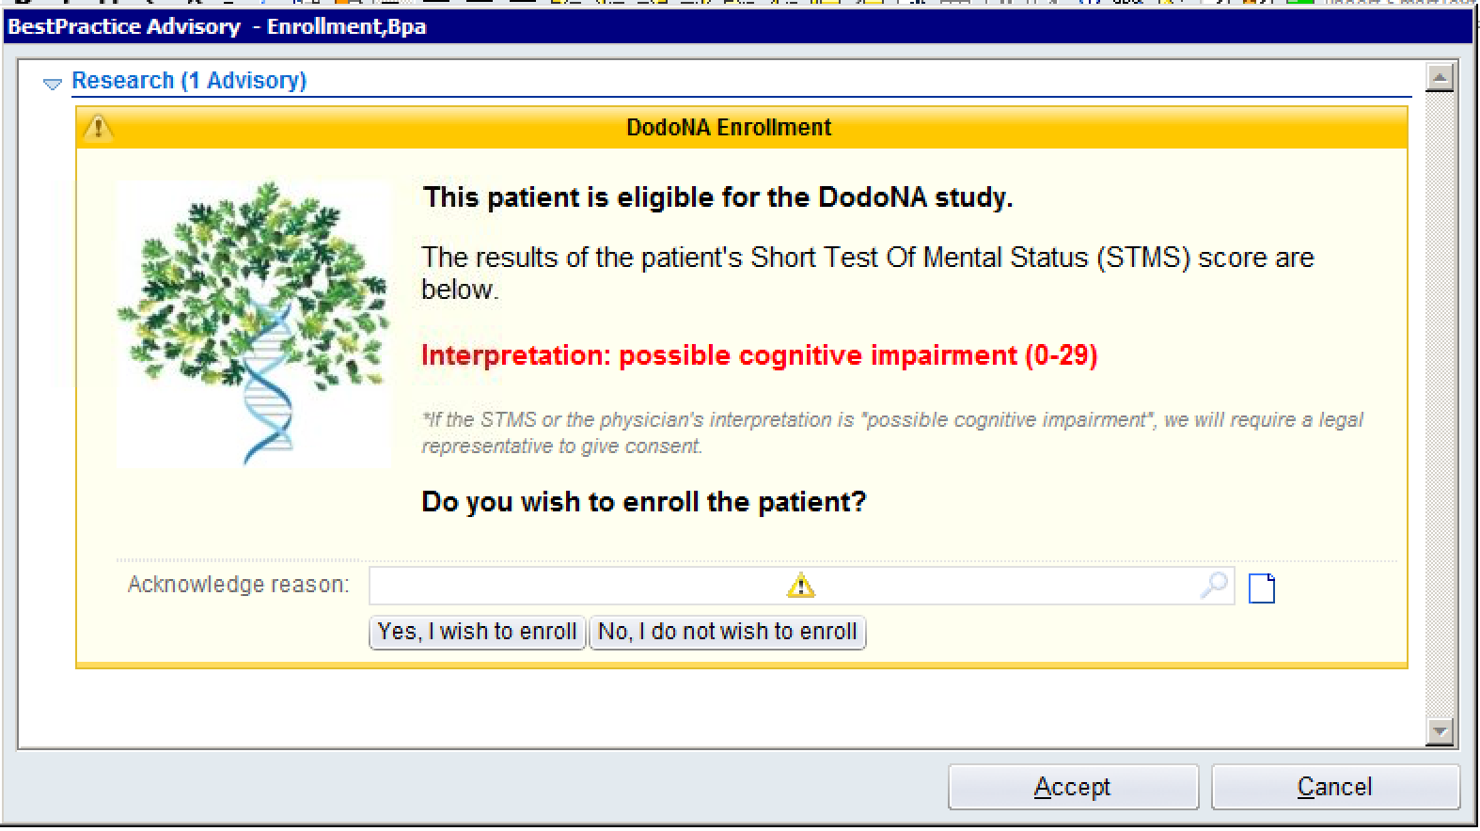
BPAs

Slide 12
Stage 2: Enrollment Reports

Slide 13
Discrete fields:
Brain Health 373
Brain Tumors 796
Epilepsy 897
Memory 363
Migraine 491
Mild Traumatic Brain Injury 575
Multiple Sclerosis 1000
Neuropathy TBD
Parkinson’s Disease 767
Sleep Disorders 857
Stroke 899

Slide 14
As of January 24, 2016

Slide 15
As of January 24, 2016

Slide 16
As of January 24, 2016

Slide 17
As of January 24, 2016

Slide 18
Stage 3: Quality Reports

Slide 20
Stage 4: Descriptive Cohort Reports

Slide 21
Description of Initial Visits:
HTML for Posting on the NNI Website

Slide 22
Description of Longitudinal Visits:
HTML for Posting on the NNI Website

Slide 23
Next Steps: QI, SUBA, NPBRN

Slide 24
Quality Improvement and Practice-Based Research in Neurology Using the EMR
Aim 1: Create a Neurology Practice Based Research Network (NPBRN). NorthShore will share SCDS tools for 10 common neurological disorders with other Neurology Departments that use Epic. The NPBRN will share data for quality improvement and practice-based research.
Aim 2: Conduct pragmatic trials using the EMR for 10 common neurological disorders. We will demonstrate the feasibility of subgroup based adaptive assignment of treatments, and outcomes data capture, at the point of care using the EMR. We will identify the most effective treatments for common neurological disorders and build CDS tools for dissemination through the NPBRN.

Slide 25
Aim 1

Slide 26
Quality Initiatives | Disorders | Quality Measures
Detect and manage psychosocial stress | Brain Tumors, Epilepsy | If NCCN or QOLIE-10 positive, % social worker order
Detect and manage depression or anxiety | Brain Tumors, Epilepsy, Migraine, MCI, mTBI, MS, Neuropathy, PD, RLS | If CES-D, GAD-7, GDS, or NDDI-E positive, % antidepressant or anxiolytic or psychiatry order
Detect and manage cognitive impairment | Brain Tumors, Epilepsy, MCI, MS, PD, Stroke | If MoCA positive, % neuropsychological testing order or advanced care planning documentation
Prevent fall-related injury | Brain Tumors, MCI, MS, Neuropathy, PD, Stroke | If falls in the past year or HY stage 3+ (PD), % physical therapy order
Detect and manage osteoporosis | Brain Tumors, Epilepsy | If on enzyme-inducing anticonvulsant, % bone density test order
Prevent teratogenesis | Brain Tumors, Epilepsy | If woman of childbearing age on anticonvulsant, % folate medication order
Detect and manage sleep disorder | Epilepsy, Migraine, mTBI, PD, RLS | If ESS or ISI positive, % sleep study order
Detect temporal arteritis | Migraine | If age >55 years and headache less than one year, % ESR and/or CRP order
Protect vulnerable adults | MCI | If FAQ positive (e.g., financial management difficulty), % social worker order
Prevent motor vehicle accidents | MCI, Neuropathy, PD | If driving safety screen positive, % driving evaluation order
Prevent complications of immunotherapy | MS, Neuropathy | If steroids or disease modifying therapies prescribed, % orders (CBC, CMP, TSH, pregnancy test, VZV antibody, JCV index, urinalysis, EKG, ophthalmology)
Detect Wilson’s disease | PD | If symptoms onset < age 55 years, % ceruloplasmin order
Detect and manage compulsive disorder | PD, RLS | If compulsive symptoms, % discontinuation of dopamine agonists orders
Detect iron deficiency | RLS | If no ferritin or anemia testing in past year, % orders (iron, total iron binding capacity, ferritin, CBC)

Slide 27
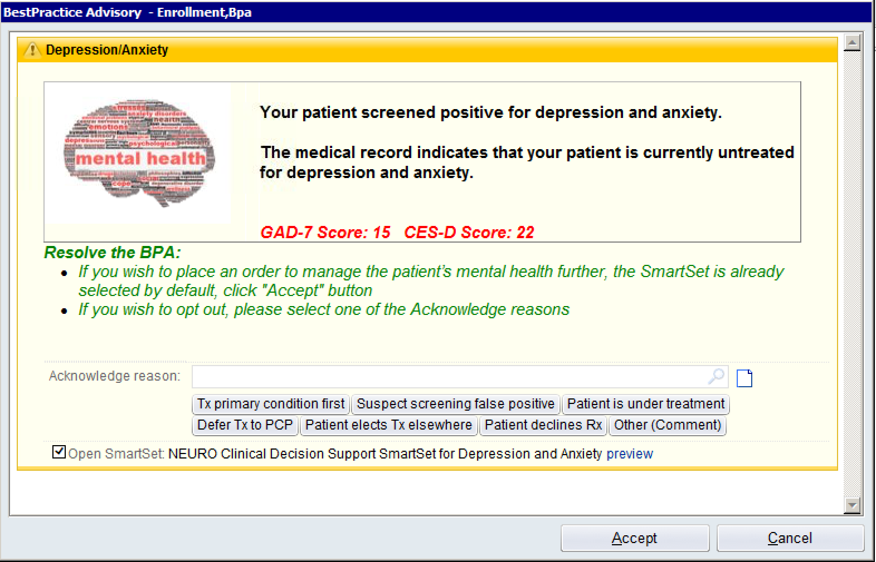

Slide 28
NPBRN Site | New Visits | Established Visits | Total Visits/Year
Dartmouth-Hitchcock | 8,150 | 30,260 | 38,410
Medical University of South Carolina | 6,475 | 17,503 | 23,978
NorthShore University HealthSystem | 10,904 | 24,583 | 35,487
Ochsner Health System | 4,130 | 11,166 | 15,296
The Nebraska Medical Center | 2,762 | 9,112 | 11,874
University of Arkansas for Medical Sciences | 2,001 | 6,692 | 8,693
University of Pennsylvania Health System | 8,674 | 22,080 | 30,754
Wake Forest University Baptist Medical Center | 5,742 | 16,850 | 22,592
TOTALS | 48,838 | 138,246 | 187,084*
* Data for 2013; projecting to ~ 1 million total office visits over 5 years for the eight sites combined.

Slide 30
Aim 2

Slide 31
Disorder | Compared Treatments | Outcome Measures
Brain Tumors (seizures) | Lamotrigine Levetiracetam Valproic acid | Survival (free of discontinuation, adjunctive therapy, seizures, hospice, death); 50% reduction of seizure frequency; Δ CES-D, GAD-7, KPS, MDASI, MoCA, NCCN
Epilepsy (other seizures) | Lamotrigine Levetiracetam Valproic acid | Survival (free of discontinuation, adjunctive therapy, seizures, death); 50% reduction of seizure frequency; Δ ESS, GAD-7, MoCA, NDDI-E, QOLIE-10
MCI | Donepezil (hs) Rivastigmine patch Namenda XR | Survival (free of discontinuation, adjunctive therapy, dementia); Δ FAQ, GDS, MoCA
Migraine (prophylaxis) | Amitriptyline (hs) Propranolol LA Topiramate (bid) | Survival (free of discontinuation, adjunctive therapy, medication overuse, chronic transformation); 50% reduction of migraine frequency; Δ CES-D, GAD-7, ISI, MIDAS, MSQ
Migraine (abortive) | Sumatriptan 100 mg (po) Rizatriptan 10 mg (po) Zolmitriptan 5 mg (po) | Survival (free of discontinuation, adjunctive therapy, medication overuse, chronic transformation); 2 hours pain relief; 2 hours and 24 hours pain free; Δ CES-D, GAD-7, ISI, MIDAS, MSQ
mTBI | Omega-3 fatty acids Education only | Survival (free of discontinuation, adjunctive therapy); RPCQ/Symptom Inventory (2 weeks, 3 months); Δ CES-D, GAD-7, ISI (3 months)
MS | Acthar (SQ) Methylprednisolone (IV) Crossover (relapses) | Survival (free of discontinuation, adjunctive therapy, relapse, disease progression); Δ 9-hole peg, 25 ft walk, CES-D, EDSS, FSS, GAD-7, MoCA
Neuropathy (painful) | Duloxetine (am) Pregabalin (bid) Amitryptiline (hs) | Survival (free of discontinuation, adjunctive therapy); Δ CES-D, EQ-5D, Neuropathic Pain scale
PD | Pramipexole ER Ropinirole XL Rotigotine patch | Survival (free of discontinuation, adjunctive therapy, levodopa, dyskinesias, motor fluctuations, freezing, falls, nursing home, death); Δ 9-hole peg, ESS, GDS, MoCA, UPDRS 1-6
RLS | Pramipexole (hs) Ropinirole (hs) Rotigotine patch | Survival (free of discontinuation, adjunctive therapy, augmentation, impulse control); Δ CES-D, ESS, GAD-7, IRLSSG, ISI, PSQI
Stroke | Aspirin Clopidogrel Clopidogrel (CYP2C19) | Survival (free of discontinuation, adjunctive therapy, transient ischemic attack, ischemic stroke, intracranial hemorrhage, systemic hemorrhage, myocardial infarction, cancer, nursing home, death); Δ Barthel index, MoCA, mRankin, NIHSS

Slide 32
Disorder | ICD-9 Codes | New Patients | Total Patients*
Brain Tumors | 191x, 198.3, 198.4, 215.9, 225.1, 225.2, 237.5, 237.6, 239.6, 239.7, V12.41 | 335 | 810
Epilepsy | 345x, 780.39 | 774 | 2,194
Mild Cognitive Impairment | 780.93, 331.83 | 798 | 1,100
Migraine | 346x | 1,408 | 2,682
Mild Traumatic Brain Injury | 850.9, 310.2, 850.11, 850.12, 850.5, 850.0, 850.49, 959.01, 857.69, 854.09, 854.0, 908.9 | 398 | 468
Multiple Sclerosis | 340x | 179 | 701
Neuropathy | 356.9, 355.9, 357.4, 357.2, 357.5 | 804 | 1,236
Parkinson’s Disease | 332x | 463 | 1,361
Restless Legs Syndrome | 333.94 | 382 | 644
Stroke | 433x, 434x, 435x, 436x, 437x | 865 | 1,231
* Data for 2013; projecting to >30,000 new patients over 5 years at the NorthShore site.

Slide 33


Slide 34
The authors’ group is a leader in successfully implementing these futuristic ideas into neurological practice. All neurologists should study their project and consider whether and how to work with their medical informatics experts to exploit the potential of their electronic health records to further practice improvements in quality and comparative effectiveness research.

Slide 35

Data Democratization
Of the people, by the people,
for the people!
Quality Improvement and Practice-Based Research in Neurology Using the EMR

