Slide 1

Neurological Clinicopathologic
Case
Stephanie Roller, MD
Department of Neurology
August 19, 2015

Slide 2
Disclosures
None

Slide 3
Outline
Case History
Case Physical exam
Case Summary
Initial Differential Diagnoses
Case labs, CSF studies
Imaging
Hospital Course
Differential Diagnoses Discussion
Summary

Slide 4
The Case
CC: Confusion, word finding difficulty
HPI:
A 70 year old man with history of smoking, HTN, and DM presented in mid-February to an outside hospital with concern of “I think I’m having stroke symptoms. Two days ago, I was talking with a client and my mind went blank and [I] couldn’t think.” His head was feeling like it was pulsating but denied pain.
MRI was done. He was diagnosed with cardioembolic strokes and was started on Xarelto for remote history of a fib. Carotid ultrasound and TTE were negative.
At discharge, he was noted to have some gait difficulties and some mild dysphagia and was sent home with 24 hour supervision.

Slide 5
The Case – cont
Ten days later he was re-admitted because his son found him confused, not able to find the appropriate words to communicate. He admitted feeling “funny” and “strange” saying that “his thought was difficult.”
He exhibited some tardiness of response and impaired facility to verbalize his thoughts. No unilateral weakness or facial weakness.
Noted urinary incontinence which was new.
Noted to be “forgetful, unable to demonstrate use of nurse call light.” “Noted to neglect his right side while shaving.” An MRI was repeated. He was diagnosed with strokes and encephalopathy. He was eventually discharged to a nursing facility.

Slide 6
The Case – cont
About 4 weeks later, he presented to the ED from his nursing facility because nurses noticed that he was requiring complete assistance with eating, which was new, and seemed to have more difficulty finding words.

Slide 7
Additional History
Past Medical History
  Type II or unspecified type diabetes mellitus
  Atrial fibrillation
  Obstructive sleep apnea
  Hypertension
Medications
  Lisinopril, insulin, aspirin, metoprolol, viagra
Social History
  Former smoker, occasional EtOH, bank manager, widow
Family History
  2 brothers with pulmonary sarcoid
  Son died of leukemia one year prior to presentation
Allergies: none

Slide 8
Physical Exam
Vitals: Temp 97.8° F, Pulse 97, BP 157/101, Resp 16, SpO2 100%, height 5’10’’, weight 154 lbs
General: sitting on chair, breathing normally, NAD
Mental status:
  Oriented to name, year, president, not to date or place. Follows simple commands with marked decrease in information processing, speed and psychomotor retardation. Cannot perform LURIA, serial seven; cannot spell house backward. Unable to interpret newspaper headlines. Tearful at times. Difficulty with naming family members in room.

Slide 9
Physical Exam - cont
CN: No facial droop, no gaze deviation, no nystagmus, blink to threat, tongue midline, mild dysarthria.
Strength: symmetric 4+/5 in all 4. No pronator drift. RAMs slow but accurate.
Tone normal
Reflexes: R/L (MRC scale)
  Biceps 2/2, triceps 2/2, brachioradialis 2/2
  Quadriceps 2/2, achilles 1/1
  Toes down / down
No ataxia on finger to nose. Mild intention tremor noted in bilateral upper extremities.
Sensation: withdraws from pain bilaterally, subjectively symmetric to light touch and temperature. Unable to perform proprioception.
Gait and station: Cannot stand from chair without assistance, + retropulsion. Wide based, hesitant, unable to turn to sit back into his chair.

Slide 10
Case Summary
70 yo male with progressive stepwise cognitive decline associated with:
  gait disturbance, urinary incontinence
  ?Left field cut, Aphasia
Physical Exam:
  Impairment in orientation, attention, information processing, language comprehension, and memory
  RAMs slow, psychomotor retardation
  Assistance to stand, +retropulsion, hesitant, difficulty turning
Notes:
Cognitive decline with parkinsonian features – small vessel vascular dementia-like picture that we commonly see in chronic small vessel ischemic disease.
Deep structures? And cortical with aphasia and left field cut

Slide 11
Time Course and Localization
Time course: Subacute, 6 weeks
Localization: multifocal process; cortical and subcortical; left superior temporal region and right occipital lobe

Slide 12
VITAMIN E
Vascular
  Vasculitis
  Embolic stroke
Infectious
Viral
  VZV
  HSV
  CMV
  HIV
  Cryoglobulinemic vasculitis – Hep C
Bacterial
  Mycobacterium tuberculosis
  Spirochete: Neurosyphilis - treponema pallidum; Lyme - borrelia burgdoferi
Fungal
  Histoplasma capsulatum, Coccidioides immitis, Aspergillus
Toxic/Metabolic
  Substance abuse
  Electrolyte abnormalities
  Heavy metals poisoning
Autoimmune
  Neurosarcoidosis
  Primary Angiitis of the CNS
  Vasculitis 2/2 autoimmune condition
  Hashimoto’s encephalopathy
Mets/Neoplastic
  Metastatic cancer
  Paraneoplastic limbic encephalitis
  Intravascular lymphoma
  Primary CNS lymphoma
Iatrogenic
Neurodegenerative
Epilepsy
Notes:
Not neurodegenerative based on time course
Not metabolic, no exposures to suggest toxic
Less likely paraneoplastic encephalomyelitis with negative panel; limbic encephalitis less likely without specifically mesial temporal lobe abnormality on flair

Slide 13
Basic Labs
WBC 6.4, Hb 14.4, plt 188
Na 136, K 3.7, Cl 99, CO2 32*, BUN 14, Cr, 0.97, glucose 249*
B12 1416, folate 12.6, TSH 1.00, T4 1.2

Slide 14
LP results
Colorless, clear
Total nucleated cells: 24, 84% lymphs, 16% monos
Tube 1: 22, 79% lymphs, 21% monos
RBC 2
Glucose 116 (ratio to serum 0.46 but serum is high 249)
Protein 97 (high)
Albumin 46, CSF/serum index 12, IgG index 0.5, IgG/alb ratio 0.13, IgG 6.2, OCBs 0 (all normal range)
Notes:
Chronic inflammatory markers in csf negative – intrathecal ab synthesis

Slide 15
Additional labs
AChR gangl neuro Ab, AChR (mus) bind Ab 0.00
Amphiphysin ab, anti-glial nucAb T1 negative
ANNA-1, ANNA-2 negative
Ca ch binding ab, N type negative, P/Q type negative
CRMP-5 IgG negative
NEUR (V-G) K ch Ab negative
Purking Cytop Ab T1, T2, Tr negative
Striational (striated muscle) Ab negative
Paraneoplastic autoab interpretation: negative
Notes:
Amphiphysin (paraneoplatic stiff person)
Anti-glial (Lambert eaton myasthenic synd paraneoplastic with small cell lung ca)
ANNA – antineuronal nuclear ab anti-Hu – small cell PNS, possible thymoma
p/q Ca ch – lambert eaton, small cell
N type limbic encephalitis, small cell, LEMS
Striatioanl - MG

Slide 16
Additional labs
ANA negative
P-ANCA negative, C-ANCA negative
Rheumatoid factor negative
SSA (Ro) ab, SSB (La) ab negative
ESR 11
Thyroid peroxidase ab negative
RPR non reactive
HTLV I/II Ab negative
Hepatitis B surface Ag negative
Hepatitis C ab non reactive
Cryoglobulin none
HIV 1 + 2 ab nonreactive

Slide 17
Additional labs
ACE CSF 0.4 (nl 0-2.5)
VDRL CSF non reactive
Lyme disease IgM/IgG absent
CMV IgM CSF negative
HSV 1, 2 PCR not detected
VZV PCR negative
WNV IgM, IgG negative
AFB smear no acid fast bacilli seen
Cytology: no malignant cells

Slide 18
VITAMIN E
Vascular
  Vasculitis
  Embolic stroke
Infectious
Viral
  VZV
  HSV
  CMV
  HIV
  Cryoglobulinemic vasculitis – Hep C
Bacterial
  Mycobacterium tuberculosis
  Spirochete: Neurosyphilis - treponema pallidum; Lyme - borrelia burgdoferi
Fungal
  Histoplasma capsulatum, Coccidioides immitis, Aspergillus
Toxic/Metabolic
  Substance abuse
  Electrolyte abnormalities
  Heavy metals poisoning
Autoimmune
  Neurosarcoidosis
  Primary Angiitis of the CNS
  Vasculitis 2/2 autoimmune condition
  Hashimoto’s encephalopathy
Mets/Neoplastic
  Metastatic cancer
  Paraneoplastic limbic encephalitis
  Intravascular lymphoma
  Primary CNS lymphoma
Iatrogenic
Neurodegenerative
Epilepsy
Notes:
Rule out some viral infections and lyme disease.
Not fungal – lack of exposure, not immunocompromised, glucose not low in CSF
Toxic/met category not likely with no history of exposure or risk. Neg renal panel and met labs.
Hasthimotos, epilepsy less likely the sole cause. Remains to have vascular/ inf/inflamm/neo

Slide 19
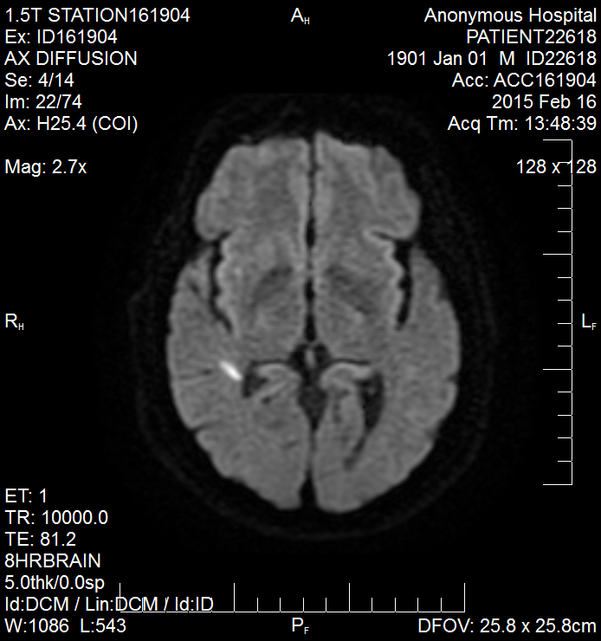
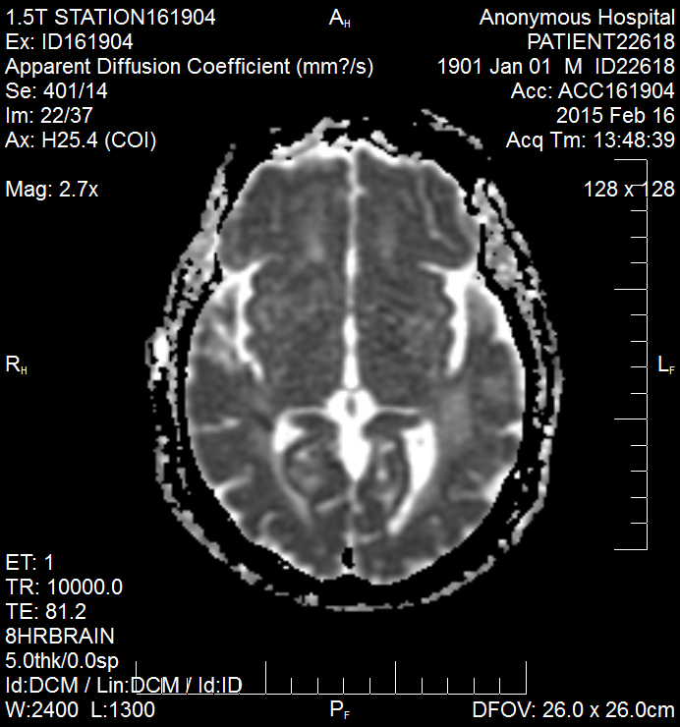
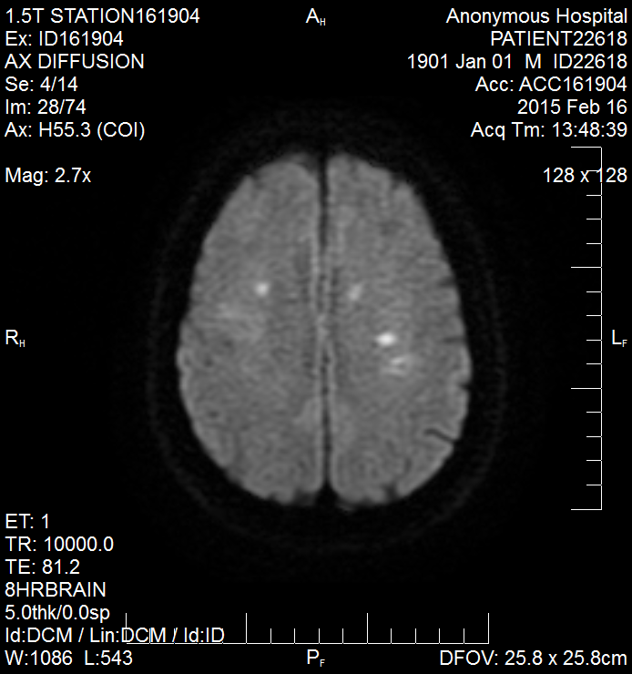
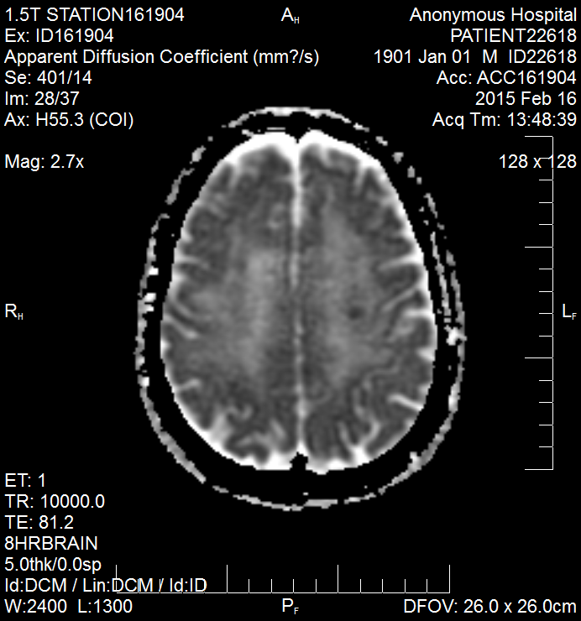
MRI #1 2/16
Notes:
Right temporal; bilateral centrum semiovale; different ages: right frontal with less ADC correlate; varying intensities

Slide 20
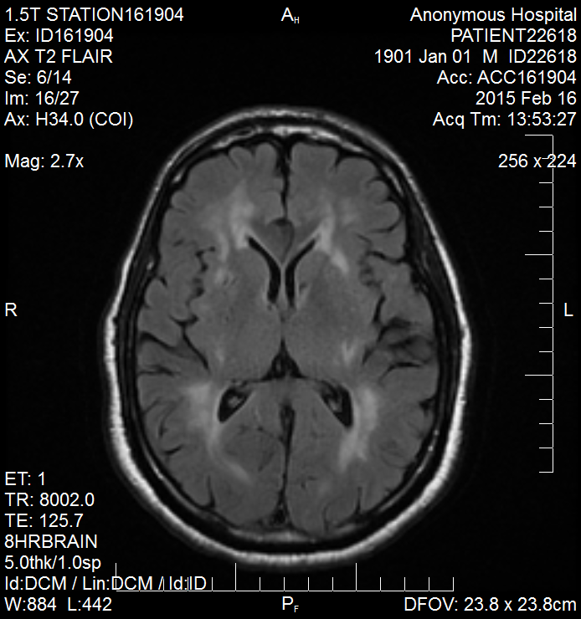
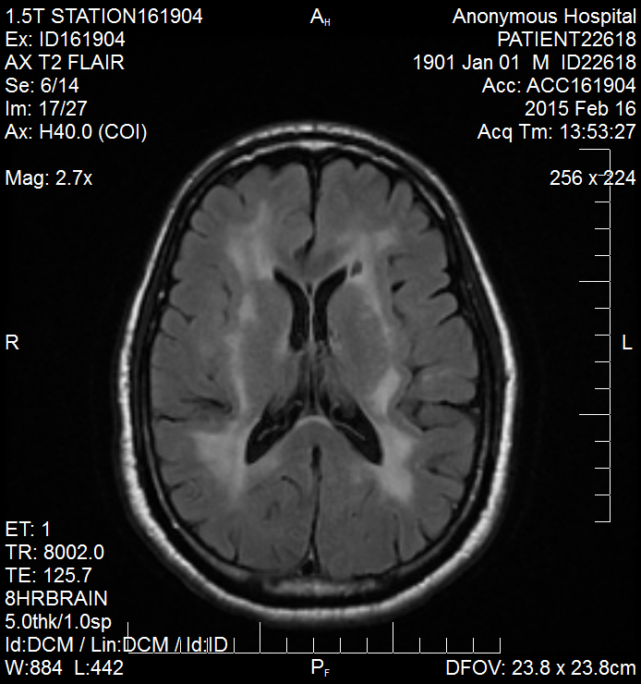
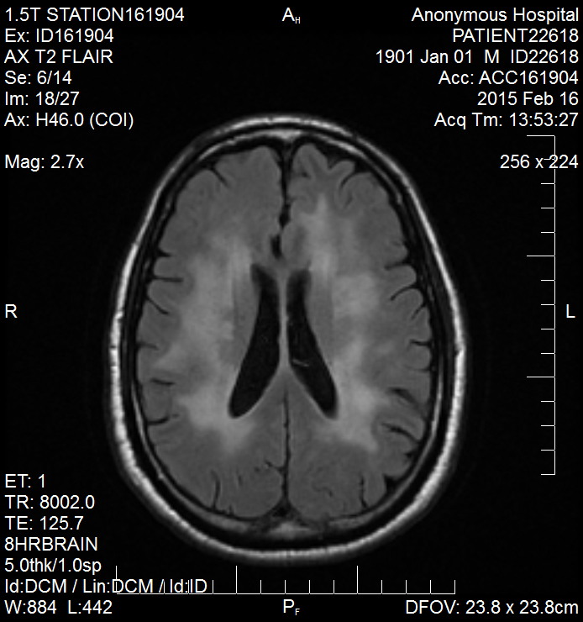
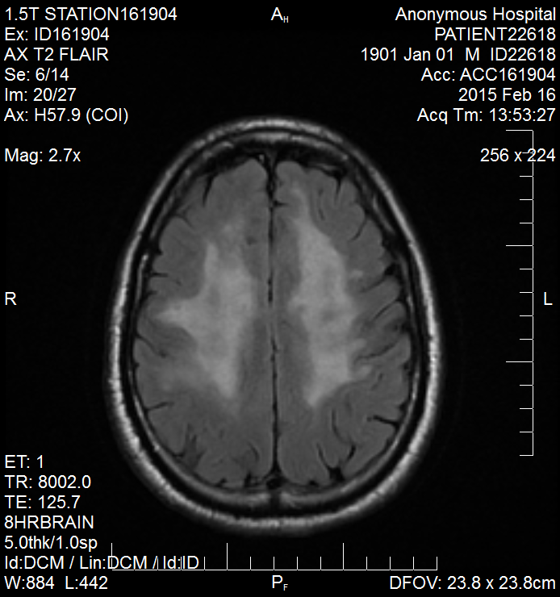
Notes:
Leukoaraiosis or periventricular white matter disease – result of multiple small vessel infarcts within the subcortical white matter = subcortical dementia syndrome picture – slowing of cognition, attention, language, abstraction – incontinence and gait disturbance are motor manifestations – disruption of connecting fibers in frontal-subcortical circuits

Slide 21
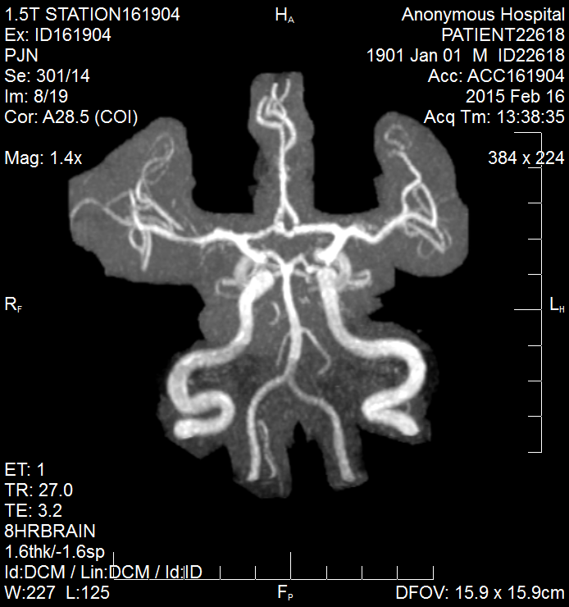
MRA head #1

Slide 22
Imaging #1
MRI brain with and without gad, 2/16
Findings: right temporal, right occipital, left frontal, bilateral centrum semiovale infarcts. No enhancement.
Impression: multiple small bilateral nonhemorrhagic infarctions, left cerebellum and bilateral hemispheres greatest in the centrum semiovale. Because of this, embolic infarctions are considered likely. Moderate white matter disease. Mild mucosal thickening greatest in the maxillary sinuses.
Notes:
Right temporal, right occipital (lateral margin of CC), left frontal, bilateral centrum semiovale. No enhancement.

Slide 23
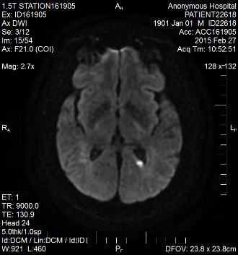
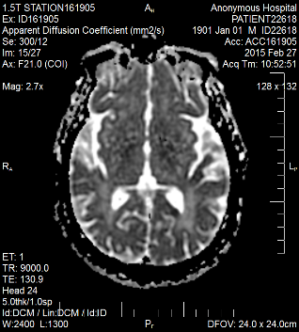
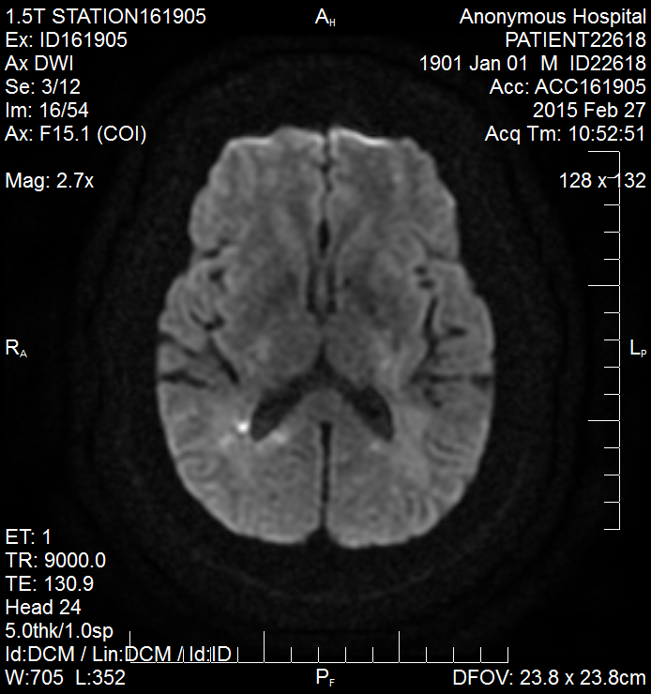
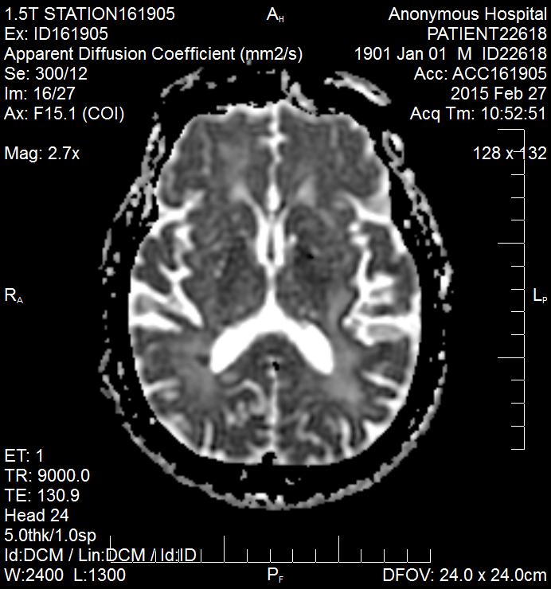
MRI #2
Notes:
Not respecting particular vascular territories; small strokes

Slide 24
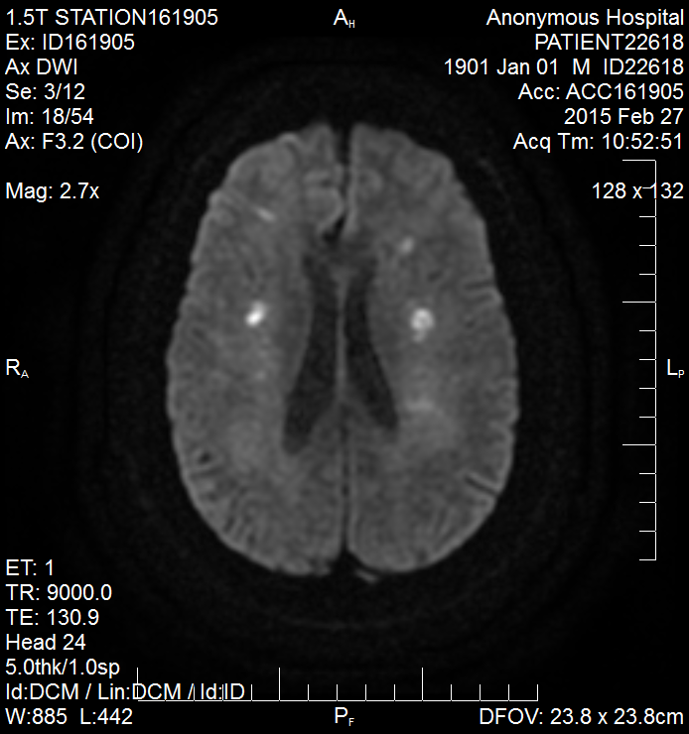
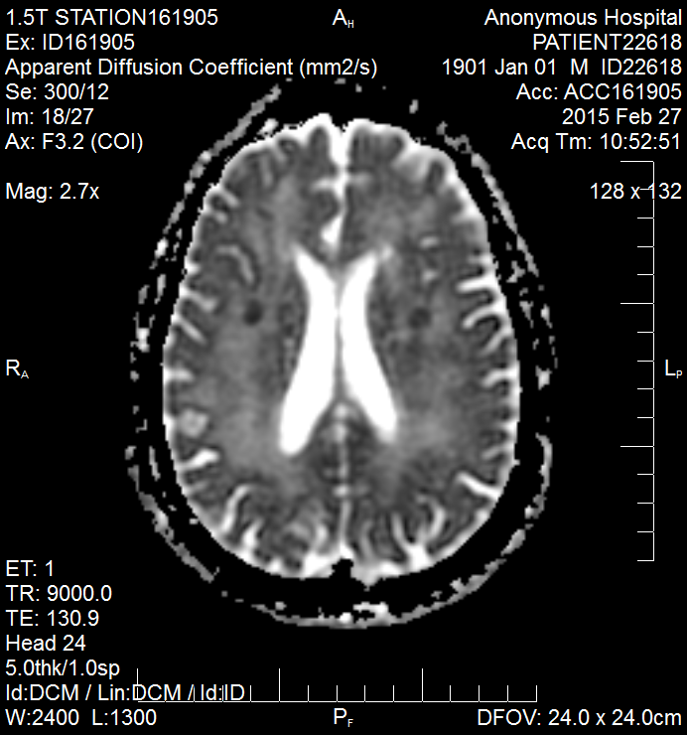
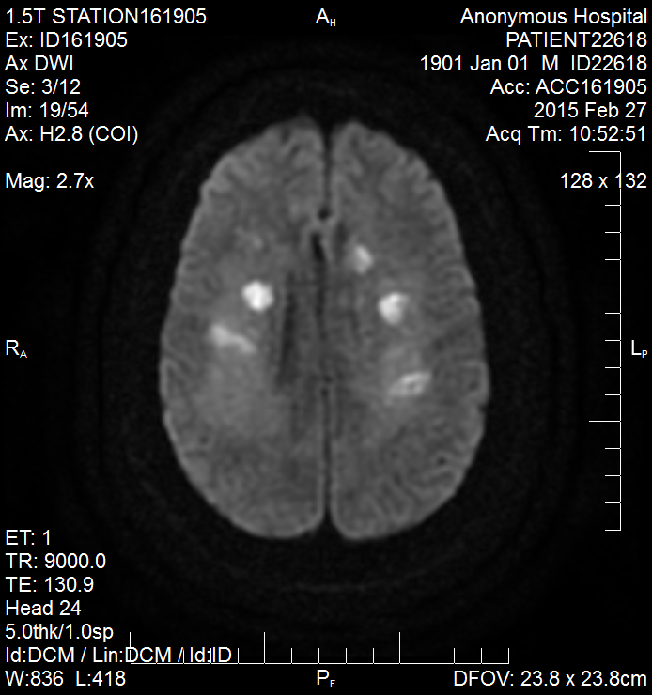
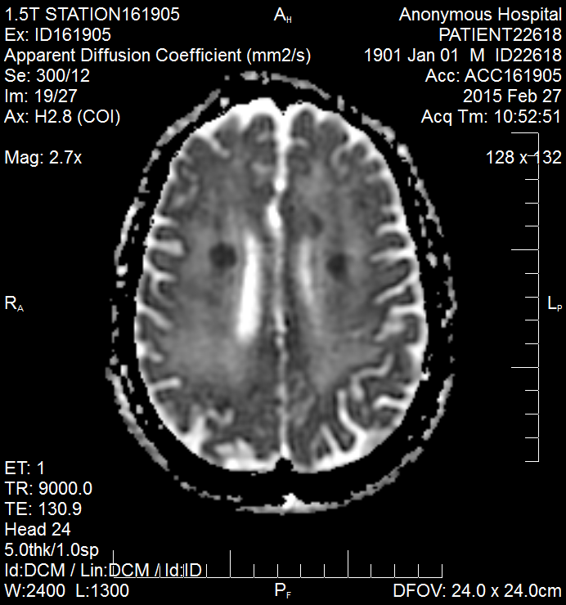

Slide 25
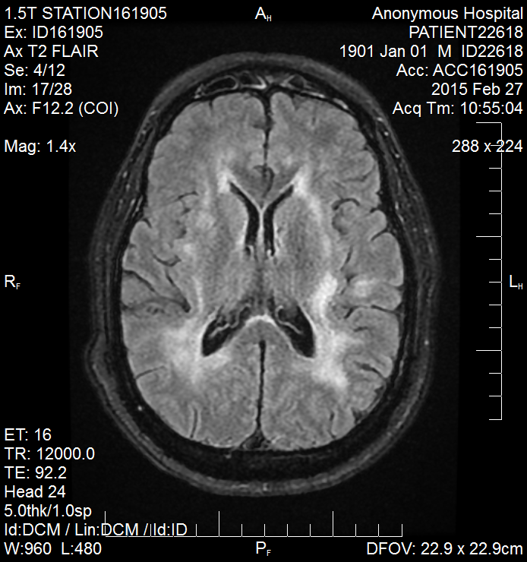
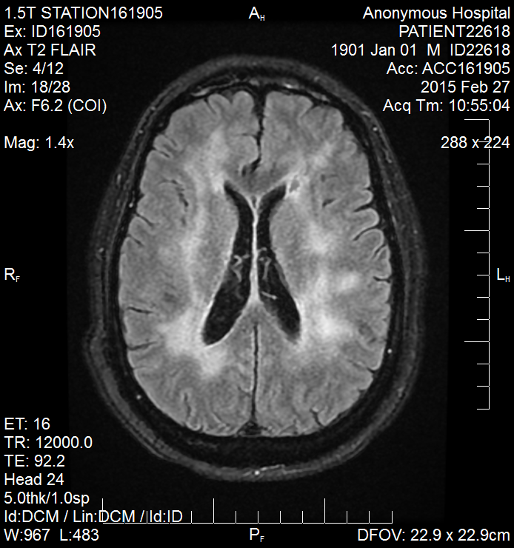
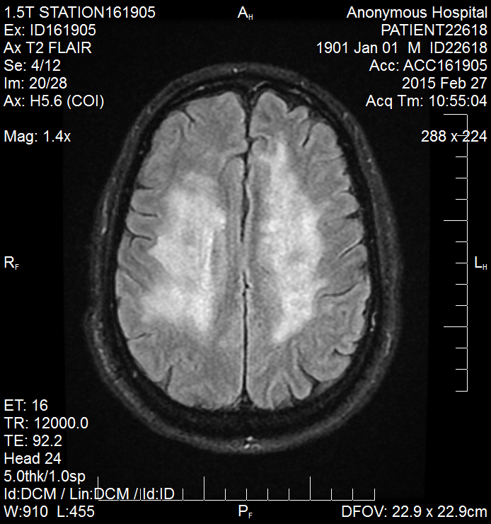
MRI #2

Slide 26
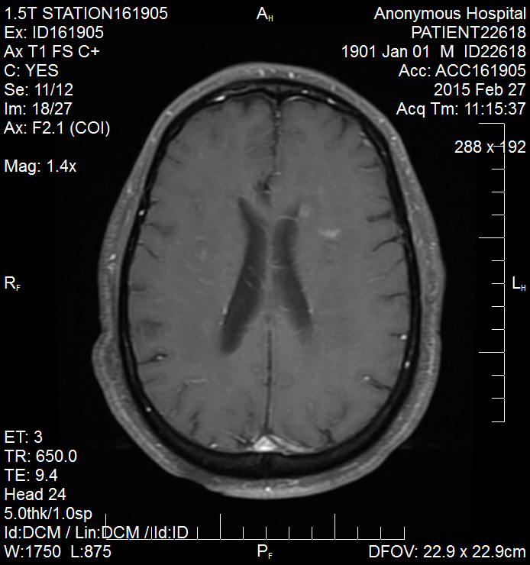
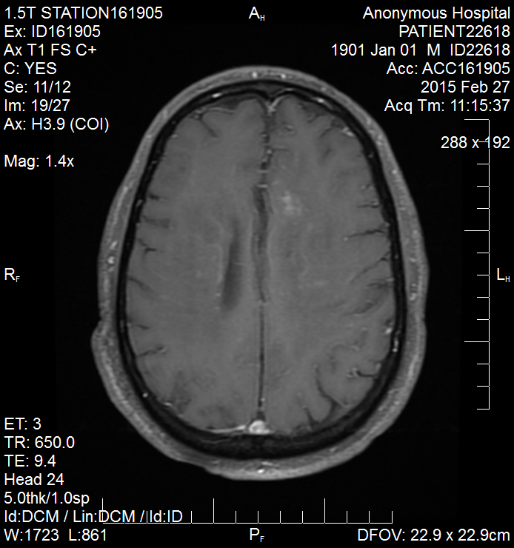
Notes:
Subacute stroke enhances; different age strokes

Slide 27
Imaging 2
MRI brain 2/27
Impression: 1) Focal areas of restricted diffusion in the periventricular, deep and subcortical white matter with innumerable foci of abnormal enhancement. This may represent embolic phenomena from a central location, such as the heart. 2) Extensive white matter leukoencephalopathy and/or vasogenic edema.

Slide 28
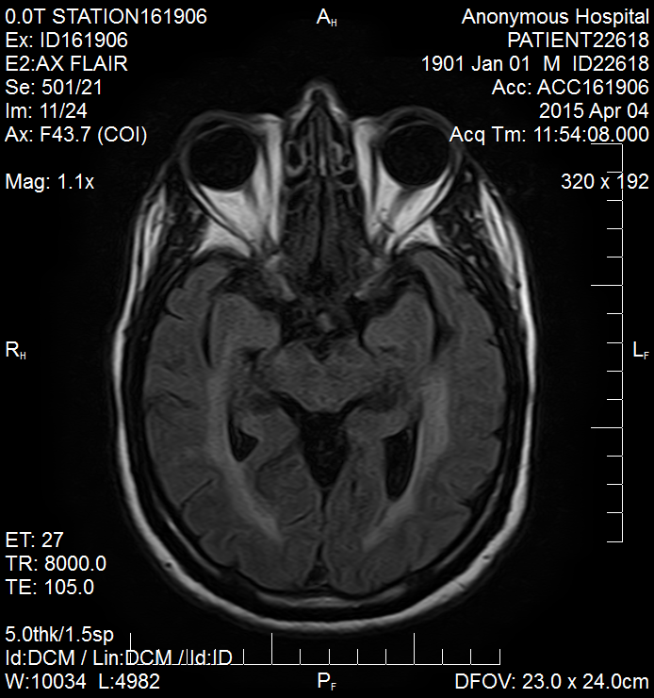
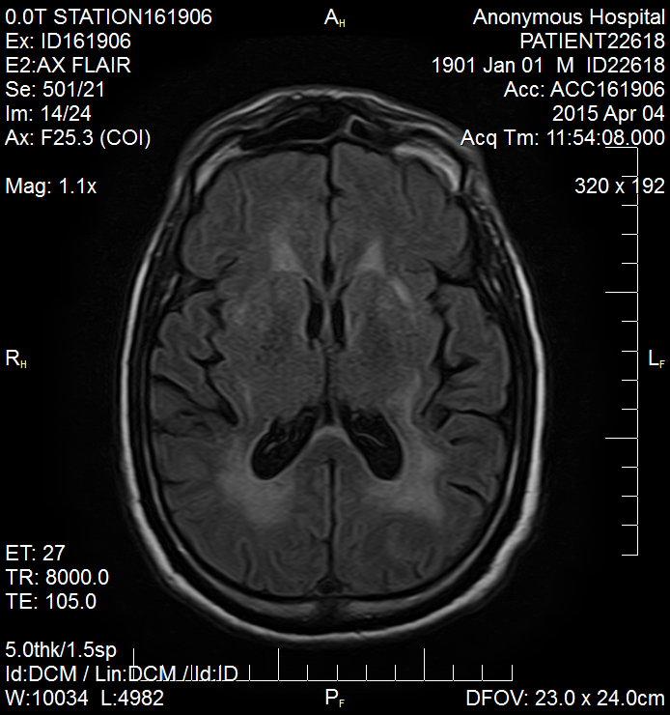
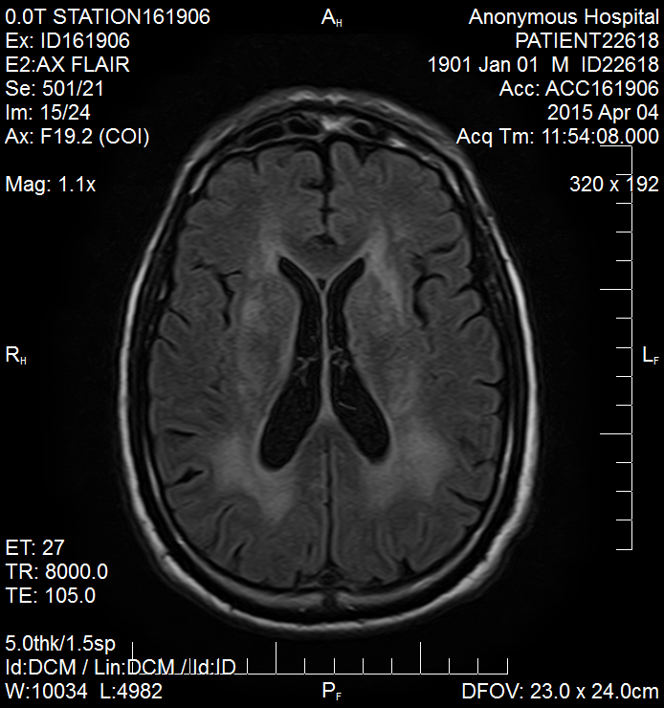
MRI #3

Slide 29
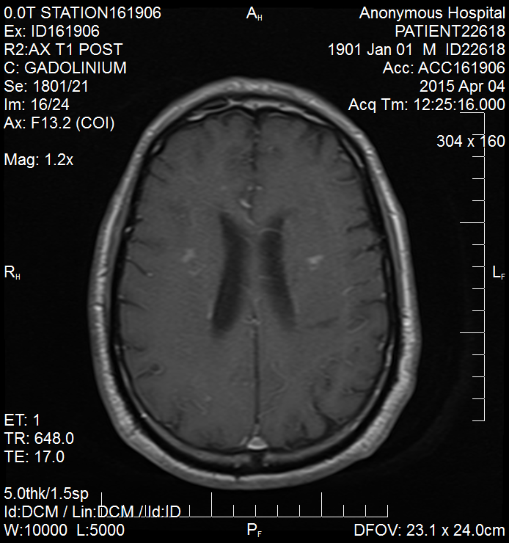

Slide 30
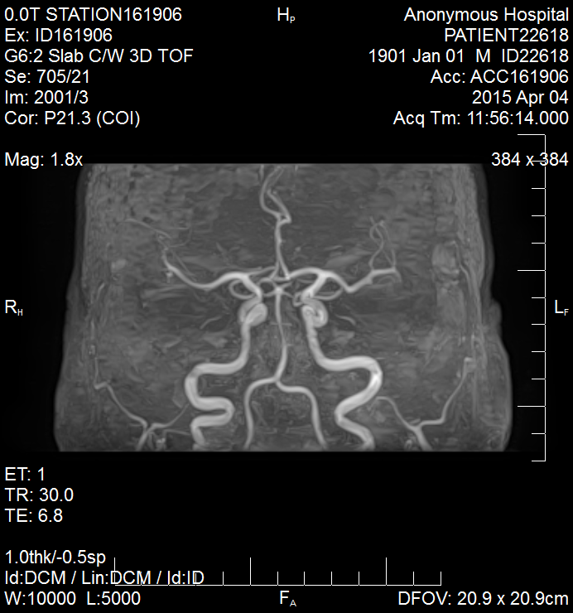
MRA Head #2
Notes:
Mra shows normal large and medium vessels
Even conv angio has false neg of 20-30% this includes small vessel vasculitis

Slide 31
Imaging 3 – 4/4
MRI brain: Marked chronic periventricular leukoencephalopathy with acute or early subacute ischemic change within the corona radiata bilaterally. No hemorrhage, significant edema, or shift.
MRA head: anterior, middle posterior circulation intact. No aneurysms, AV fistulas, or malformations appreciated.
MRA neck: b/l common, internal and external carotids are widely patent. Both vertebral arteries are widely patent.

Slide 32
Additional imaging
CT chest/abdomen/pelvis with contrast 4/6
Impression: enlarged right thyroid lobe with heterogeneous nodule.
Impression: numerous hepatic cystic lesions are identified likely representing benign cysts. No evidence of additional benign or metastatic neoplastic process.

Slide 33
Imaging summary
Symmetric progressive hyperintensities on FLAIR involving the deep subcortical white matter
Multifocal acute ischemic changes on DWI in both the anterior and posterior circulation territory; varying ages
Isointense on T1; minimal contrast enhancement in areas corresponding to DWI changes
MRA without obvious stenoses of large and medium vessels

Slide 34
H&P and Diagnostic Test Summary
70 yo M with subacute progressive stepwise cognitive decline and motor impairment with deep small subcortical periventricular white matter strokes.
Inflammatory CSF with 24 wbc, lymphocytic, mildly high protein.
Notes:
Vasculopathy affecting small vessels

Slide 35
VITAMIN E
Vascular
  Vasculitis
  Embolic stroke
Infectious
Viral
  VZV
  HSV
  CMV
  HIV
  Cryoglobulinemic vasculitis – Hep C
Bacterial
  Mycobacterium tuberculosis
  Spirochete: Neurosyphilis - treponema pallidum; Lyme - borrelia burgdoferi
Fungal
  Histoplasma capsulatum, Coccidioides immitis, Aspergillus
Toxic/Metabolic
  Substance abuse
  Electrolyte abnormalities
  Heavy metals poisoning
Autoimmune
  Neurosarcoidosis
  Primary Angiitis of the CNS
  Vasculitis 2/2 autoimmune condition
  Hashimoto’s encephalopathy
Mets/Neoplastic
  Metastatic cancer
  Paraneoplastic limbic encephalitis
  Intravascular lymphoma
  Primary CNS lymphoma
Iatrogenic
Neurodegenerative
Epilepsy
Notes:
Likely not small metastatic tumors; although >50% of brain tumors are mets; usually gray white junction due to mech of hematogenous spread and where vessel diameter changes or watershed areas; why not: little enhancement, not well circumscribed lesions, no primary found on body imaging – ct c/a/p.
Is vascular process but not cardioembolic stroke although was placed on xarelto for a fib – vasculitis tx different from cardioembolic stroke which is important to consider in this case with continued decline

Slide 36
Hospital Course at UCMC
MRI repeated
LP performed
CT of the neck revealed a thyroid nodule that was biopsied and found to be benign.
Treated empirically with a short course of high dose steroids with mild improvement in his level of attention but his cognition remained severely impaired. Brain biopsy performed 3 weeks later.

Slide 37
VITAMIN E
Vascular
  Vasculitis
  Embolic stroke
Infectious
Viral
  VZV
  HSV
  CMV
  HIV
  Cryoglobulinemic vasculitis – Hep C
Bacterial
  Mycobacterium tuberculosis
  Spirochete: Neurosyphilis - treponema pallidum; Lyme - borrelia burgdoferi
Fungal
  Histoplasma capsulatum, Coccidioides immitis, Aspergillus
Toxic/Metabolic
  Substance abuse
  Electrolyte abnormalities
  Heavy metals poisoning
Autoimmune
  Neurosarcoidosis
  Primary Angiitis of the CNS
  Vasculitis 2/2 autoimmune condition
  Hashimoto’s encephalopathy
Mets/Neoplastic
  Metastatic cancer
  Paraneoplastic limbic encephalitis
  Intravascular lymphoma
  Primary CNS lymphoma
Iatrogenic
Neurodegenerative
Epilepsy

Slide 38
Infectious
Varicella Zoster Virus
Tuberculosis
Neurosyphilis

Slide 39
CNS Whipple’s Disease
Notes:
No oculomasticatory or oculo-facial-skeletal myorhythmia
No supranuclear gaze palsy
No hypothalamic manifestations – no SIADH
-does have cognitive changes – seen in 71%
-no eye movement abnormality
No restricted diffusion
Most commonly, researchers report that MR images reveal diffuse unilateral or bilateral abnormal T2 signal intensity most evident on FLAIR sequences within the mesial temporal lobe, midbrain, hypothalamus, and thalamus, at times including transient enhancement similar to the cases presented in this series.13–15 Less frequently, patients with WD may present with scattered lesions of high T2 signal intensity in a peripheral array involving the gray-white junction with or without associated vasogenic edema, which does not involve the typical midline diencephalic structures.7,16 In 1 case, these areas of T2 signal intensity became confluent and were associated with hemorrhage.17,18

Slide 40
Vasculitis 2/2 VZV
  Encephalitis due to large or small vessel multifocal vasculitis
  MRI multiple areas of ischemic or hemorrhagic infarcts both gray and white matter; particularly gray-white junction
  CSF diagnosis: PCR for VZV DNA and antibody testing
  Histopathology: patchy vasculitis; VZV ag not detected diffusely while inflammation may be detected posing a diagnostic challenge
  This case: negative CSF PCR; MRI does have multifocal ischemic infarcts; no OCBs or increase in RBCs in CSF which can be seen; glucose often normal
Notes:
Small vessel more likely in immunodef; large vessel in immunocompetent; IgM CSF not sent and both should be tested if highly suspected

Slide 41
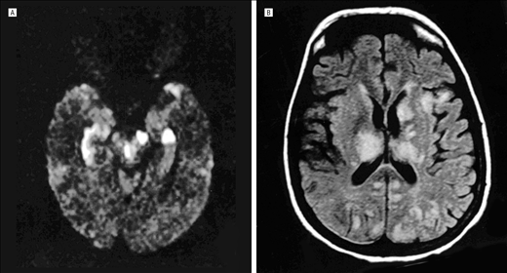
VZV
12. Multifocal Varicella-Zoster Virus Vasculopathy Without Rash; Andrew N. Russman, DO; Richard J. Lederman, MD, PhD; Leonard H. Calabrese, DO; Peter J. Embi, MD; Bagher Forghani, PhD; Donald H. Gilden, MD; Arch Neurol. 2003;60(11):1607-1609. doi:10.1001/archneur.60.11.1607.; JAMA neurology
Notes:
Case does not have deep lesions as in this case affecting BG, thalami
VZV – often deep white matter structures often predominate although cortical and subcortical involved, can have hemorrhage, can have periventriculiits due to involvement of subependymal vessels;

Slide 42
CNS Tuberculosis
CNS involvement more common in HIV-coinfected individuals and children; 1% of all tuberculosis cases.
Manifests as tuberculous meningitis, tubercular encephalitis, intracranial tuberculoma, abscess
TBM can cause vasculitis (tuberculous vasculopathy) as a consequence; often local inflammatory gelatinous exudate in subarachnoid space at the base of the brain
CSF: lymphocytic pleocytosis (can be neutrophilic), elevated protein, low glucose
In this case, AFB smear was negative. Definitive diagnosis is by culture, sensitivity 25-70%¹⁸. Nucleic acid amplification (NAA) 56% sensitive, 98% specific. Other PCR methods available as well to supplement but culture remains gold standard.
Common MRI findings: basal meningeal enhancement, hydrocephalus, infarctions in supratentorial region and brain stem
Our case – no particular risk factors, did not present with features of meningitis, CSF glucose normal
18. Rock RB, Olin M, Baker CA, Molitor TW, Peterson PK. Central Nervous System Tuberculosis: Pathogenesis and Clinical Aspects. Clinical Microbiology Reviews. 2008;21(2):243-261. doi:10.1128/CMR.00042-07.
Notes:
CT chest negative
Similar sensitivity of PCR to culture
Culture sens varies on lab and volume of csf
Our case no particular risk factors, did not present with typical features of meningitis (although adults less commonly have HA). CSF glucose normal

Slide 43
Neurosyphilis
Syphilis incidence increasing in the U.S according to latest 2013 statistics report; 10/100,000 men, 0.9/100,000 women
Variants: early meningitis, meningovascular disease; later spinal and parenchymal disease - general paresis, tabes dorsalis; estimated to be 10% of untreated syphilis cases¹
Meningovascular 10% of all NS cases¹: Infectious arteritis
Most often large and medium vessels involved (MCA, basilar); but can involve small vessels
Clinically: headaches, encephalopathy, stroke; can have neuropathy and myelopathy
Notes:
Spirochete invasion into endothelial cells
Often concomitant meningitis causing headache – meningovascular syphilis; most commonly MCA and basilar, less ACA or spinal cord infarction
Early stage can have meningitis; later vessels then parenchyma
Pre-antibiotic era risk of neurosyphilis estimated to be 25- 35% in untreated; unknown risk in abx era

Slide 44
Neurosyphilis Diagnostic Tests
CSF: Mild lymphocytic pleocytosis, elevated protein
MRI: ischemic and hemorrhagic changes in neurosyphilis vasculitis; parenchymal and meningeal enhancement usually present; white matter lesions common; can also show bilateral mesial temporal lobe high intensity or atrophy
Ischemic changes on MRI in different vascular territories and of different ages in vasculitis

Slide 45
Neurosyphilis testing
Nontreponemal tests: VDRL (venereal disease research laboratory) and RPR (rapid plasma reagin)
Treponemal tests: FTA-ABS (fluorescent treponemal antibody absorption), TPPA (treponema pallidum particle agglutination assay), EIA (syphilis enzyme immunoassay), MHA-TP (microhemagglutination assay for TP ab)
Nontreponemal tests may be non-reactive in late neurosyphilis
CSF-VDRL is thought to have poor sensitivity but high specificity in diagnosing neurosyphilis
CSF-VDRL may be falsely negative in 50% of patients with neurosyphilis⁹
CSF FTA-ABS is sensitive but not specific; negative test is thought to rule out neurosyphilis.
CSF will have lymphocytic pleocytosis, elevated protein and low glucose
9. The Performance of Cerebrospinal Fluid Treponemal-Specific Antibody Tests in Neurosyphilis: A Systematic Review.; Sexually Transmitted Diseases. 39(4):291-297, April 2012.
Notes:
STD journal systematic review in 2012 – meta analysis
Csf fta abs expensive
Serum VDRL highly sensitive and specific for syphilis; similar to RPR serum – about 85% - can be negative in latent syphilis
- Notes must take in pretest probability based on prevalence of disease in a particular population; if lower prevalence then negative predictive value of FTA-ABS is high; works for our population; in a patient with known syphilis this may not be true – where clinical suspicion is high a neg FTA may still not exclude the diagnosis due to pretest probability

Slide 46
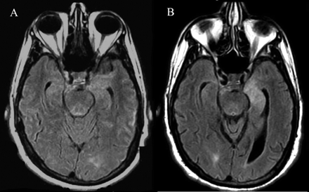
Neurosyphilis
7. J. W. Lee, M. Wilck, and N. Venna; Dementia due to neurosyphilis with persistently negative CSF VDRL; December 13, 2005 65:11 1838doi:10.1212/01.wnl.0000187082.92497.95 ; doi:10.1212/01.wnl.0000187082.92497.95 1526-632X
Notes:
FLAIR images with hyperintensities left mesial temporal lobe
This patient had negative CSF VDRL, negative HIV; cognitive decline
Does not have this type mri; not a specific pattern for NS

Slide 47
VITAMIN E
Vascular
  Vasculitis
  Embolic stroke
Infectious
Viral
  VZV
  HSV
  CMV
  HIV
  Cryoglobulinemic vasculitis – Hep C
Bacterial
  Mycobacterium tuberculosis
  Spirochete: Neurosyphilis - treponema pallidum; Lyme - borrelia burgdoferi
Fungal
  Histoplasma capsulatum, Coccidioides immitis, Aspergillus
Toxic/Metabolic
  Substance abuse
  Electrolyte abnormalities
  Heavy metals poisoning
Autoimmune
  Neurosarcoidosis
  Primary Angiitis of the CNS
  Vasculitis 2/2 autoimmune condition
  Hashimoto’s encephalopathy
Mets/Neoplastic
  Metastatic cancer
  Paraneoplastic limbic encephalitis
  Intravascular lymphoma
  Primary CNS lymphoma
Iatrogenic
Neurodegenerative
Epilepsy
Notes:
NS still on differential with 50% false neg VDRL, CSF findings

Slide 48
Initial Differential cont…
Autoimmune
Neurosarcoidosis
Vasculitis secondary to autoimmune cause
  SLE
  Sjogren’s syndrome
  But negative ANA, C- and P- ANCA, RF, SSA, SSB
  Normal ESR
Primary Angiitis of the CNS
Notes:
Not neurosarcoid - CN inv 50-70% - 7, 2; No leptomeningeal enhancement; No bands – present in 45%
T1 iso or hypo; T2 hyper mostly; most common is parenchymal lesions
Periventricular high T2
Wegeners no bc cANCA negative
Churg-strauss eosinophilic rich small vessel vasc – often lung sxs with asthma; ANCA + 40% - can have renal, cardiac disease
Behcets – rare immune mediated small vessel vasculitis – uveitis and oral ulcers not in this case – often venous system

Slide 49
Neurosarcoidosis
Reasons not neurosarcoidosis:
  No leptomeningeal enhancement
  Lesions not enhancing
  No CN involvement
Notes:
CN inv 50-70% - 7, 2
No leptomeningeal enhancement
No bands
Lesions not enhancing
T1 iso or hypo; T2 hyper mostly; most common is parenchymal lesions
Periventricular high T2

Slide 50
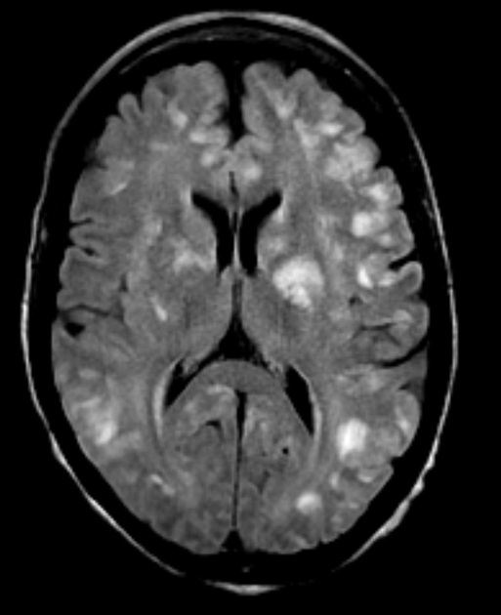
CNS lupus

Slide 51
Primary CNS angiitis
Primary vasculitis of the CNS or granulomatous angiitis of the CNS
Rare: annual incidence 2.4 per million people¹⁴
Small- and medium-sized vessels; leptomeningeal, cortical or subcortical;
Granulomatous in most cases; can have a lymphocytic pattern or necrotizing pattern
Clinically – 2:1 male predominance, 4th to 6th decade, course progresses over months; headaches (63%) with cognitive impairment (50%) and multifocal signs; cord involvement possible (10%), cranial neuropathies and seizures (16%) ¹⁴
14. Alba MA, Espígol-Frigolé G, Prieto-González S, et al. Central Nervous System Vasculitis: Still More Questions than Answers. Current Neuropharmacology. 2011;9(3):437-448. doi:10.2174/157015911796557920.
Notes:
Numbers from large series reported of 101 patients
Rule out mimics with appropriate stains, viral studies, cultures
56% with headache!
Not uniform pathology – not all granulomatous; heterogeneous histopathology
Mean protein 177 and mean wbc 77 in 1 study
Tx – steroids and cyclophosphamide; aza or mtx as steroid sparing agents

Slide 52
Primary CNS angiitis
ESR and CRP usually normal in isolated CNS disease
CSF abnormal – often elevated protein and lymphocytic pleocytosis
MRI bilateral supratentorial lesions; cases of diffuse white matter findings; linear enhancement along vessels or meninges with gad
MRA insufficient
Must rule out secondary causes – infectious, neoplastic
Favorable response to glucocorticoids and cyclophosphamide

Slide 53
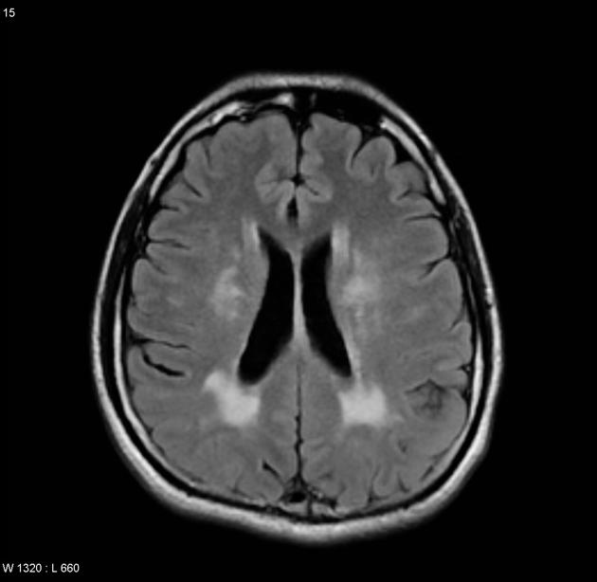
Primary CNS angiitis
Case
Notes:
http://radiopaedia.org/cases/vasculitis-cns

Slide 54
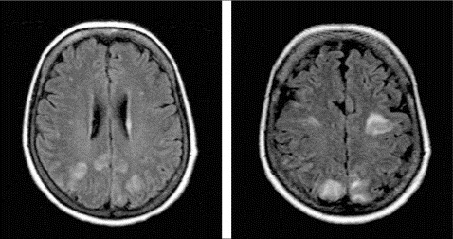
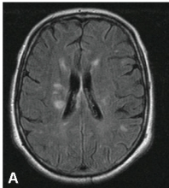
Primary CNS angiitis

Slide 55
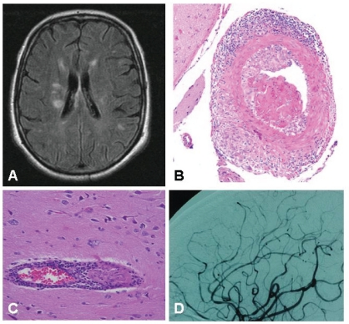
Primary CNS angiitis
A: T2 hyperintense lesions on FLAIR
B: granulomatous pattern, transmural and adventitial inflammation, intimal injury with fibrin deposition
C: inflammatory involvement of small vessel
D: areas of irregular stenoses
14. Alba MA, Espígol-Frigolé G, Prieto-González S, et al. Central Nervous System Vasculitis: Still More Questions than Answers. Current Neuropharmacology. 2011;9(3):437-448. doi:10.2174/157015911796557920.

Slide 56
Less likely PACNS?
No notable headache (did have “head pulsating” sensation), age of this patient is older than typical for Primary Angiitis of the CNS.
Did not have favorable clinical response to steroids although further clinical course unknown. 81% favorable response noted in 1 retrospective study in 2007.¹⁵
Must rule out infectious or neoplastic causes in this case as in others when PACNS is suspected.
15. Salvarani C, Brown RD, Jr, Calamia KT, Christianson TJ, Weigand SD, Miller DV, Giannini C, Meschia JF, Huston J, 3rd, Hunder GG. Primary central nervous system vasculitis, analysis of 101 patients. Ann. Neurol. 2007;62:442–451.
Notes:
Treatment is different than inf/neo

Slide 57
VITAMIN E
Vascular
  Vasculitis
  Embolic stroke
Infectious
Viral
  VZV
  HSV
  CMV
  HIV
  Cryoglobulinemic vasculitis – Hep C
Bacterial
  Mycobacterium tuberculosis
  Spirochete: Neurosyphilis - treponema pallidum; Lyme - borrelia burgdoferi
Fungal
  Histoplasma capsulatum, Coccidioides immitis, Aspergillus
Toxic/Metabolic
  Substance abuse
  Electrolyte abnormalities
  Heavy metals poisoning
Autoimmune
  Neurosarcoidosis
  Primary Angiitis of the CNS
  Vasculitis 2/2 autoimmune condition
  Hashimoto’s encephalopathy
Mets/Neoplastic
  Metastatic cancer
  Paraneoplastic limbic encephalitis
  Intravascular lymphoma
  Primary CNS lymphoma
Iatrogenic
Neurodegenerative
Epilepsy

Slide 58
Neoplastic
Intravascular lymphoma
Primary CNS lymphoma (primary cerebral)

Slide 59
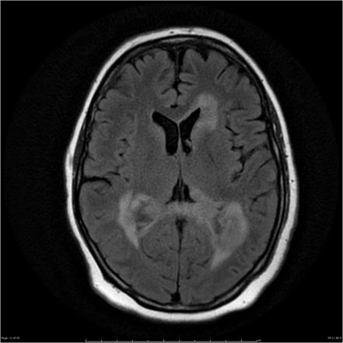
Primary CNS lymphoma
Uncommon form of extranodal non-Hodgkin’s lymphoma
Median age 40s
Spinal; leptomeningeal; ocular; cranial or spinal nerve roots
EBV may be causal link
MRI periventricular lesions common, hemispheres, CC; 50-70% solitary lesions
Low grade tumors may not enhance
Diffusion restricted
http://radiopaedia.org/cases/primary-cns-lymphoma-8
Notes:
FLAIR
most notable risk factor is immunodeficiency which our patient is not known to have
can manifest in leptomeninges, intraocular (vitreous and veal deposits), spinal, cranial or spinal nerve roots (neurolymphomatosis); 50-70% will have solitary lesion, usually sharply circumscribed

Slide 60
Intravascular lymphoma
Malignant lymphocyte proliferation restricted to the lumen of small and medium sized blood vessels
A subset of diffuse large B cell lymphoma
Intravascular growth of neoplastic CD20-positive large B cells
Inability to extravasate due to loss of adhesion molecules
Isolated nervous system affliction is frequent (CNS and skin most common sites)
Annual incidence 0.5-1/1,000,000 ^{5,6}
Median age of 70 years old
Elevated serum LDH, elevated ESR (43% of cases) and anemia can be seen
Fever in 45% of cases ⁵
Notes:
*can have fever in 45% of cases
ESR up in near 40% of cases according to one paper

Slide 61
Intravascular Lymphoma
Can mimic embolic stroke; clinical picture of subacute encephalopathy and multiple strokes
Clotting of neoplastic lymphoid cells leads to occlusion of small vessels and ischemia
Brainstem and cerebellum less frequently involved; often deep white matter of bilateral hemispheres, closer to cortex at junction of caliber change of vessels
Untreated relapsing-progressive course
Brain biopsy is the diagnostic procedure of choice
Notes:
Brain biopsy important to rule out infectious process as treatment here is immunosuppressive

Slide 62
Diagnosis of IVL
MRI: often shows multiple, subcortical and cortical lesions, hyperintense on T2 and FLAIR; DWI changes noted which is most sensitive sequence during acute phase
CSF lymphocytic pleocytosis, elevated protein
Notes:
Cytology often negative

Slide 63
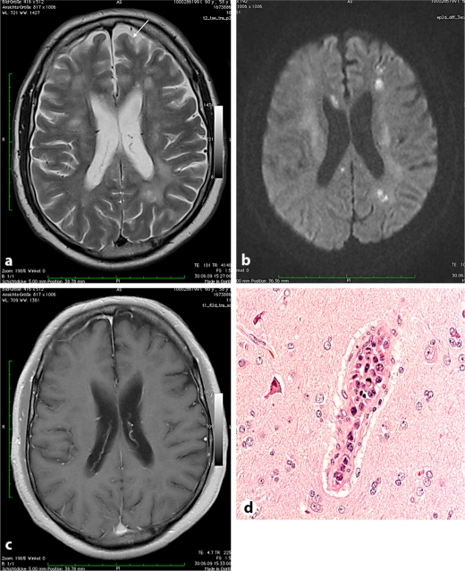
Hundsberger T, Cogliatti S, Kleger G-R, et al. Intravascular Lymphoma Mimicking Cerebral Stroke: Report of Two Cases. Case Reports in Neurology. 2011;3(3):278-283. doi:10.1159/000334130.
Notes:
C contrast enhanced T1 showing intact blood brain barrier
Brain biopsy (case 1): blastic lymphoid tumor cells within intracerebral vessels but not in the brain tissue

Slide 64
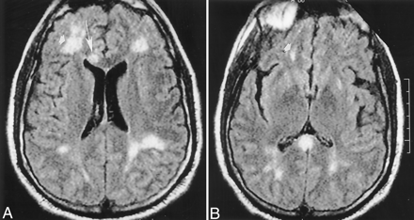
Case
Intravascular lymphoma
Song et al; Angiotropic Large Cell Lymphoma with Imaging Characteristics of CNS Vasculitis; AJNR Am J Neuroradiol 2002 23: 239-242
Notes:
FLAIR
Brainstem and cerebellum less freq involved in IVL
Deep white matter or close to cortex of bilateral hemispheres most often

Slide 65
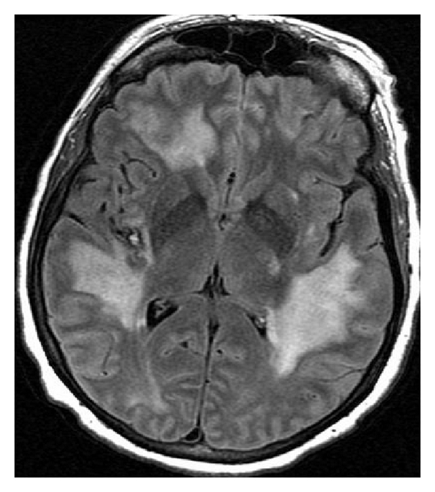
IVL
Case
IVL
17. Amer Awad, Bachir Estephan, and Olaf Stüve, “CNS Intravascular Lymphoma: A Case Report,” Case Reports in Neurological Medicine, vol. 2011, Article ID 515182, 4 pages, 2011. doi:10.1155/2011/515182
Notes:
From a case report

Slide 66
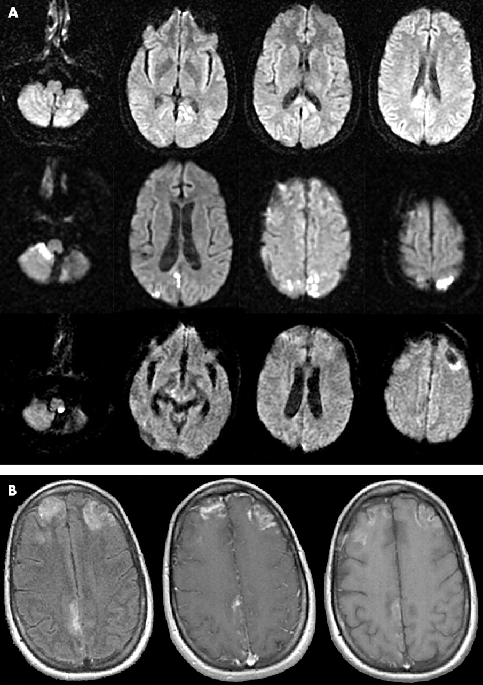
Intravascular lymphoma: magnetic resonance imaging correlates of disease dynamics within the central nervous system; J M Baehring et al; Neurol Neurosurg Psychiatry 2005;76:4 540-544
Notes:
Paper above
DWI with acute ischemic changes; rows are subsequent months
B – flair on left, middle with con, right t1 non con later in time

Slide 67
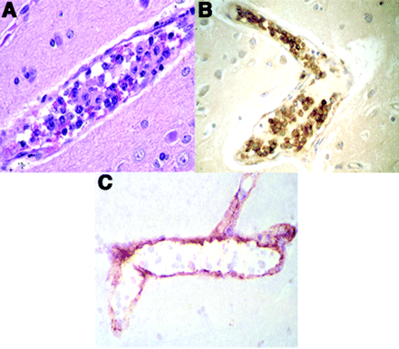
Brain biopsy
A: vessel lumen
B: CD20 staining
C: vessel wall staining factor VIII
Intravascular Lymphoma: The Oncologist’s “Great Imitator”; Dan Zuckerman, et al; The Oncologist 2006; 11:496-502
Notes:
Large malignant lymphocytes filling vessel lumen
Factor VIII classically assoc with endothelial cells – may represent absorption of the protein

Slide 68
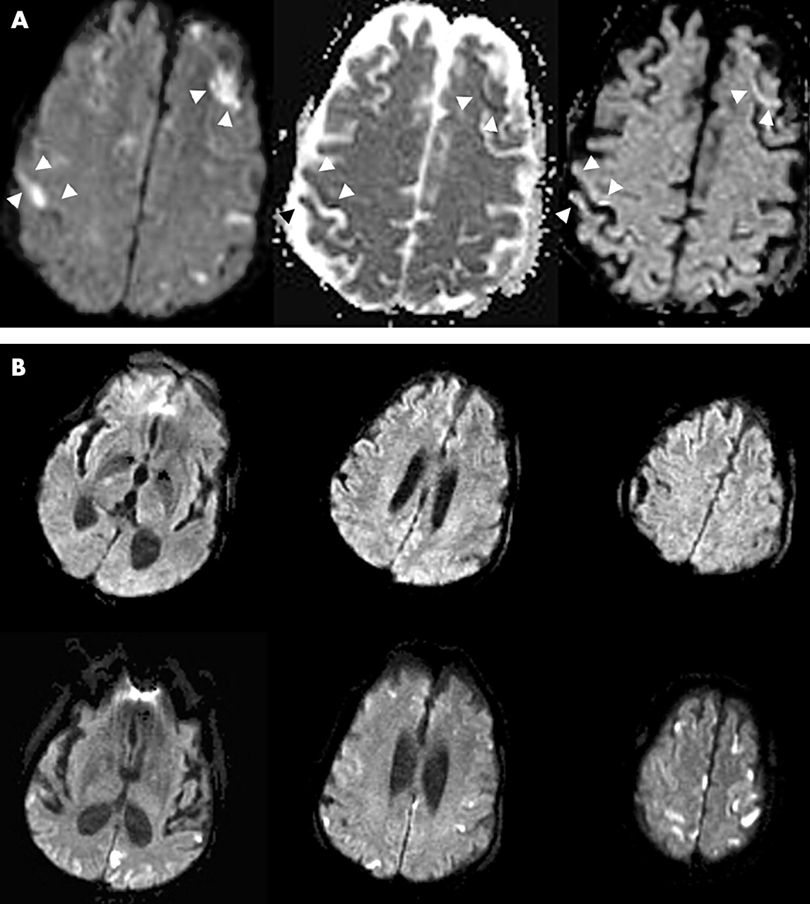
Notes:
IVL example DWI

Slide 69
IVL Prognosis
Of those diagnosed at autopsy, progression of course was typically over 3 months from symptom onset to death.
In one study summarizing results from literature, 43% attained complete remission with chemotherapy.¹⁶
According to case reports and retrospective studies of intravascular large cell lymphoma, with chemotherapy plus rituximab complete response can be seen in 82%, 2 year progression free survival rate 56%, and 2 year overall survival 66%. This data is for systemic disease, whereas CNS disease requires direct therapy (MTX, intrathecal chemo) and prognostic data is limited.
16. J A DiGiuseppe, et al. Intravascular lymphomatosis: a clinicopathologic study of 10 cases and assessment of response to chemotherapy; Journal of Clinical Oncology; Dec 1, 1994:2573-9

Slide 70
VITAMIN E
Vascular
  Vasculitis
  Embolic stroke
Infectious
Viral
  VZV
  HSV
  CMV
  HIV
  Cryoglobulinemic vasculitis – Hep C
Bacterial
  Mycobacterium tuberculosis
  Spirochete: Neurosyphilis - treponema pallidum; Lyme - borrelia burgdoferi
Fungal
  Histoplasma capsulatum, Coccidioides immitis, Aspergillus
Toxic/Metabolic
  Substance abuse
  Electrolyte abnormalities
  Heavy metals poisoning
Autoimmune
  Neurosarcoidosis
  Primary Angiitis of the CNS
  Vasculitis 2/2 autoimmune condition
  Hashimoto’s encephalopathy
Mets/Neoplastic
  Metastatic cancer
  Paraneoplastic limbic encephalitis
  Intravascular lymphoma
  Primary CNS lymphoma
Iatrogenic
Neurodegenerative
Epilepsy

Slide 71
Summary
Differential Diagnoses
  Infectious – Neurosyphilis
  Inflammatory – Primary Angiitis of the CNS
  Neoplastic – Intravascular Lymphoma
Based on age, rapid progression, MRI and CSF findings - intravascular lymphoma appears possible but must rule out infectious processes in terms of treatment choice.
Brain biopsy is needed to determine the final diagnosis
Notes:
Difficult to determine etiology with negative lab work up . MRI and CSF findings similar among these processes affecting small vessels.
Tb, VZV and neurosyphilis still have not been entirely ruled out.

Slide 72
References
Behrouz, et al; Meningovascular Syphilis, Revisiting an Old Adversary; Practical Neurology; July/August 2-11. 32-37
Hundsberger T, Cogliatti S, Kleger G-R, et al. Intravascular Lymphoma Mimicking Cerebral Stroke: Report of Two Cases. Case Reports in Neurology. 2011;3(3):278-283. doi:10.1159/000334130.
BRAIN: Debbie K. Song, Nicholas M. Boulis, Paul E. McKeever, and Douglas J. Quint; Angiotropic Large Cell Lymphoma with Imaging Characteristics of CNS Vasculitis; AJNR Am J Neuroradiol 2002 23: 239-242
J M Baehring, C Henchcliffe, C J Ledezma, R Fulbright, F H Hochberg; Intravascular lymphoma: magnetic resonance imaging correlates of disease dynamics within the central nervous system; J Neurol Neurosurg Psychiatry 2005;76:4 540-544 doi:10.1136/jnnp.2003.033662
Zuckerman, et a; Intravascular Lymphoma, The Oncologist’s Great Imitator, The Oncologist, May 2006 vol 11, no 5, 496-502
Stephanie Lessig and Evelyn Tecoma; Perils of the prozone reaction: Neurosyphilis presenting as an RPR-negative subacute dementia; March 14, 2006 66:5 777doi:10.1212/01.wnl.0000201187.17578.49 ; doi:10.1212/01.wnl.0000201187.17578.49 1526-632X
J. W. Lee, M. Wilck, and N. Venna; Dementia due to neurosyphilis with persistently negative CSF VDRL; December 13, 2005 65:11 1838doi:10.1212/01.wnl.0000187082.92497.95 ; doi:10.1212/01.wnl.0000187082.92497.95 1526-632X
Siva, Aksel; Vasculitis of the Nervous System; Journal of Neurology, ISSN 0340-5354, 06/2001, Volume 248, Issue 6, pp. 451 – 468
The Performance of Cerebrospinal Fluid Treponemal-Specific Antibody Tests in Neurosyphilis: A Systematic Review.; Sexually Transmitted Diseases. 39(4):291-297, April 2012.

Slide 73
References
Czarnowska-Cubala et al; MR Findings in Neurosyphilis – A literature review with a focus on a practical approach to neuroimaging; Psychiatria Danubina, 2013; Vol. 25, Suppl. 2, pp 153–157
Javaud NN. Tuberculous cerebral vasculitis: retrospective study of 10 cases. European journal of internal medicine. 2011-12-01;22:e99-e104.
Andrew N. Russman, DO; Richard J. Lederman, MD, PhD et al; Multifocal Varicella-Zoster Virus Vasculopathy Without Rash; Arch Neurol. 2003;60(11):1607-1609. doi:10.1001/archneur.60.11.1607.; JAMA neurology
Gilden D, Cohrs RJ, Mahalingam R, Nagel MA. Varicella zoster virus vasculopathies: diverse clinical manifestations, laboratory features, pathogenesis, and treatment. Lancet neurology. 2009;8(8):731. doi:10.1016/S1474-4422(09)70134-6.
Alba MA, Espígol-Frigolé G, Prieto-González S, et al. Central Nervous System Vasculitis: Still More Questions than Answers. Current Neuropharmacology. 2011;9(3):437-448. doi:10.2174/157015911796557920.
Salvarani C, et al. Primary central nervous system vasculitis, analysis of 101 patients. Ann. Neurol. 2007;62:442–451.
J A DiGiuseppe, et al. Intravascular lymphomatosis: a clinicopathologic study of 10 cases and assessment of response to chemotherapy; Journal of Clinical OncologyDec 1, 1994:2573-9
Amer Awad, Bachir Estephan, and Olaf Stüve, “CNS Intravascular Lymphoma: A Case Report,” Case Reports in Neurological Medicine, vol. 2011, Article ID 515182, 4 pages, 2011. doi:10.1155/2011/515182
Rock RB, Olin M, Baker CA, Molitor TW, Peterson PK. Central Nervous System Tuberculosis: Pathogenesis and Clinical Aspects. Clinical Microbiology Reviews. 2008;21(2):243-261. doi:10.1128/CMR.00042-07.

Slide 74
Thank you!
Dr. Simona Ferioli
Dr. Nazanin Majd

Slide 75
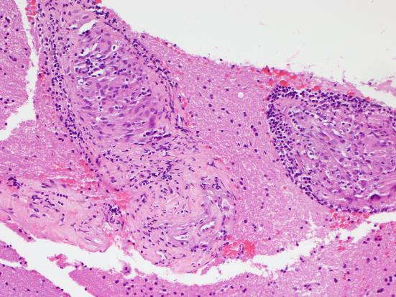
Notes:
CNS Graznulomatous Vasculitis

