Slide 1

ALS update:
Genetics and interventions
University of Cincinnati
Neurology Grand Rounds
Holli Horak, MD
June 17th, 2015

Slide 2
ALS update
Introduction
  Review of ALS pathology
Genetics
  RNA trafficking; C9orf72
Biomarkers
  Ongoing search
Interventions
  Respiratory care
    AVAPs NIV; diaphragmatic pacer

Slide 3
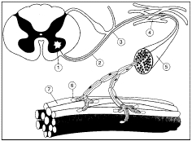
ALS: Amyotrophic Lateral Sclerosis
Motor Neuron Disease
  Upper Motor Neuron
    Spasticity, hyperreflexia
  Lower Motor Neuron
    Weakness, atrophy
Frontotemporal dysfunction
  FTD
Pseudobulbar affect
  Emotional lability

Slide 4
ALS
Motor Neuron Disease:
  Death of Anterior Horn Cells:
    denervation
    Muscle atrophy
    Paralysis
  LMN features:
    Fasciculations
    Atrophy
    Weakness
  Myotomal pattern

Slide 5
ALS
UMN disease
  Corticospinal tract involvement
    Spasticity
    Hyperreflexia
    Weakness
FTD
  10-30% of patients
  Executive dysfunction
  Impaired decision making
  Personality changes

Slide 6
ALS progression
Differing phenotypes:
  Location of onset
    Bulbar
    Appendicular
    Respiratory onset
  Progression/ time course
  Different degrees of UMN vs. LMN
    PLS
    PMA

Slide 7
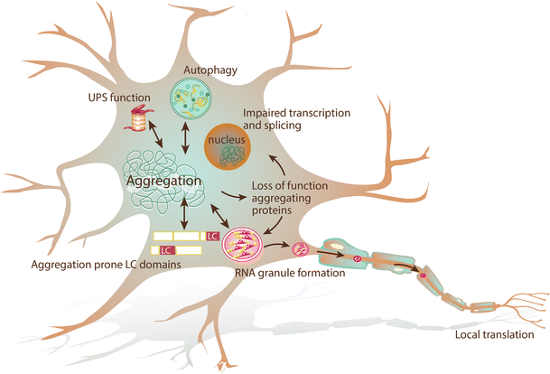
Why is there so much individual variability?
One disease
  Many phenotypes?
Many diseases
  One final pathway
    Abnormal RNA regulation
    Abnormal Vesicules
Epigenetics
  Does environment influence genes?
  Is the disease caused by one gene defect
    or several overlapping ones?
Notes:
Change to Turner figure 3; use this figure next slide?

Slide 8

Sunday’s NYTimes

Slide 9
Genetics
2 strategies to identify disease genes:
  Linkage studies (traditional)
    Evaluate family w/ disease
      Look for a variant that occurs more frequently than by chance alone
  Genome wide association studies (GWAS)
    Frequency of a variant is compared between large groups of patients vs. controls
    If the variant is greater in affected pts, then there is “association” w/ the disease

Slide 10
ALSoD
http://alsod.iop.kcl.ac.uk

Slide 11
Genetics
Typical familial ALS (fALS)
  SOD1
  TARDBP
  FUS
Rare
  ANG
  OPTN
ALS-FTD
  UBQLN2
  C9orf72
FTD-TDP
  TARDP
Notes:
Verify this? TARDP only causes typical ALS?

Slide 12
Paradigm shifts in ALS
ALS: multiple causes
  Heterogeneity
    Clinical and genetic
  Final common pathway
    RNA dysregulation
    Proteosome dysfunction
ALS = FTD
  Same pathology
    TDP-43 deposition
SOD1 model no longer adequate
Familial ALS (fALS) may be under-recognized
  Small family size
  Incomplete penetrance
Notes:
Turner figure 1

Slide 13
ALS pathogenesis
RNA processing error
  Toxic gain of function
    Excess mis-folded protein
    Or protein that traps mRNA
  Loss of function
    Non-viable protein
      Cannot aide in hnRNP function
Prion-like propagation
  Cell-cell spread
Repeat disorder(?)
Abnormal vesicles
  Abnormal cleavage
  Due to membranes or
  Substance within vesicle
Notes:
Ravits article to discuss this; pur in pix Turner, figure 1

Slide 14
1993: SOD1
20% familial ALS (fALS) patients
Cu/Zn superoxide dismutase
  Reactive oxidative stress
Initiated mouse model
  Source of most research focus in 1990’s/early 2000’s
  No significant therapies ever developed
    Successes in mouse model never translated

Slide 15
2006: TDP-43 protein
Ubiquinated cytoplasmic inclusions
  ALS
  Frontotemporal Dementia- ubiquinated (FTD-U)
Contain TDP-43 protein
  Transactive region-DNA binding protein (TDP)
    43kDa
    But gene unknown
  Function of protein uncertain
    In normal cells, TDP-43 is intranuclear

Slide 16
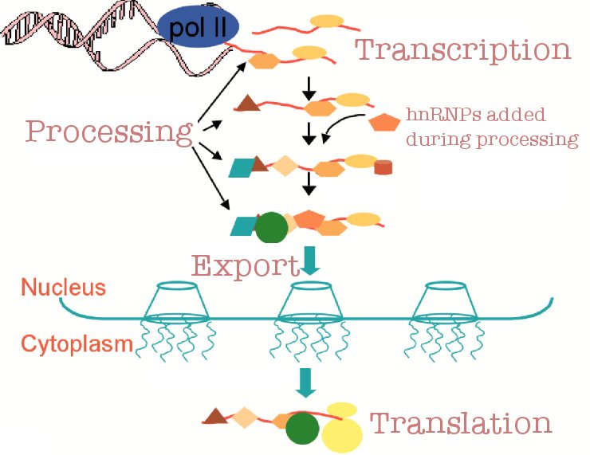
2008: TARDBP
Gene coding for TDP-43
  Chromosome 1
  Transactive-region DNA-binding protein
    RNA processing/ proteosomal regulation
    hnRNP
      Heterogenous ribonucleoprotein
        intranuclear
      Stress granules
        cytoplasmic

Slide 17
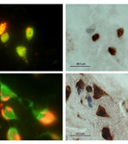
2009: FUS
Fused-in sarcoma (FuS) gene
  Also involved in RNA processing and proteosome regulation
  hnRNP
    Normal location: nucleus
  Stress granules
    Cytoplasmic inclusions
Not a common cause of fALS

Slide 18
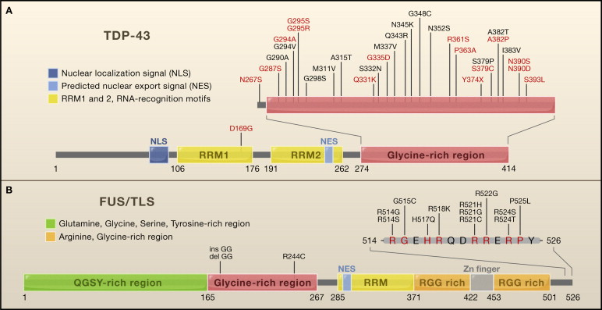
Figure 1 TDP-43 and FUS/TLS Mutations in ALS (A) Thirty dominant mutations in TDP-43 have been identified in sporadic (red) and familial (black) ALS patients, with most lying in the C-terminal glycine-rich region of TDP-43. All are missense mutations, exc...
Clotilde Lagier-Tourenne , Don W. Cleveland
Rethinking ALS: The FUS about TDP-43
Cell Volume 136, Issue 6 2009 1001 - 1004
http://dx.doi.org/10.1016/j.cell.2009.03.006

Slide 19
TDP-43 and FUS displacement
Notes:
Cleveland article

Slide 20


Slide 21
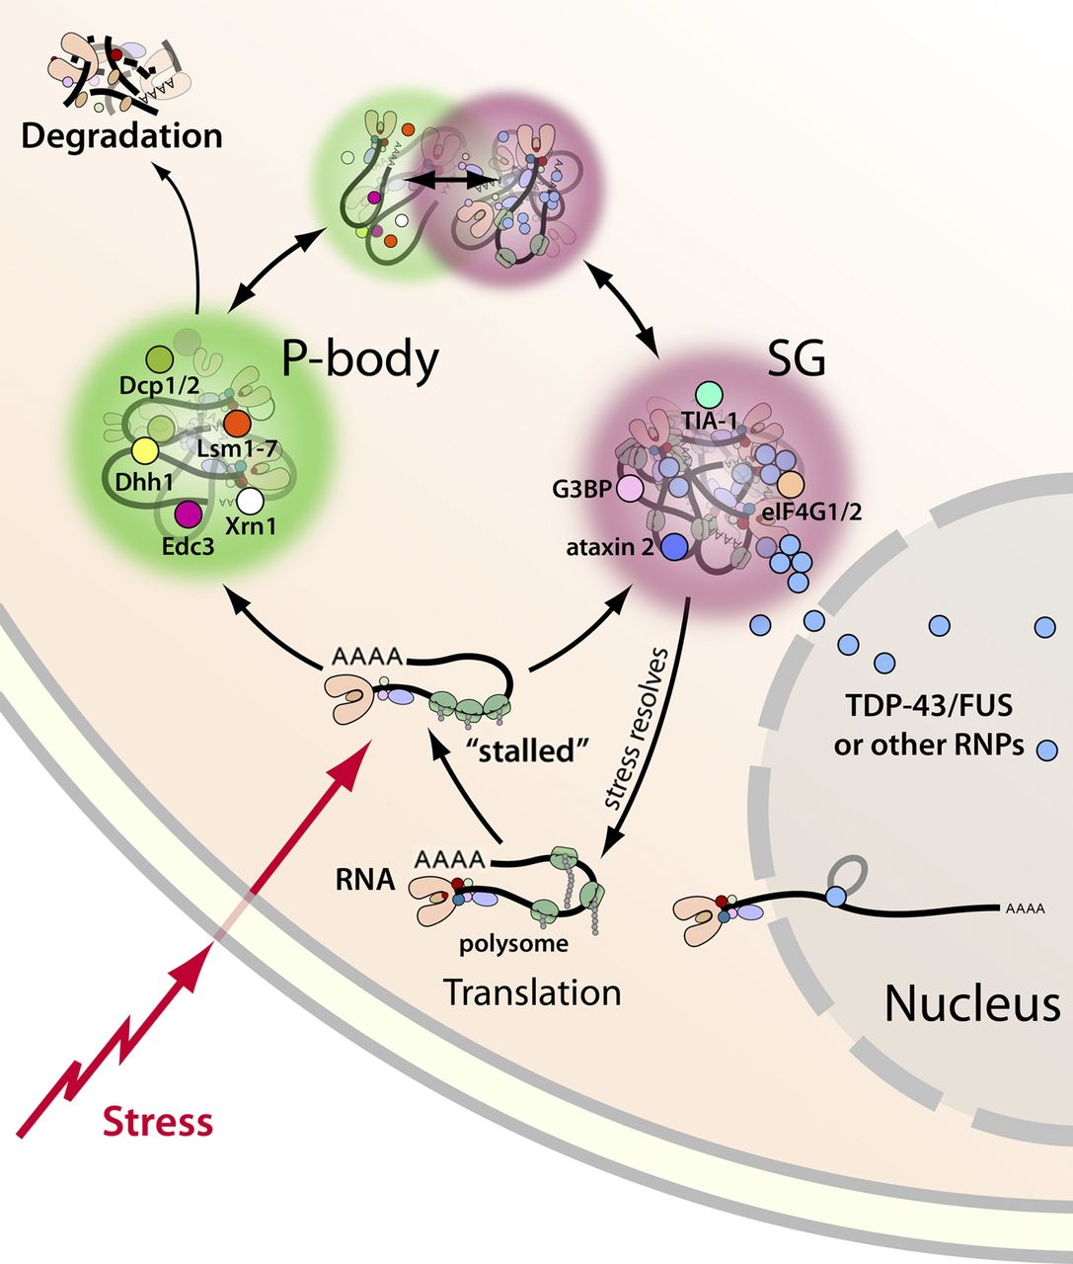
2013: Stress granule theory
Formed during periods of cell stress
  Halt RNA function
  Stops protein production
In normal circumstances, when stress abates, the granules are rapidly dissassembled

Slide 22
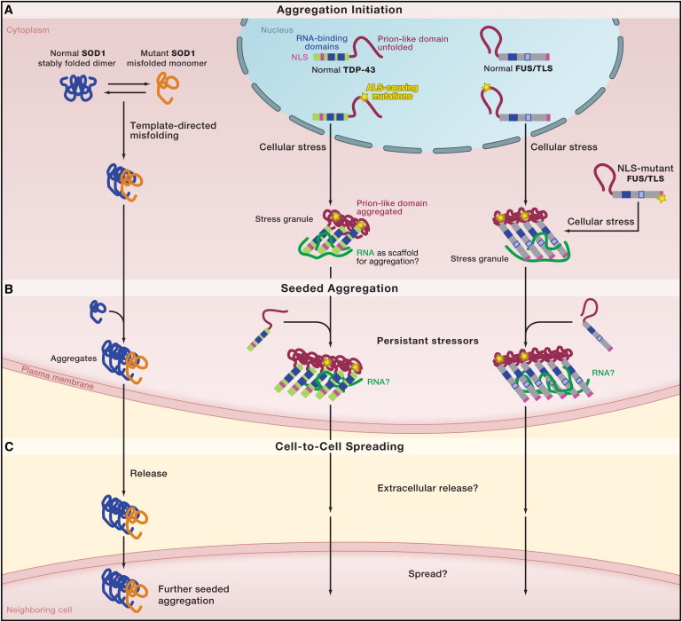
Prion-like proteins and stress granules
Abnormal TDP-43, FUS or VCP
  Moved from nucleus
    To cytoplasm
  Bound in stress granules
    Proteins then mis-fold in prion-like fashion
Inclusions and aggregates form in cytoplasm

Slide 23
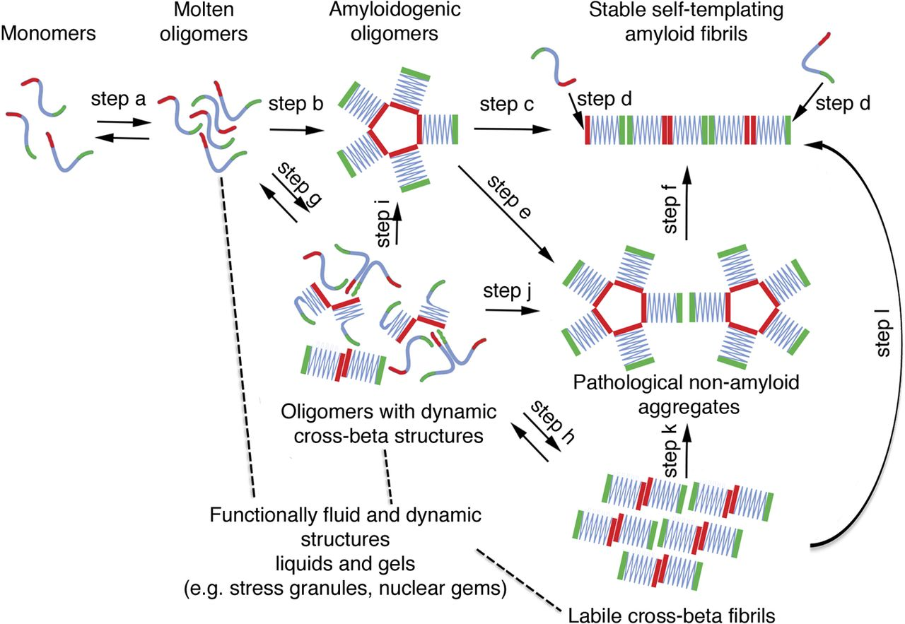
Prion-like nature of TDP-43 and FUS
Both proteins have prion-like domains
  Areas where proteins can quickly bind together
  Useful for rapid aggregation
But, the balance can shift to mis-folding
  Pathological aggregates
Latest data suggests misfolding can be transmitted cell-to-cell

Slide 24
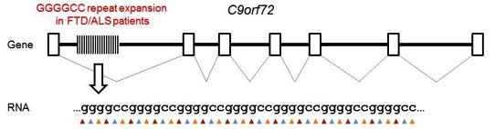
2012: C9orf72
Chromosome 9: open reading frame #72
  Discovered in both familial (fALS) and sporadic ALS (sALS)
  Possibly up to 34% of fALS
  Hexanucleotide repeat
    GGGGCC
    Non-coding!
    Normal up to 30 repeats
    Affected: over 200 repeats
Also a cause of FTD
Gene product implicated in RNA binding

Slide 25
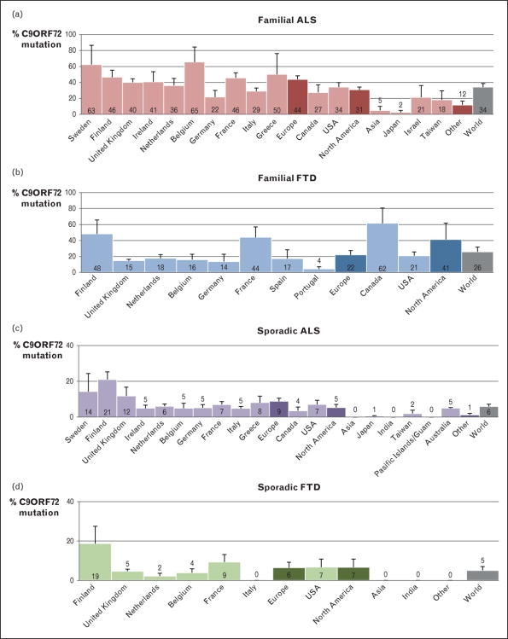

C9orf72
How do C9ORF72 repeat expansions cause amyotrophic lateral sclerosis and frontotemporal dementia: can we learn from other noncoding repeat expansion disorders?.
van Blitterswijk, Marka; DeJesus-Hernandez, Mariely; Rademakers, Rosa
Current Opinion in Neurology. 25(6):689-700, December 2012.
DOI: 10.1097/WCO.0b013e32835a3efb
© 2012 Lippincott Williams & Wilkins, Inc. Published by Lippincott Williams & Wilkins, Inc.
2

Slide 26
Repeat disorders in Neurology
Notes:
Van Blitterswijk table 3

Slide 27
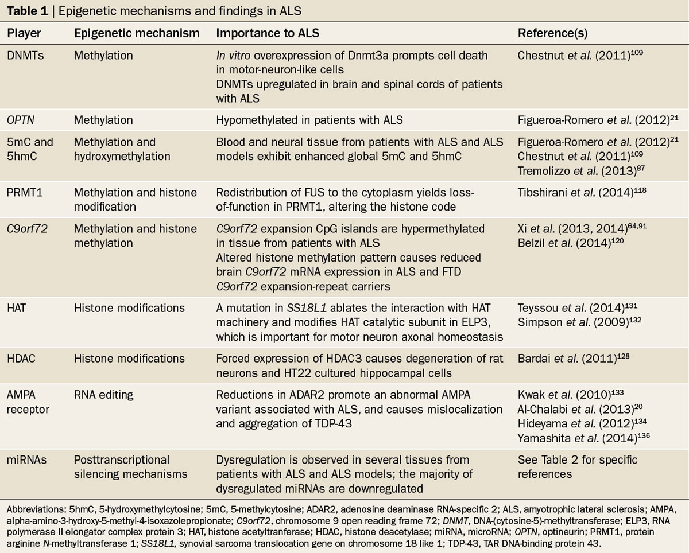
Table 1 Epigenetic mechanisms and findings in ALS
Paez-Colasante, X. (2015) Amyotropic lateral sclerosis: mechanisms and therapeutics in the epigenomic era
Nat. Rev. Neurol. doi:10.1038/nrneurol.2015.57

Slide 28


Slide 29
Biomarkers
Why?
  Earlier diagnosis
  Diagnostic certainty
  Stratify patients
    Different etiologies?
    Disease progression
    Prognosis
  Improved clinical trials
  Track patients over time
Proteomic markers:
  CSF:
    Neurofilaments
    TDP-43
    Neuroinflammatory molecules
  Blood
    TDP-43
    Neuroinflammatory molecules
fMRI
Neurophysiology
  Neurophysiological index
  MUNE
  Electrical impedance

Slide 30
Ongoing Biomarker studies
Fluid Biomarkers with Deep Phenotyping in Patients with ALS
- Grant funded study to study fluid biomarkers in ALS over a two year period, associating them with a variety of outcome measures including MUNE, HHD, ALSFRS, EIM, and TMS using paired pulse stimulation.
Integrated Genomics in Clinical ALS:
- Goal: Generate whole genome sequence and transcriptome data for 1500 people with ALS who undergo longitudinal phenotype assessments.
Iron Horse Dx: A Study to evaluate the sensitivity, specificity, and overall accuracy of a diagnostic for ALS
- Goal: One time sample collection of early stage patients and disease mimics. CSF, Blood (serum + plasma), DNA, RNA, with optional urine and skin biopsy.
NEALS Biorepository CABB (Cross-Sectional ALS Biofluid Biomarker) Study
- Goal: to expand the NEALS Biorepository and ongoing ALS DAN analysis. Straightforward protocol; Essential/Basic clinical information; Single collection of blood (with or without other biofluids)
NEALS Biorepository LABB (Longitudinal ALS Biofluid Biomarker) Study
- Goal: to collect blood samples and cerebrospinal fluid (CSF) from people with amyotrophic lateral sclerosis (ALS). These samples will be collected approximately every 4 months.
Individualized ALS Therapeutics Initiative/Answer ALS
- A comprehensive and longitudinal ALS omics data set on a large patient population. Will create the largest and most comprehensive foundation of ALS data ever amassed, encompassing clinical, chemical, genetic and biological data.
Clinical Research in ALS and Related Disorders for Therapeutic Development (CReATe) Consortium – Part of NIH’s Rare Disease Clinical Research Network
- Goal: phenotype-genotype relationships in ALS and related disorders; biomarker discovery and validation
Target ALS Multicenter Human Postmortem Tissue Core
- The Core integrates geographically distributed academic ALS centers with expertise in postmortem tissue-banking. Includes all forms of ALS and healthy non-neurologic control cases.
Project MinE
- Goal: To understand the genetic basis of ALS and to ultimately find a cure for the disease; aims to analyze the DNA of at least 15,000 ALS patients and 7,500 control subjects.

Slide 31
Therapeutics
Riluzole
Dextromethorphan/Quinidine
Stem Cell therapy
“gene therapy”
Respiratory care
  Diaphragmatic pacer
  Non-invasive ventilation (NIV)

Slide 32
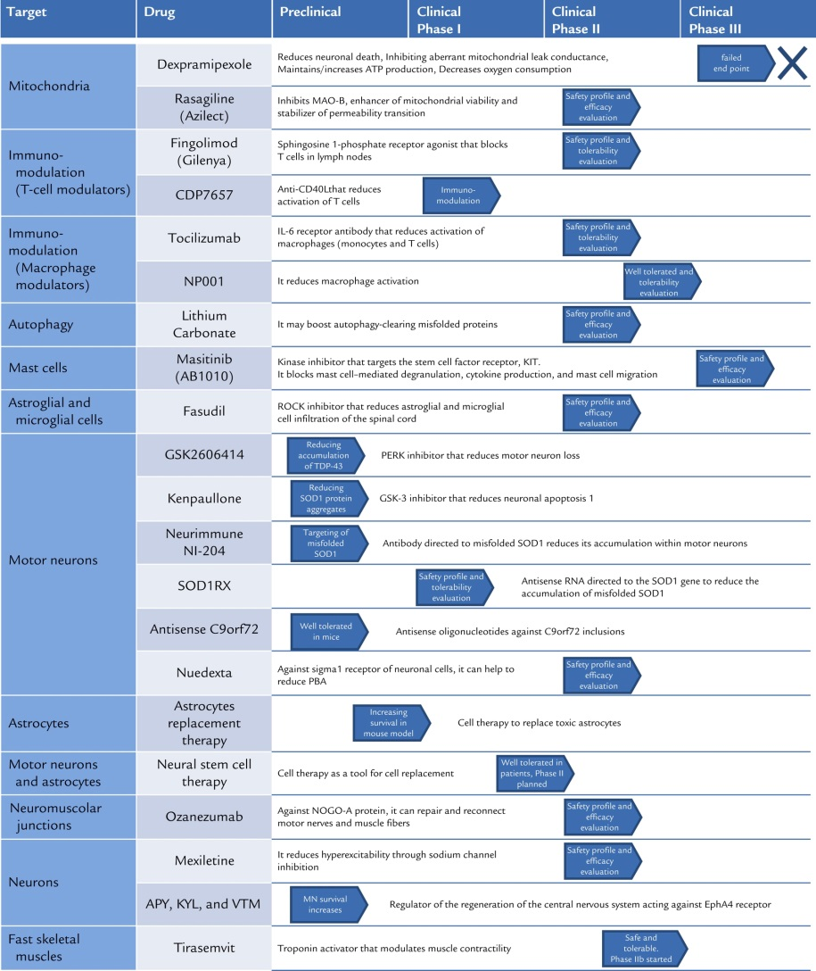
Riluzole
Still only approved drug
50mg po BID
  Need periodic laboratory evaluation
    CMP and CBC
Recently validated in dexpramipexole study
  Prolongs life modestly

Slide 33
Dextromethorphan/Quinidine
Dextromethorphan 20mg/ Quinidine 10mg
Start 1X a day for 7 days
  Then BID
Contraindications:
  MAOI
  Quinidine/ Quinine
  Prolonged QT
Indicated for:
  PBA
  Uncontrolled laughing
  Crying
Do not need to treat if pt not concerned/ impaired by PBA

Slide 34
Memantine
One clincial trial
  “safe”
  20mg/ day
Upcoming clinical trial
  Efficacy
ClinicalTrials.gov Identifier:
NCT02118727
Amyotroph Lateral Scler. 2010 Oct;11(5):456-60. doi: 10.3109/17482968.2010.498521.
A randomized, placebo-controlled trial of memantine for functional disability in amyotrophic lateral sclerosis.
de Carvalho M1, Pinto S, Costa J, Evangelista T, Ohana B, Pinto A.
Notes:
Amyotroph Lateral Scler. 2010 Oct;11(5):456-60. doi: 10.3109/17482968.2010.498521.
A randomized, placebo-controlled trial of memantine for functional disability in amyotrophic lateral sclerosis.
de Carvalho M1, Pinto S, Costa J, Evangelista T, Ohana B, Pinto A.

Slide 35
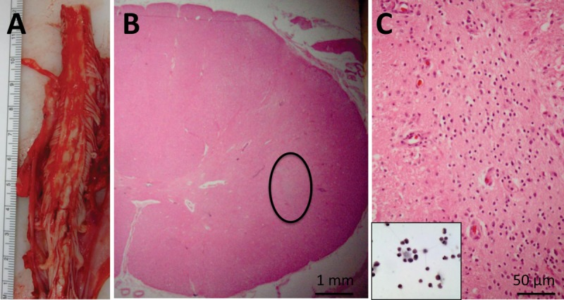
Stem Cells
18 patients
  Cervical or lumbar
  Human spinal Stem Cells
Phase 1 trial
  Safety and feasibility
Phase 2 study underway

Slide 36
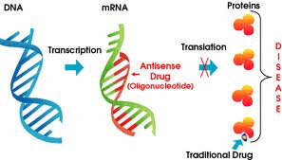
“Gene therapy”
Antisense oligonucleotide
  Short synthetic nucleic acids
    Bind to mRNA target
Goal is to reduce level of toxic mutant protein
  mRNA is bound up, cannot produce protein
  Toxic gain of function is often cause of AD disorders

Slide 37
ISIS 333611 phase 1 trial
Antisense oligonucleotide
  Against SOD1
    Theoretical goal to reduce SOD1 expression
    Goal is to slow progression
    Shown to work in an animal model
Phase 1: safety and tolerability
  Administered intrathecally
    Post LP HA and back ache were adverse events

Slide 38
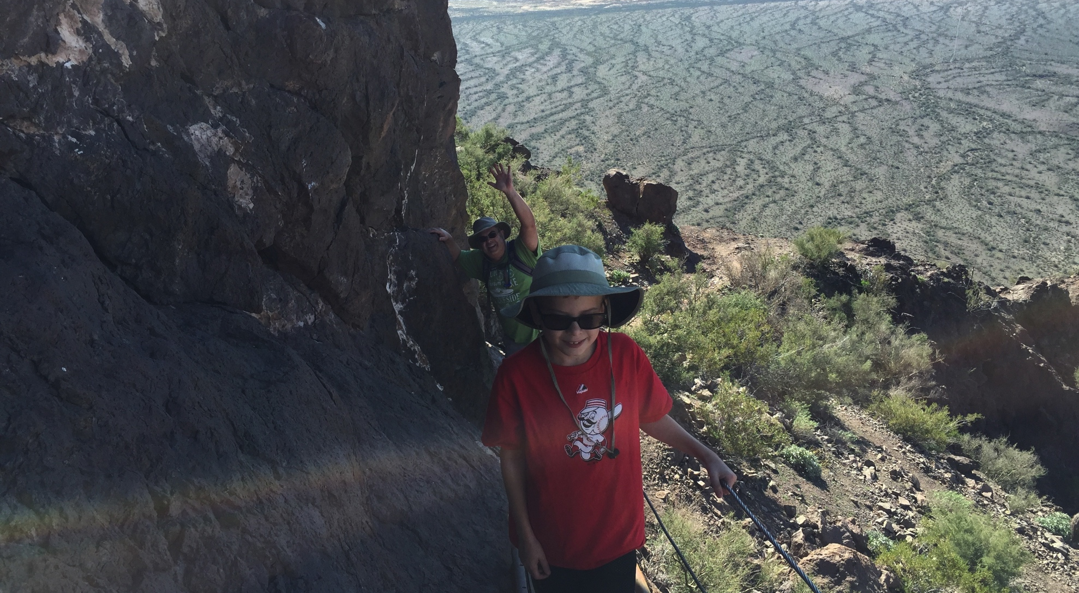

Slide 39
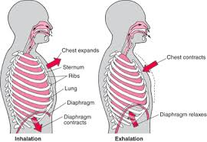
Respiration
Diaphragm affected in ALS
  Air exchange is not affected!
Hypoventilation
  Aided by gravity
    Ie. Being upright
  Diaphragm works harder when supine

Slide 40
Respiratory symptoms
Breathing
  SOB
  Orthopnea
    Sleeping in chair
    Sleeping propped up
Coughing
  Bulbar involvement
  Clear secretions
  Demonstrate cough
Sleep
  Fatigue
  Sleepiness
  Frequent Yawning
  Awakening at night
  Poor sleep
  Anxiety at night

Slide 41
Respiratory Managment
Evaluation
  Bedside PFTs
  PFTs
    Spirometry
    MIPs/MEPs
    Upright and supine
    Do not need lung volumes
  Overnight Pulse Oximetry
    Not a spot check
  Sleep Study (OPSG)
Interventions
  Bilevel (BIPAP)
  Cough Assist
Already using Bilevel
  Adjustments
  Increase IPAP
  Change in mask
For those who are considering tracheostomy
  Referral to surgeon or pulmonologist

Slide 42
Oxygen
Oxygen does not help in ALS
Air exchange (alveoli) are unaffected

Slide 43
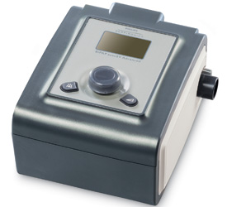
Bilevel (BIPAP)
NOT CPAP
Settings I/E
  Inspiration: 8-20
  Expiration: 3-10
  Increased as disease progresses
Tolerability
  Change settings
  Change masks
  Humidify air

Slide 44
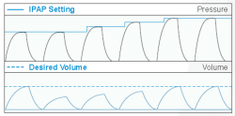
AVAPS
Average volume adjusted pressure support
  Changes pressure with each breath
  Detects breath initiated by patient
    Adjusts pressure to reach target volume
  Far more tolerable

Slide 45


Slide 46
Diaphragmatic pacer
Initially created for patients with spinal cord injury
  Intact Phrenic nerve
    Therefore muscle (diaphragm) still “innervated”
  Device “paces” the diaphragm, initiating contraction
  Useful for specific subset of high spinal cord injury patients

Slide 47
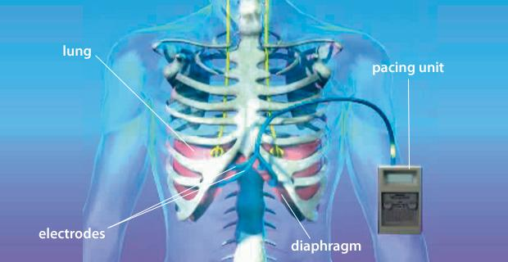
Diaphragmatic pacer in ALS
Approved by FDA: Class III device
In lieu of Bilevel
Does not prevent respiratory failure
  Diaphragm continues to atrophy
  ALS continues to progress
Invasive procedure
  risks
Notes:
Add picture of the pacer

Slide 48
Diaphragm Pacing Literature review
2012:
  Summarized all published articles
  Described methodology and use of device
Significant flaws in each published article
  Patients dropped/ methodologies not blinded
  No “intent to treat”
  No clear outcome measurements
At least 3.5% Adverse event rate

Slide 49
Complications of DP
Venous Thromboembolism
  2/10 patients in one study
Authors note that VTE not reported in clinical trials
Capnothorax
  CO2 in thoracic space
Hemothorax
Pneumonia
Shoulder pain from stimulation
  Stimulator wires extrude from shoulder
Notes:
Rezania, K., Gottlieb, O., Guralnick, A., Prachand, V., Sweitzer, B. J., Vigneswaran, W., White, S. R. and Roos, R. P. (2014), Venous thromboembolism after Diaphragm Pacing in amyotrophic lateral sclerosis. Muscle Nerve, 50: 863–865. doi: 10.1002/mus.24420

Slide 50


Slide 51
Summary: ALS genetics
C9orf72 cause of fALS
  Etiology of some sALS
  Hexanucleotide repeat expansion
Many of the genetic defects result in RNA dysfunction
ALS may be from multiple causes
  ie. Many gene defects producing overlapping phenotypes
  Gene defects predispose one to MND

Slide 52
Summary:
Our knowledge of ALS pathology is evolving
  Expanding knowledge of genetics
  New techniques such as next generation sequencing
Identifying a reliable biomarker is a goal
ALS treatment is still symptom management
  Improved technology may provide better support

Slide 53
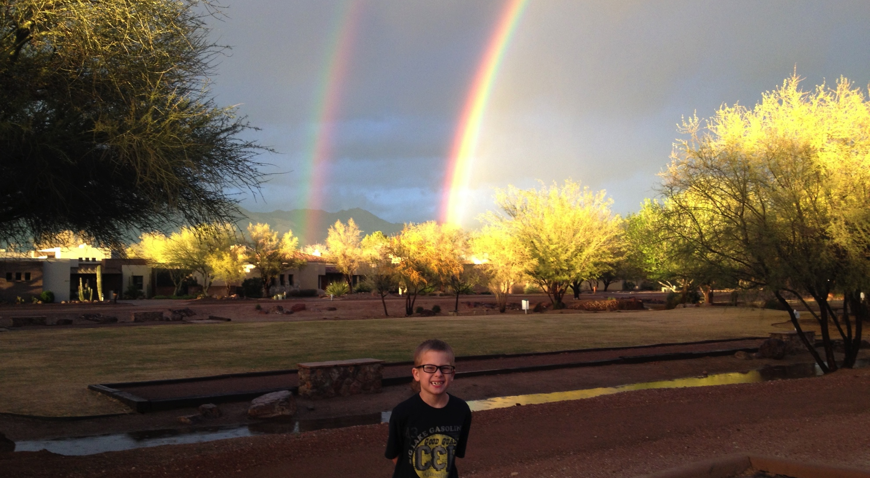

Slide 54
References:
Bucchia M et al. Therapeutic development in amyotrophic lateral sclerosis. Clin Ther. 2015 Mar 1;37(3):668-80.
Ravits, J et al. Deciphering amyotrophic lateral sclerosis: What phenotype, neuropathology and genetics are telling us about pathogenesis. Amyotrophic Lateral Sclerosis and Frontotemporal Dementia 2013, 14 (Supple 1): 5-18
Van Blitterswijk, M et al. How do C9orf72 repeat expansions cause amyotrophic lateral sclerosis and frontotemporal dementia: can we learn from other noncoding repeat expansion disorders? Curr Opin Neurol 2012, 25: 689-700
Turner, M et al. Mechanisms, models and biomarkers in amyotrophic lateral sclerosis. Amyotrophic Lateral Sclerosis and FTD, 2013: 14 (Suppl 1): 19-32
Al-Chalabi, A et al. Genetic and epigenetic studies of amyotrophic lateral sclerosis. ALS and FTD, 2013: 14 (Suppl 1): 44-52
Baloh, R. How do the RNA-binding proteins TDP-43 and FUS relate to Amyotrophic Lateral Sclerosis and frontotemporal degeneration and to each other? Curr Opin Neurol 2012, 25: 701-707
Mahahan, K et al. Diaphragm Pacing and Noninvasive Respiratory management of amyotrophic lateral sclerosis/ motor neuron disease. Muscle Nerve 2012, 46: 851-855.
Chesi, A et al. Exome sequencing to identify de novo mutations in sporadic ALS trios. Nature Neuroscience 2013, published online: doi: 10.1038/nn.3412
Keller, B et al. Co-aggregation of RNA binding proteins in ALS spinal motor neurons: evidence of a common pathogenic mechanism. Acta Neuropathol 2012, published online doi: 10.1007/s00401-012-1035-z
Turner, M et al. Controversies and priorities in amyotrophic lateral sclerosis. The Lancet Neurology 2013, 12: 310-322
Scherer, K et al. Diaphragm pacing in amyotrophic lateral sclerosis: a literature review. Muscle Nerve 2012, 46(1):1-8
Miller, T et al. An antisense oligonucleotide against SOD1 deilvered intrathecally for patients with SOD1 familial amyotrophic lateral sclerosis: a phase 1, randomised, first-in-man study. The Lancet, 2013, 12: 435-442.
Berry, JD et al. Design and Initial Results of a Multi-phase Randomized Trial of Ceftriaxone in Amyotrophic Lateral Sclerosis. PLoS ONE 8(4): e61177. doi: 10.1371/journal.pone.0061177
Rezania, K., Gottlieb, O., Guralnick, A., Prachand, V., Sweitzer, B. J., Vigneswaran, W., White, S. R. and Roos, R. P. (2014), Venous thromboembolism after Diaphragm Pacing in amyotrophic lateral sclerosis. Muscle Nerve, 50: 863–865
Rudnicki, SE et al. Dexpramipexole effects on functional decline and survival in subjects with amyotrophic lateral sclerosis in a Phase II study: Subgroup analysis of demographic and clinical characteristics. ALS and FTD, 2013; 14: 44-51
Cudkowicz, M et al. The effects of Dexpramipexole (KNS-760704) in individuals with amyotrophic lateral sclerosis. Nature Medicine; doi: 10.1038/nm.2579
Lagier-Tourenne, C et al. Rethinking ALS: The FUS about TDP-43. Cell, 2009; 136: 1001-1004
Chen-Plotkin, AS et al. TAR DNA-binding protein-43 in neurodegenerative disease. Nat Rev Neurol, 2010; 6(4): 211-220
Feldman, E et al.Intraspinal Neural Stem Cell Transplantation in Amyotrophic Lateral Sclerosis: Phase 1 Trial Outcomes. Ann Neurol. 2014 Mar; 75(3): 363–373.
Lancet Neurol. Author manuscript; available in PMC 2014 May 1.
Millter T et al. A Phase I, Randomised, First-in-Human Study of an Antisense Oligonucleotide Directed Against SOD1 Delivered Intrathecally in SOD1-Familial ALS Patients. Lancet Neurol. 2013 May; 12(5): 435–442.
Siddiqui, T et al. Sporadic and Hereditary ALS. Biochimica et Biophysica Acta 1852 (2015) 679–684

Slide 55
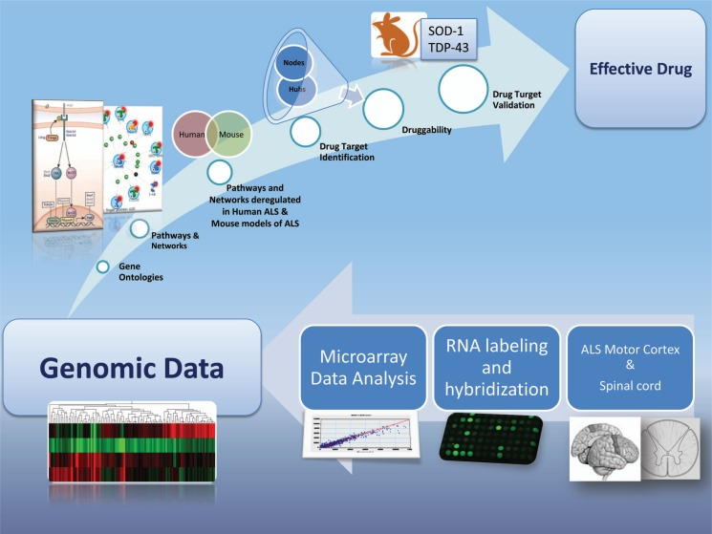

Slide 56
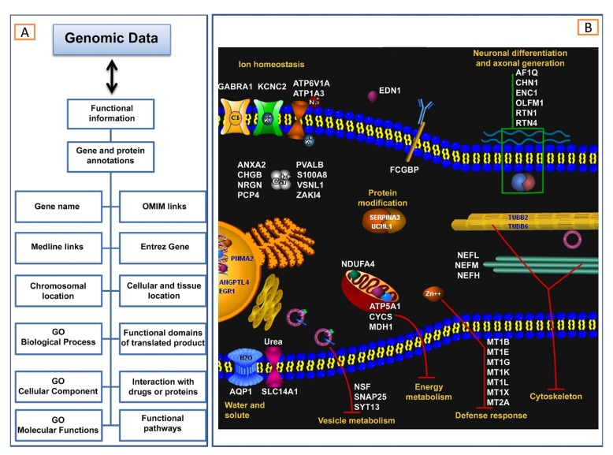

Slide 57
TDP-43
RNA binding proteins
  Form aggregates
Common final pathway for many identified genetic defects
  C9orf72, VCP, UBQLN2, PFN1
  TARDBP, FUS
  But NOT SOD1
Found in both fALS, sALS and FTD
Notes:
Turner table 1

Slide 58
SGs and P-bodies are sites of RNA triage.
Li Y et al. JCB 2013;201:361-372
© 2013 Li et al.
Notes:
SGs and P-bodies are sites of RNA triage. Exposure to cellular stress can trigger a stress response that stalls translation initiation, resulting in the formation of SGs. SGs are dynamic cytoplasmic RNA–protein complexes that contain RNA-binding proteins, mRNAs, and translation initiation factors. When stress exposure dissipates, SGs disassemble and mRNA translation resumes. Nontranslating mRNAs can also be directed to P-bodies, distinct RNA-protein granules that are sites of stalled translation and mRNA degradation. SGs and P-bodies are differentially regulated and form independently, but they can and often do interact with each other. TDP-43, FUS, and other RNPs (e.g., TAF15, EWSR1, hnRNPA1, and hnRNPA2B1) reside predominantly in the nucleus, but stress exposure can trigger their recruitment to SGs. The implications for the recruitment of TDP-43, FUS, and others to SGs are explored in Fig. 3.

Slide 59
Prion and prion-like domains encode diverse conformational states and folding trajectories.
Li Y et al. JCB 2013;201:361-372
© 2013 Li et al.
Notes:
Prion and prion-like domains encode diverse conformational states and folding trajectories. Typically, prion and prion-like domains (depicted in blue, green, and red) populate a dynamic equilibrium comprised of soluble intrinsically unfolded monomers and molten oligomers (step a). These molten oligomers can subsequently evolve into multiple conformational states. In one trajectory, molten oligomers reorganize into more structured amyloidogenic oligomers (step b), which ultimately convert into a stable amyloid form (step c), which can self-template assembly (step d) and become infectious (i.e., a prion). Amyloidogenic oligomers can also cluster to form large pathological aggregates (step e), which might slowly convert to amyloid (step f). Alternatively, molten oligomers can partition into partially structured forms with dynamic cross-β structures that exhibit liquid-like properties (step g), and can rearrange further into labile cross-β fibrils with gel-like properties (step h). These liquid and gel-like collectives are likely critical structural components of various non–membrane-bound organelles including SGs and nuclear gems. Importantly, these transitions to liquid- and gel-like structures are readily reversible (steps a, g, and h). We suggest, however, that these structures are also prone to morph into amyloidogenic oligomers (step i), pathological nonamyloid aggregates (step j and k), and even stable self-templating amyloid (step l) connected with neurodegenerative disease.

Slide 60
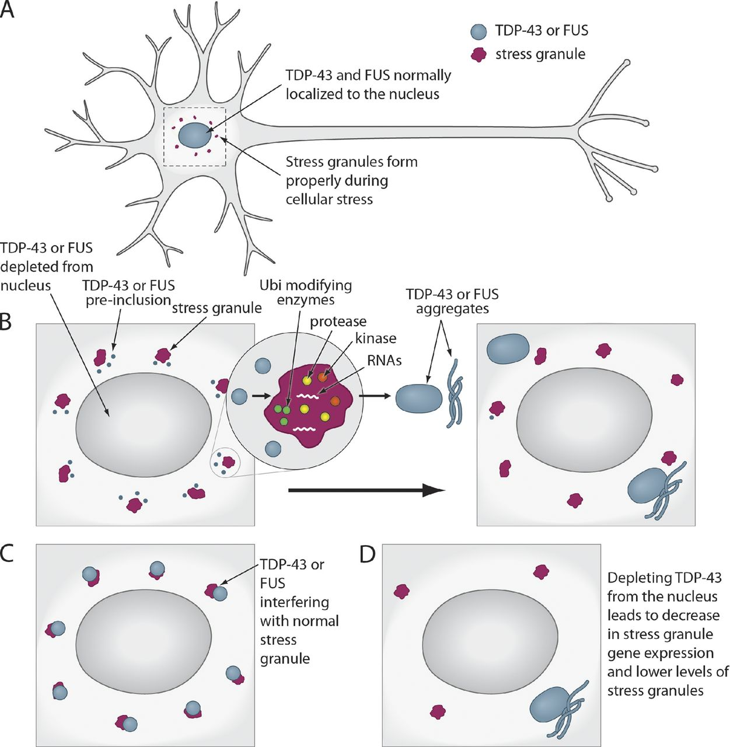
How TDP-43 and FUS might interface with SGs during pathogenesis.
Li Y et al. JCB 2013;201:361-372
© 2013 Li et al.
Notes:
How TDP-43 and FUS might interface with SGs during pathogenesis. (A) In normal neurons, TDP-43 and FUS are localized to the nucleus, and SGs form and dissipate normally. TDP-43 or FUS localization becomes abnormal during ALS pathogenesis and may interface with SGs in several different (and non-mutually exclusive) ways: (B) TDP-43 or FUS exit from the nucleus and begin to accumulate in the cytoplasm as preinclusions, where they interact and might colocalize with SGs. Here, TDP-43 and FUS might become modified by kinases, proteases, and ubiquitin-modifying enzymes, which are all present in SGs. These pathological modifications could accelerate TDP-43 and FUS aggregation or prevent return to the nucleus. Thus, SGs could serve as an obligate conduit for TDP-43 and FUS aggregation. Ubi, ubiquitin. (C) TDP-43 and FUS aggregation in the cytoplasm might interfere with SG function, perhaps by interfering with their ability to regulate RNAs targeted to these structures. (D) TDP-43 and FUS might be required in the nucleus for the regulation of SG genes, and therefore depletion from the nucleus could lead to a dysregulation of SG genes and decreased SG formation and function.

Slide 61
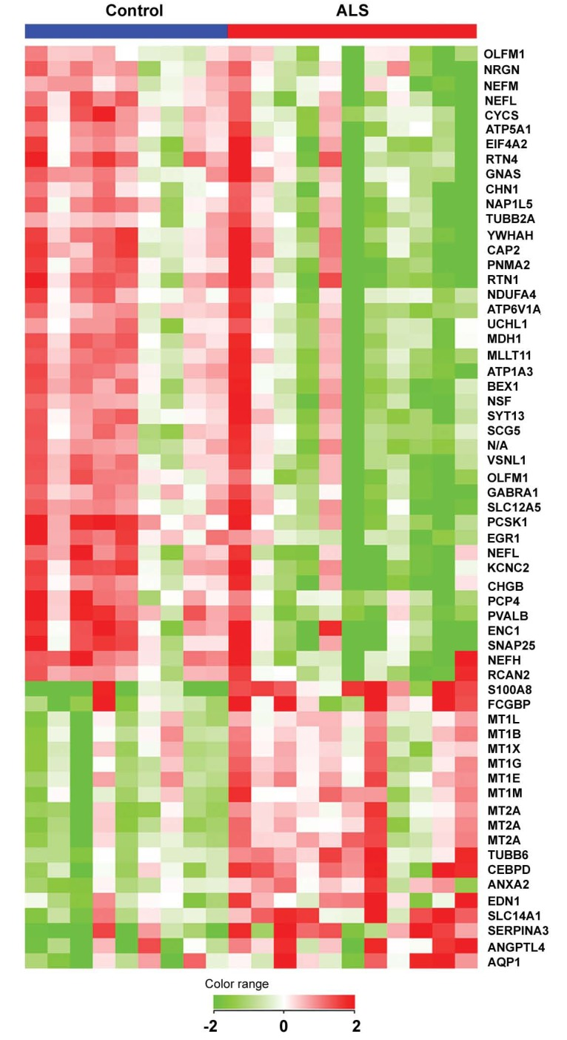

Slide 62
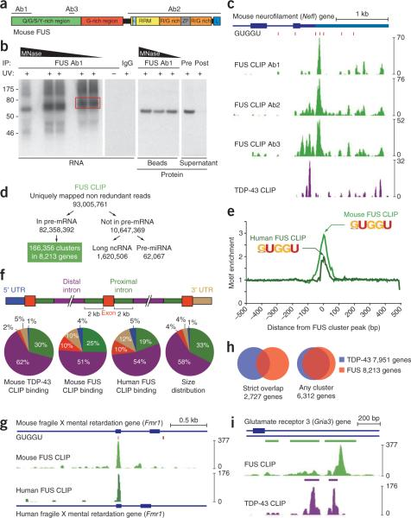

Slide 63
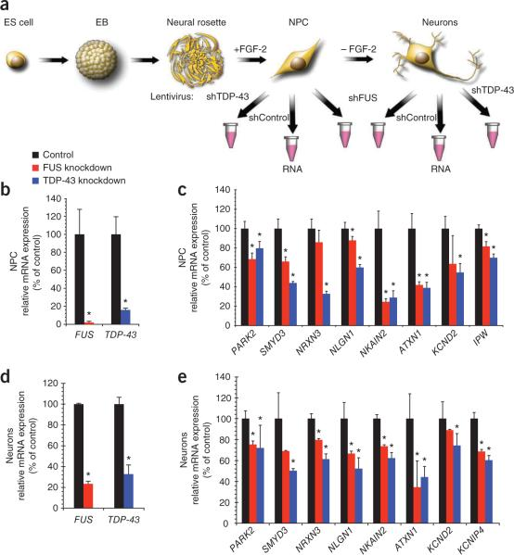

Slide 64
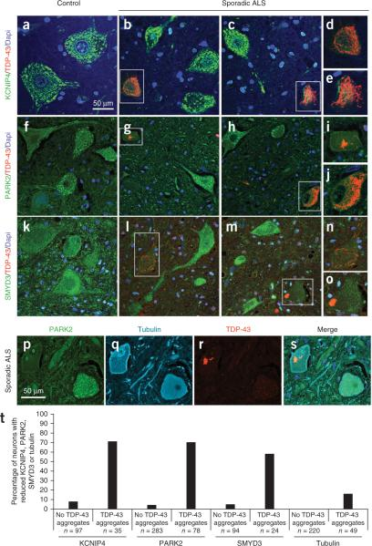

Slide 65
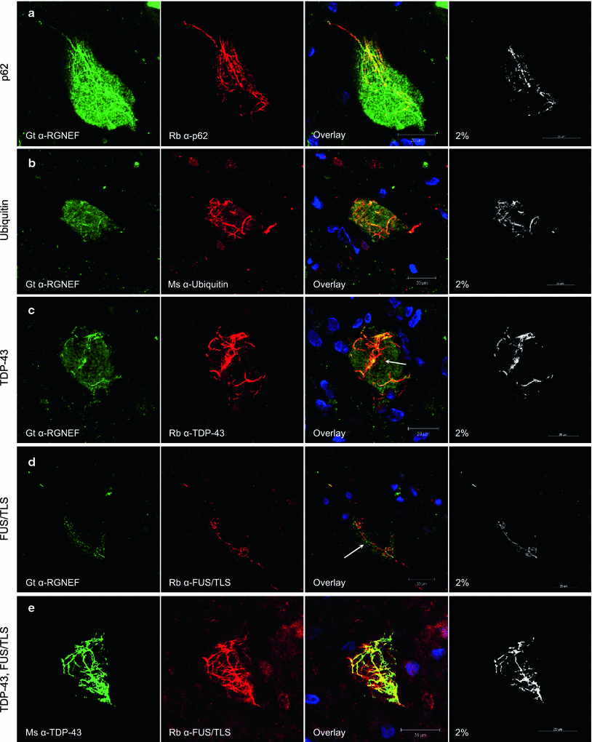

Slide 66
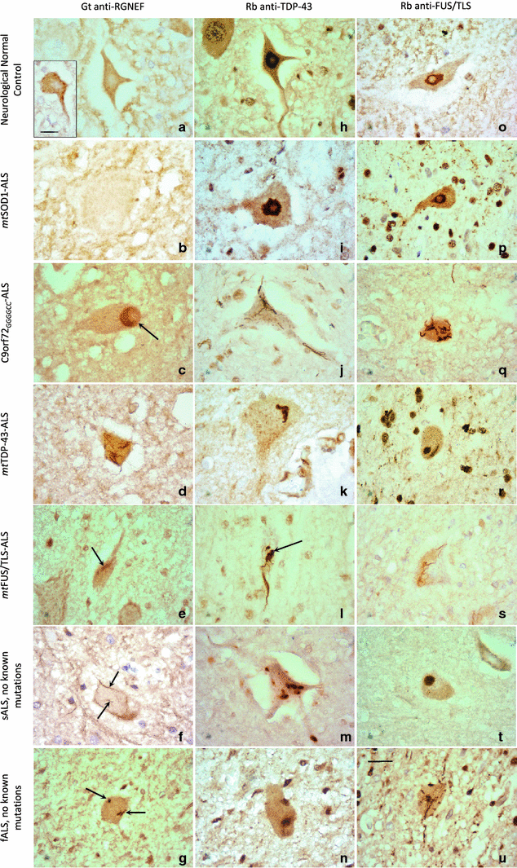

Slide 67
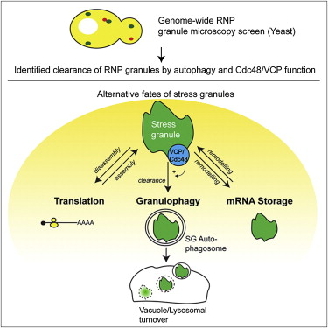
Notes:
Cell, Volume 153, Issue 7, 1461-1474, 20 June 2013

Slide 68
Figure 1 Prion-like Phenomena in Amyotrophic Lateral Sclerosis (A) Mutant, misfolded superoxide dismutase 1 (SOD1) induces the misfolding of its native counterpart, in a template-directed reaction, thereby forming a seed of aggregated protein. TDP-43 and ...
Magdalini Polymenidou , Don W. Cleveland
The Seeds of Neurodegeneration: Prion-like Spreading in ALS
Cell Volume 147, Issue 3 2011 498 - 508
http://dx.doi.org/10.1016/j.cell.2011.10.011

Slide 69
Prion and prion-like domains encode diverse conformational states and folding trajectories.
Yun R. Li et al. J Cell Biol 2013;201:361-372
© 2013 Li et al.
Notes:
Prion and prion-like domains encode diverse conformational states and folding trajectories. Typically, prion and prion-like domains (depicted in blue, green, and red) populate a dynamic equilibrium comprised of soluble intrinsically unfolded monomers and molten oligomers (step a). These molten oligomers can subsequently evolve into multiple conformational states. In one trajectory, molten oligomers reorganize into more structured amyloidogenic oligomers (step b), which ultimately convert into a stable amyloid form (step c), which can self-template assembly (step d) and become infectious (i.e., a prion). Amyloidogenic oligomers can also cluster to form large pathological aggregates (step e), which might slowly convert to amyloid (step f). Alternatively, molten oligomers can partition into partially structured forms with dynamic cross-β structures that exhibit liquid-like properties (step g), and can rearrange further into labile cross-β fibrils with gel-like properties (step h). These liquid and gel-like collectives are likely critical structural components of various non–membrane-bound organelles including SGs and nuclear gems. Importantly, these transitions to liquid- and gel-like structures are readily reversible (steps a, g, and h). We suggest, however, that these structures are also prone to morph into amyloidogenic oligomers (step i), pathological nonamyloid aggregates (step j and k), and even stable self-templating amyloid (step l) connected with neurodegenerative disease.

