Slide 1

Between dead serious and dying laughing
How to talk about dying from neurological disease

Slide 2
Between dead serious and dying laughing
How to talk about dying from neurological disease

Slide 3
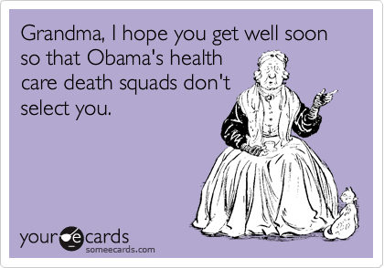

Slide 4


Slide 5
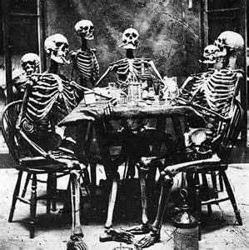
Death over Dinner
Bloody Mary Soup
HM&Ms
Death by Chocolate

Slide 6
Why go there?
Percentage of patients, regardless of age, with a diagnosis of dementia, or their caregiver(s), who
  Received comprehensive counseling
    ongoing palliation and symptom management
    end of life decisions AND
  Documentation in medical record of
    an advance care plan or
    surrogate decisions maker or
    patient refusal or inability to name a surrogate decision maker or provide an advance care plan
    within two years of initial diagnosis or assumption of care.
AAN Quality Guidelines for Dementia 2013
  Assumes a diagnosis of dementia has been carefully evaluated and determined
  All measures must be reported in order to avoid penalty in 2015
  Palliative care moved upstream
Odenheimer et al 2013

Slide 7
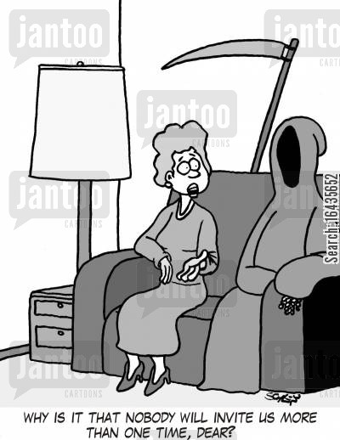
OBAMACARE:
50 MILLION AMERICANS
ENROLLED IN MEDICARE
COVERED FOR END OF LIFE CONVERSATIONS WITH PHYSICIANS

Slide 8
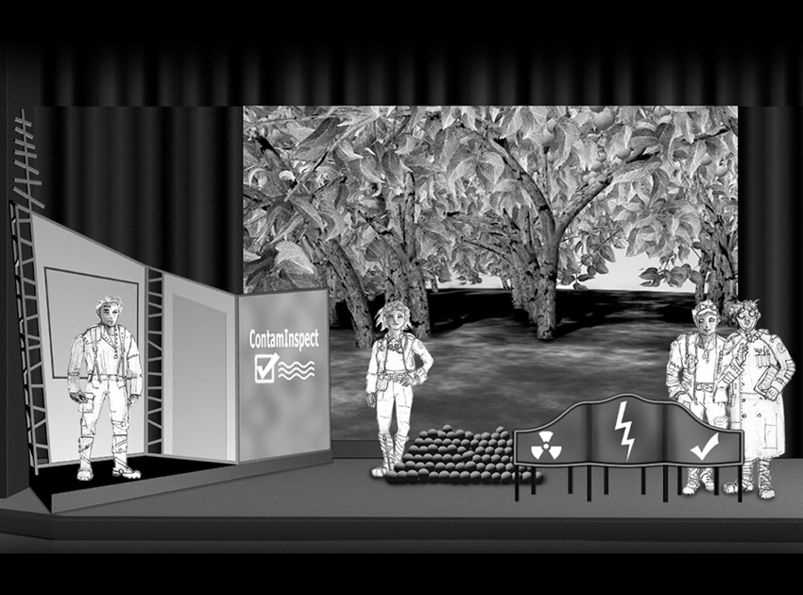
Setting the “Staging”
Global deterioration scale
Funcional Assessment Staging Tool (FAST)
Clinical Dementia Rating Scale (CDR)
Dementia Severity Rating Scale
MMSE
Formal neuropsychological assessment
MILD
MODERATE
SEVERE
AT LEAST ONCE A YEAR
Odenheimer et al 2013

Slide 9
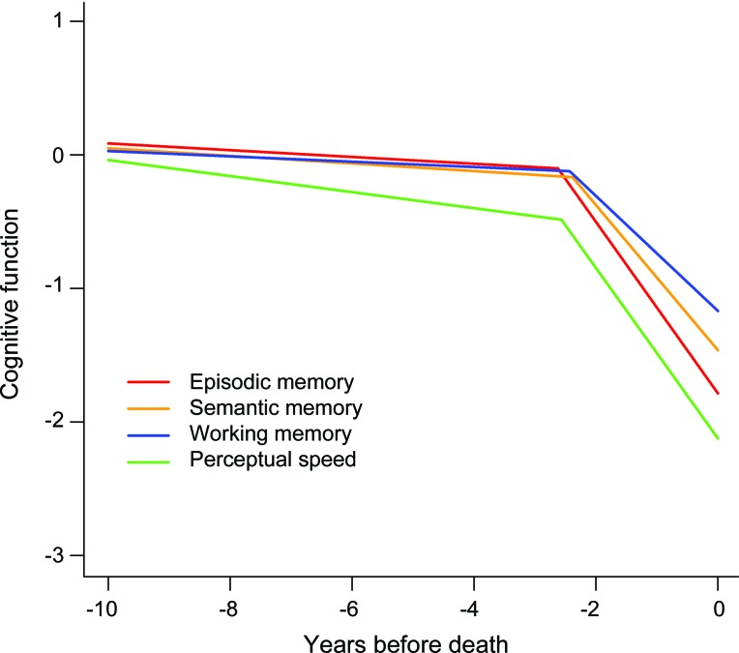
Terminal decline
-0.031 units/year
-0.535 units/year
2.62 years before death, 15X increase in rate of decline in memory
8-fold to 17-fold increases in rate of decline in other domains
Loss of specificity of decline; all domains accelerate
Cognitive dedifferentiation is a sign of impending death
Not related to plaque/tangle pathology
Wilson RS et al Neurology 2012

Slide 10
Knowing the disease
Families
  Comprehension of complications
  Comprehension of prognosis
  Counseled on health problems associated with later stages
  Counseled on estimated length of time to live (</>12 months)
  Perception of dementia as “ a disease you die from”
1 2 3 4 5
Completely Partly Neither Partly Completely

Slide 11
A disease you can die from
A family’s limited understanding of a poor prognosis in advanced dementia leads to higher rate of futile interventions
In patients with terminal diseases recognition of dying led to
  fewer diagnostic and therapeutic interventions
  A greater sense of being at peace with their situation
Alzheimer’s
Mitchell SL et al NEJM 2009; Veerbeek L et al J Palliat Care 2008

Slide 12

So Soon
Research on end of life in dementia is mostly limited to advanced dementia
Many patients do not progress to advanced dementia, but die earlier from comorbid disease or dementia-related health problems
  Less than ½ with advanced dementia in a Netherlands study
Caregiver understanding of dementia needs to be addressed early
Now you will not swell the rout
Of lads that wore their honours out,
Runners whom renown outran
And the name died before the man.
AE Housman; Van der Steen et al 2013
Notes:
Less than half (41%) died with advanced dementia.
Causes of death listed on the death certificate did not differ significantly between those with advanced and less advanced dementia regarding, for example, cachexia (23% versus 18%; P = 0.44), infection (35% versus 36%; P = 0.93), dehydration (41% versus 39%, P = 0.80) or cardiovascular disease (44% versus 49%; P = 0.54),

Slide 13
Legalese: Old school tools
Traditional advance care planning focuses on completion of legal documents to specifiy:
  A surrogate decision maker
  Future treatment preferences
Limited effect
  Low completion rates
  Legalese language that does not
    Apply in clinical situations
    Clarify individual values
  Insufficient to prepare surrogates for their role
  Forms not integrated into medical process and not available when needed
Facilitated advance care planning
  Trained facilitators serially engage with patients and families
  Identify
    Goals and values
    Document preferences
    Ensure dissemination of information to family and surrogates
  Randomized controlled trial demonstrated
    Caregiver benefit
    Increased likelihood that patient preferences enacted
Chiachiaro J et al JAMA 2015; Detering M et al BMJ 2010

Slide 14

Legal-ease: New school tools
PREPARE: the web
  Web based medical interventions in use for depression, other conditions
  Cloud based tools provide easy access and are secure
  Access and cost more favorable than in-person facilitators
  Allows for chat rooms and internet support groups
  Expand access to “stories” from others to motivate people to consider advanced planning
  Virtual vision of life at different stages via video
  Easy to update
  Eases sharing among family members
Sudore Rl et al 2014; Ng CJ et al 2013

Slide 15

Walking in the Valley

