Slide 1
All you need to know about CCAPS
CCTST Competition & Awards Program Site

Slide 2
What is CCAPS?
CCAPS is a program designed at Northwestern University to display funding opportunities and allow applicants to apply
Because it was developed at Northwestern, some of the lingo and options are based on their operations and are specific to them (we don’t use these, or we use them differently—I can show you how ☺)
CCAPS also allows administrators to run the backend of the grant award process—from controlling what fields are required for applications to running the review process

Slide 3
How can my department use CCAPS?
Great question! You can use CCCAPS in a variety of ways, including:
  Presenting funding opportunities, so interested parties know what is available
  To gather LOIs for a funding opportunity
  To gather applications for a funding opportunity
  To manage the review process (see slides ??-?? for detailed instructions)

Slide 4
How do I get started?
The first step for anyone using CCAPS is to either have a CCHMC login or have their UC login linked to the Cincinnati Children’s Research Network
  This all starts here—on the Cincinnati Children’s Research Network login page
  You can access this page by clicking the link above or going to https://ccaps.research.cchmc.org/projects

Slide 5
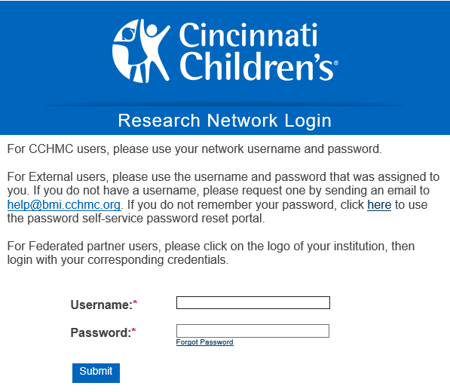
Once you are on the site…
If you are a Children’s employee, or have a Children’s login, you simply enter that information and click “submit” to enter the site

Slide 6
Or if you are a UC employee…
You will need to have your UC login linked to the Research Network.
  This is a simple process, but should be completed well ahead of the application deadline, as it can take time, especially during busy periods
  You should start the process by clicking on the UC Login link at the bottom of the Research Network login screen (shown on next slide)

Slide 7
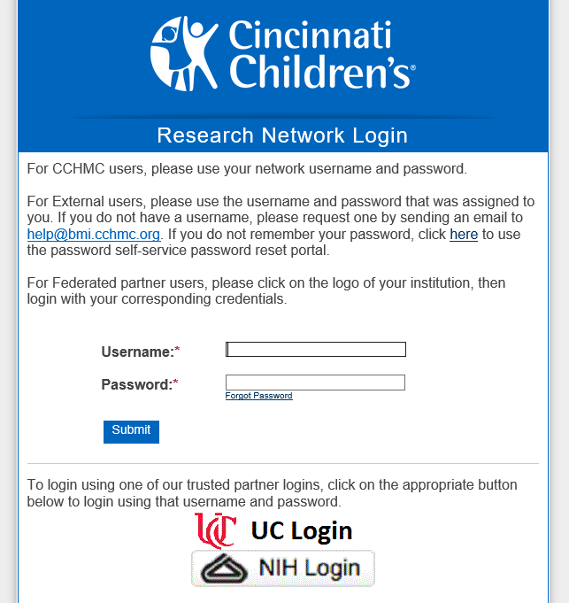
Click here to go to UC user login screen

Slide 8
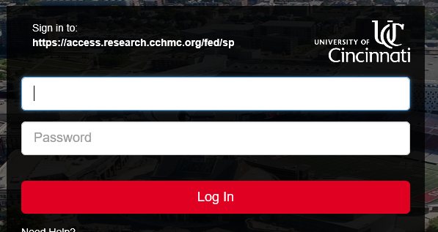
You will be taken to this screen
Enter your 6 + 2 username and UC password, click Log In

Slide 9
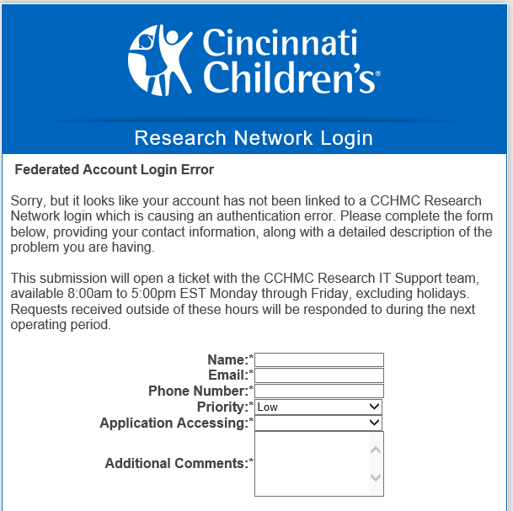
If this is your first time entering the site with your UC username,
You will be taken to the screen shown here
Fill out the form to request that your UC login be linked to the Children’s Research Network
If your request is urgent, please reach out to help-opensource@bmi.cchmc.org and provide your 6+2 and M number.

Slide 10

Once your account has been linked…
Simply go to the UC login page (as shown on slide 7)
Enter your 6 + 2 and UC password in the UC login screen
You will be taken directly into CCAPS where you can apply for funding opportunities!

Slide 11
If you need to be set up as an administrator for your department,
Please contact Laura Reedy directly at laura.reedy@cchmc.org and provide your department name, 6 + 2 username, and M number.
Turnaround time for these requests is typically 1-2 business days, but requests should be made as far in advance as possible to avoid delays in CCAPS access
This access will allow you to run the backend of CCAPS, setting up funding opportunities, changing deadlines, organizing the review process, etc.

Slide 12
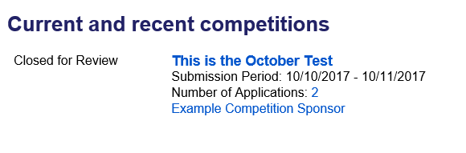
Setting up new competitions
The easiest way to set up a new competition is to use a previous competition that is similar.
You can do this by going to the Current and Recent Competitions page (Actions→ All Competitions) and opening the competition that is similar to the one you want to create by clicking on its blue title

Slide 13
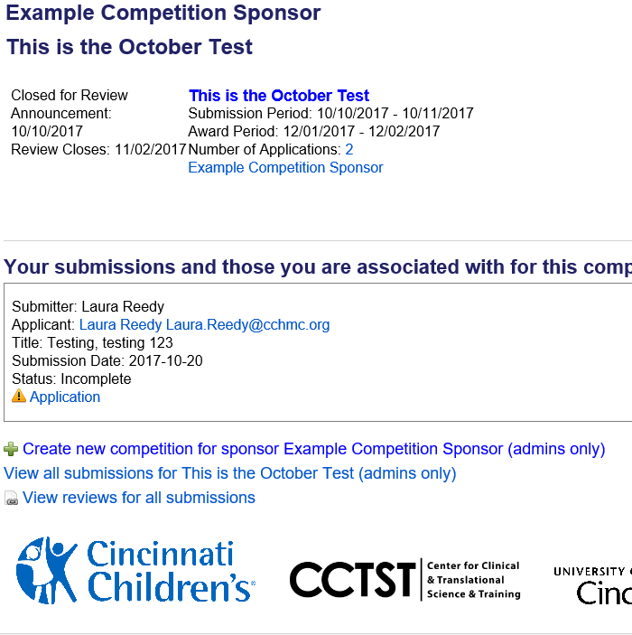
Once you have entered the competition page, right click on “Create new competition for sponsor” near bottom of page
Open this as a new window (or new tab), so you can work in the new competition, while using the old one as a reference

Slide 14
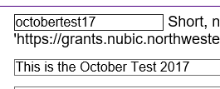

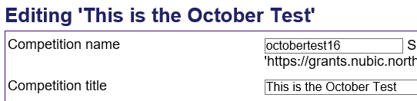

In original window, left click on “edit information”
Copy and paste any information (not already shown) that you want reflected in new competition into the new competition page
  You must make the competition name and title different from the previous year. I typically do this by adding the current year.

Slide 15
Update any information needed to suit current competition
  This is always going to be the competition dates (open/close dates, review start/end dates) and RFA/RFP (as it will always change to reflect updated deadlines)
  Be cautious to update other information that has changed and/or delete information no longer valid or not included in the current competition
  Once you have completed these steps and checked to make sure the information is as you want it, click “create” at the bottom, and your competition is created!

Slide 16
Notes for using previous competition as template:
Creating a new competition in this way allows you to use the previous competition as a guide.
This is especially beneficial if you are creating a new cycle or yearly competition for a competition posted on a regular basis.
Be sure to update any dates or linked documents that may have changed from previous competition.
Check you are working in new competition and not old one:
  Look for “editing” before competition name at top
  Look for “create” button at bottom instead of “update”

Slide 17
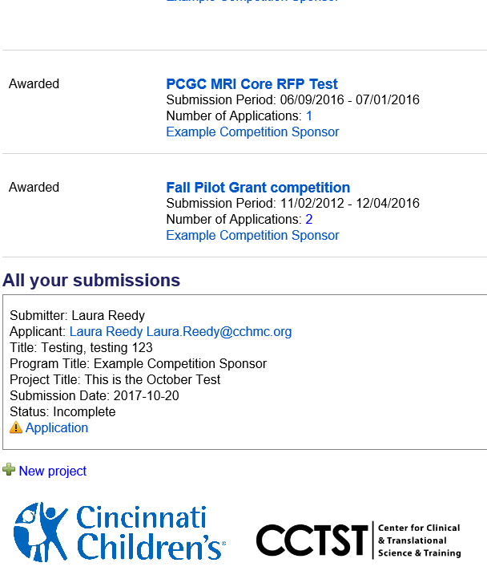
How do I set up a new competition from scratch?
On the Current and Recent Competitions page (accessible by clicking on “All Competitions” under the Actions dropdown), scroll to the very bottom and click “New Project”

Slide 18
Notes for creating competition from scratch:
When entering a new competition this way, you will not have information from previous competitions to guide you, but you start with a blank slate and avoid confusion that may be caused by looking at information from another competition.

Slide 19
How can I use CCAPS in the review process?
One of the great things about CCAPS is you can involve it as little or as much as you want
  For some grants, administrators simply assign the reviewers grants in CCAPS and the rest of the process is handled manually, outside of CCAPS
  For other grants, administrators run the entire review process (including reviewer collaboration and scoring) through CCAPS

Slide 20
Assigning Reviewers
Once the application deadline has passed and you are ready to assign reviewers, go into the competition that you want to assign reviewers for (click on the blue title)

Slide 21
Obtain CCAPS User Names for Reviewers
If a reviewer is already in CCAPS, try looking them up in the existing database of users.
If you cannot locate the user, or the user does not have a CCAPS account, contact help-opensource@bmi.cchmc.org to ensure the user is not already in CCAPS or to have a CCAPS account setup for them (in order to have a user entered into CCAPS, you will need their 6+2 and M number).

Slide 22
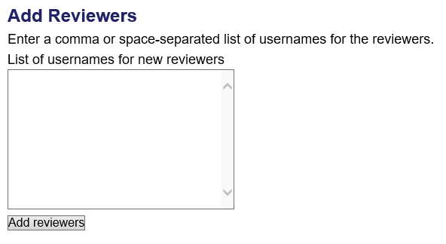
Add reviewers to specific grant
If a reviewer has a username, you can immediately add them as a reviewer.
To do this, simply type their CCAPS user name in the box shown at the bottom of the reviewers screen and click “add reviewers.”
You can add multiple reviewers at once by entering their usernames separated by commas or spaces.

Slide 23
Click and Drag Proposals to Reviewers
Once you have added the reviewers, simply click and drag the proposal names on the right side of the screen to the reviewers you would like to assign them to on the left.
The proposal will then appear in the “assigned” box for the reviewer they are assigned to

Slide 24
Assign one review to self, send link to reviewers
In order to generate a link that you can send to your reviewers, assign one of the proposals to yourself.
From the “actions” menu at the top, select “assigned reviews with files.”
The link that appears in the status bar will take any CCAPS user to those proposals assigned to them within the selected funding opportunity. Simply copy this and send to reviewers.

