Slide 1
Finding and Understanding Funding Opportunity Announcements
Amy Mistretta, MPH
NIH Guide Policy Officer
NIH Guide to Grants and Contracts
Notes:
Good Afternoon!
Welcome to FOA 101
Today we are going to cover the ins and outs of Funding Opportunity announcements

Slide 2
Learning Objectives
Upon completion of this session, participants will be able to find funding opportunity announcements (FOA) of interest and navigate the FOA efficiently to identify all the elements required to submit a responsive, compliant, and complete application.

Slide 3
Funding Opportunity Announcement Fundamentals

Slide 4
What is a FOA?
NIH advertises availability of grant support through funding opportunity announcements (FOAs)
Each FOA includes all pertinent information and requirements for an applicant to assess their eligibility, competency, and interest in the funding opportunity
Organization and content of a FOA is defined by the Office of Management and Budget (OMB)

Slide 5
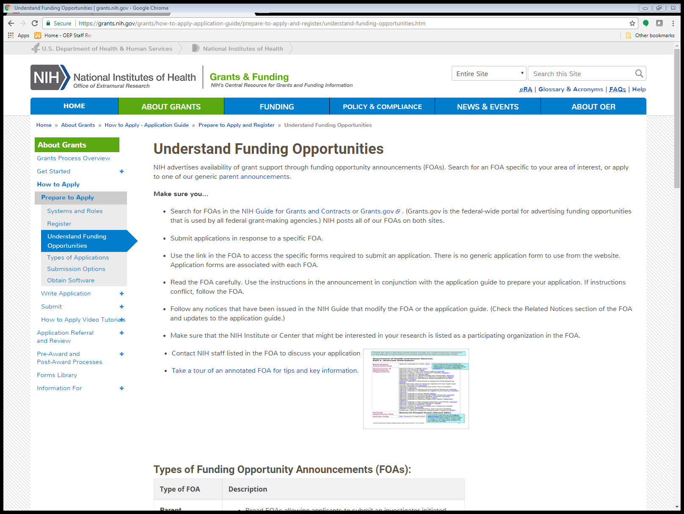
Understanding FOAs

Slide 6
Types of Announcements
Requests for Applications (RFAs)
Solicit applications in a well-defined scientific area to accomplish specific program objectives
Indicate the amount of set-aside funds and anticipated number of awards
Program Announcements (PAs)
Encourages applications for a new or ongoing extramural activity or program
Formerly termed “unsolicited” applications
PAS - PA with set-aside funds
PAR - PA with special receipt, referral and/or review considerations

Slide 7
Parent Announcements
Trans-NIH FOA enabling applicants to submit an investigator-initiated application for a specific activity code
ICs may not participate in all Parent Announcements
  Check the FOA
View Contacts and Special Interests websites for each Parent Announcement for IC-specific information
List of all Parent Announcements: Parent Announcements for Unsolicited or Investigator-Initiated Applications

Slide 8
Parent Announcements
The term ‘parent announcement’ refers to an NIH-wide FOA enabling applicants to electronically submit investigator-initiated grant application for a specific activity code, e.g., Research Project Grant (Parent R01).

Slide 9

Parent Announcements

Slide 10
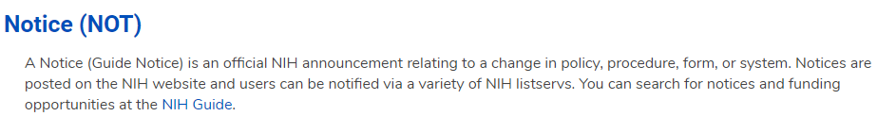

Understanding Notices

Slide 11
Types of Notices
Policy Notice
Notice of Change to FOA
Notice of Information
Notice of Intent to Publish (NOITP)
Request for information (RFI)
Request for Proposals (RFP)
Notes:
Policy notice- announces a new policy
Notice of change to FOA: modifies an existing FOA
NOITP: alerts the community about an upcoming FOA
RFI: requests comments from the extramural community on a particular issue
RFP: announces a request for proposals for a contract award

Slide 12
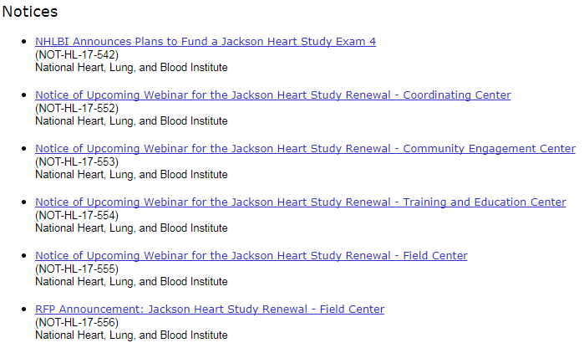
Understanding Notices

Slide 13
Finding
Funding Opportunity Announcements

Slide 14

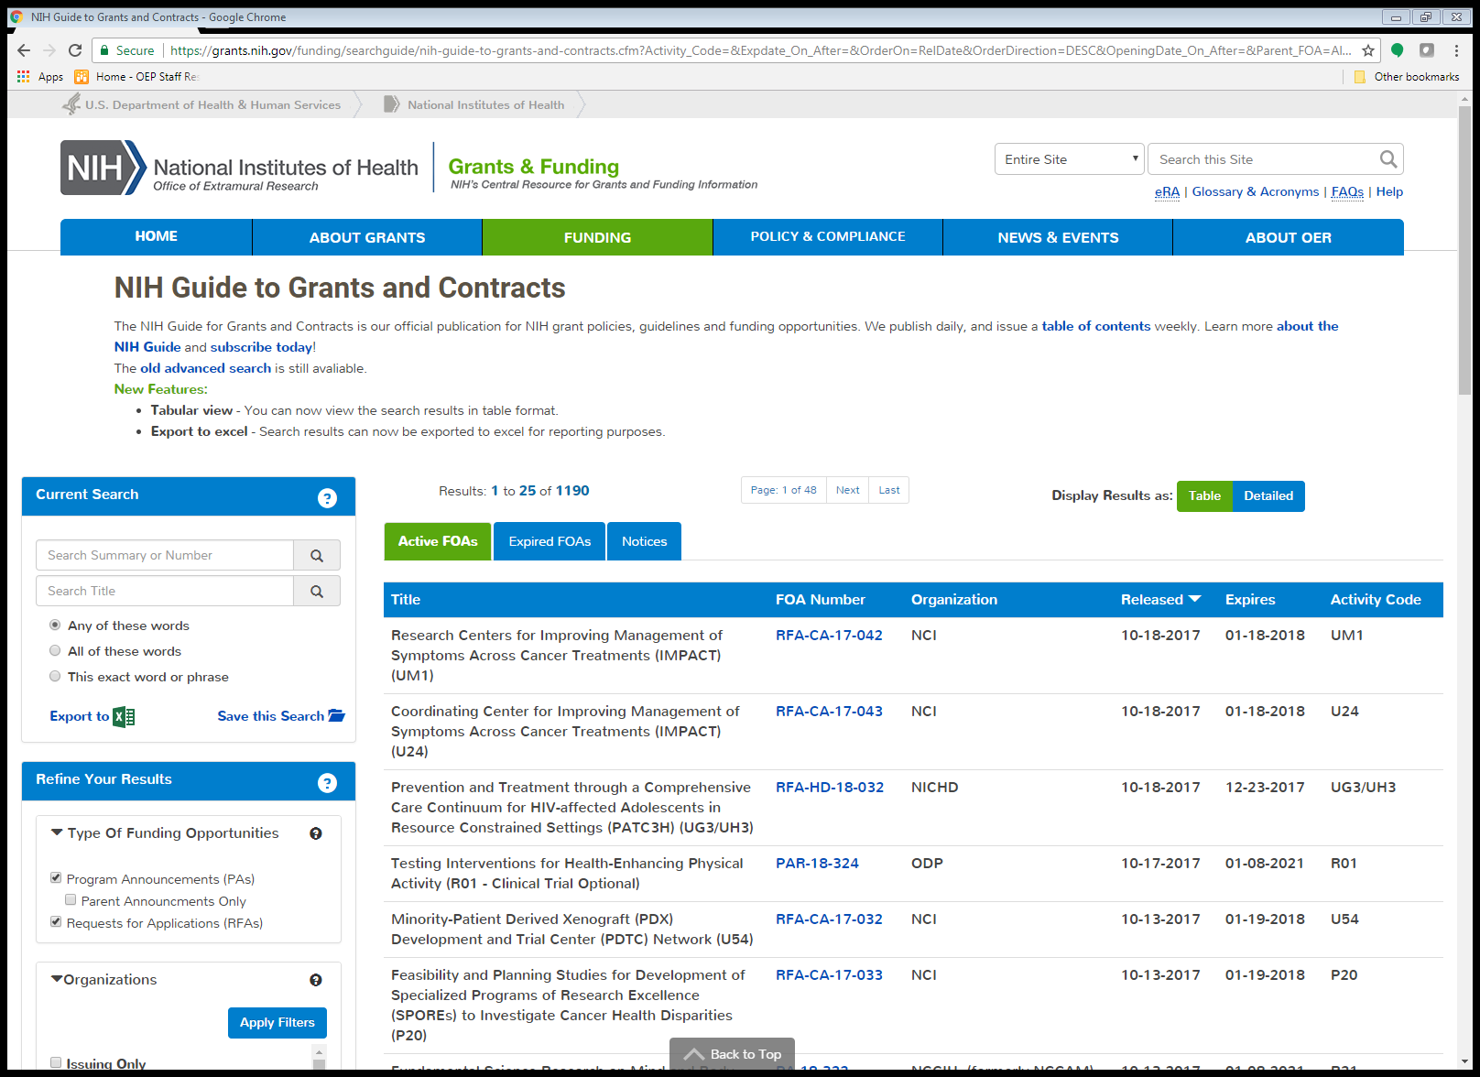
FOA Publication Sites
www.grants.gov
NIH Guide to Grants and Contracts

Slide 15


Slide 16
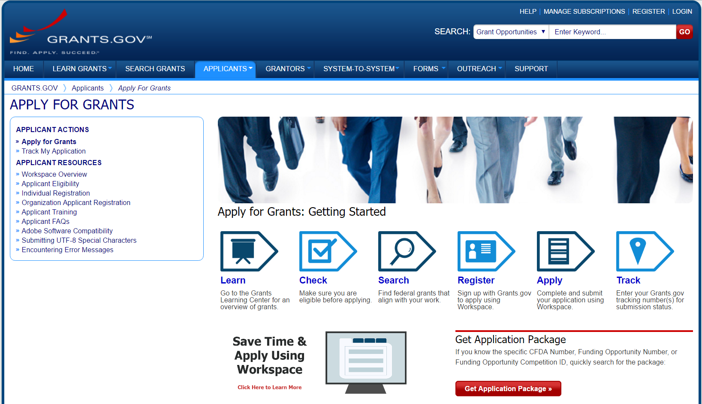

Slide 17
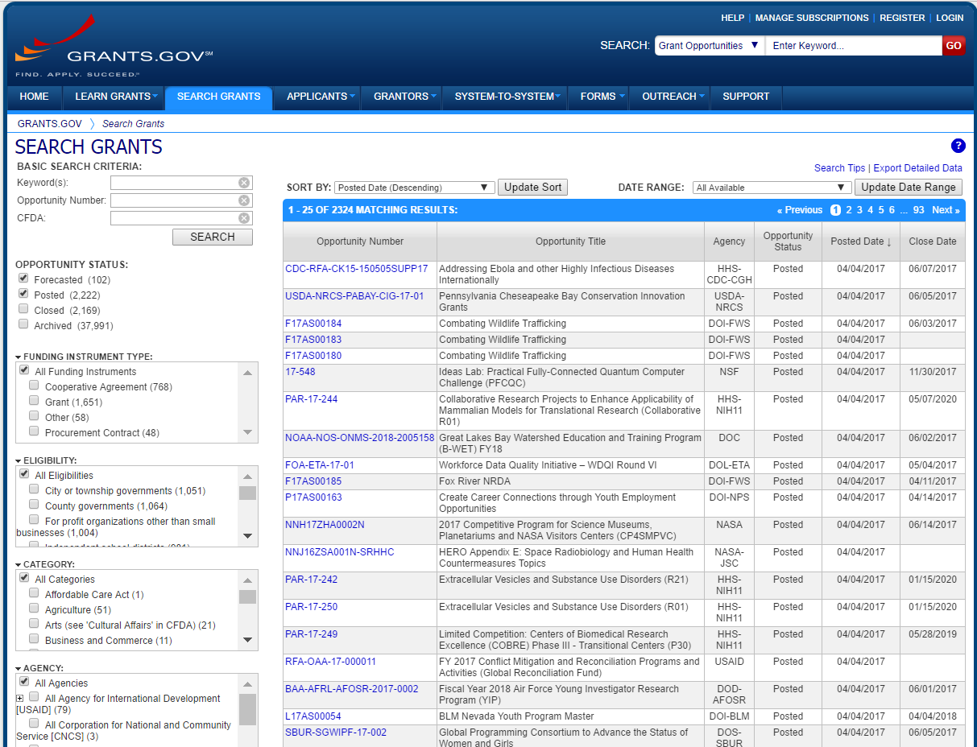

Slide 18
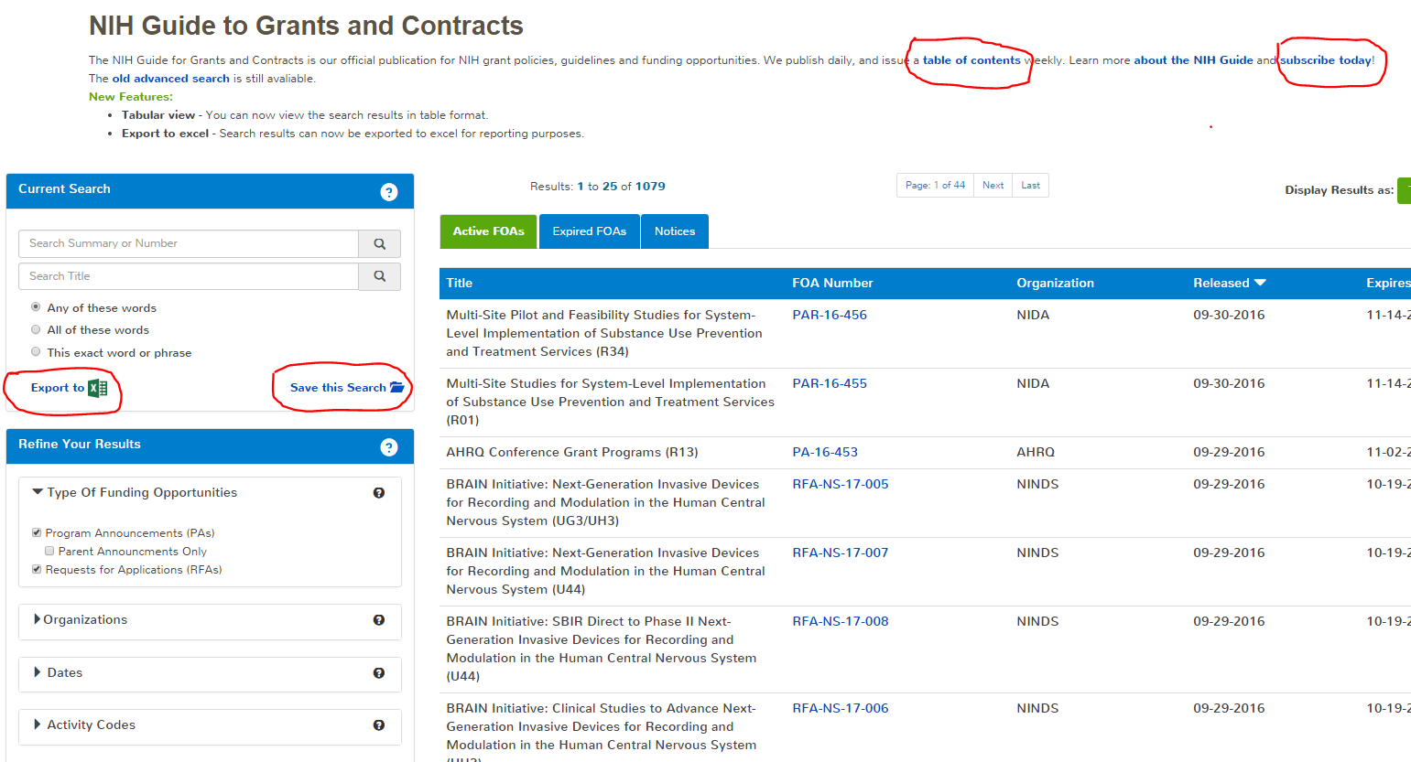
http://grants.nih.gov/funding/index.htm

Slide 19
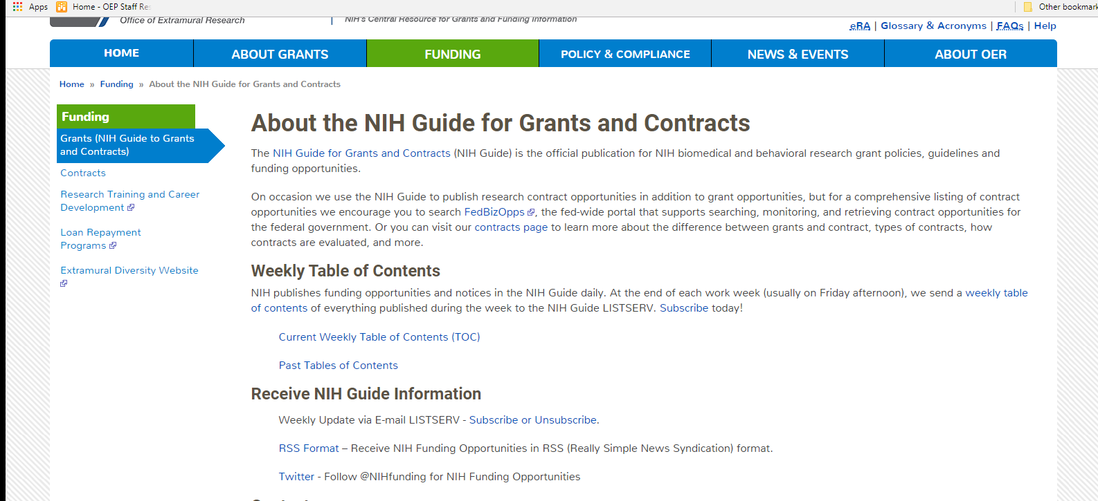
The TOC and Email Lists

Slide 20
Timeframe between Publication and First Due Date
Announcement | Days
RFAs | 60
New PA, PAR, or PAS | 60
Reissuance of active PA, PAR, or PAS | 30
Notice of Change to PA, PAR, or PAS | 30
Notice of Change to RFA | 60

Slide 21
How to Follow
Funding Opportunity Announcements

Slide 22
FOA Table of Contents
Part 1. Overview Information
  Key Dates
Part 2. Full Text of the Announcement
  Section I. Funding Opportunity Description
  Section II. Award Information
  Section III. Eligibility Information
  Section IV. Application and Submission Information
  Section V. Application Review Information
  Section VI. Award Administration Information
  Section VII. Agency Contacts
  Section VIII. Other Information

Slide 23
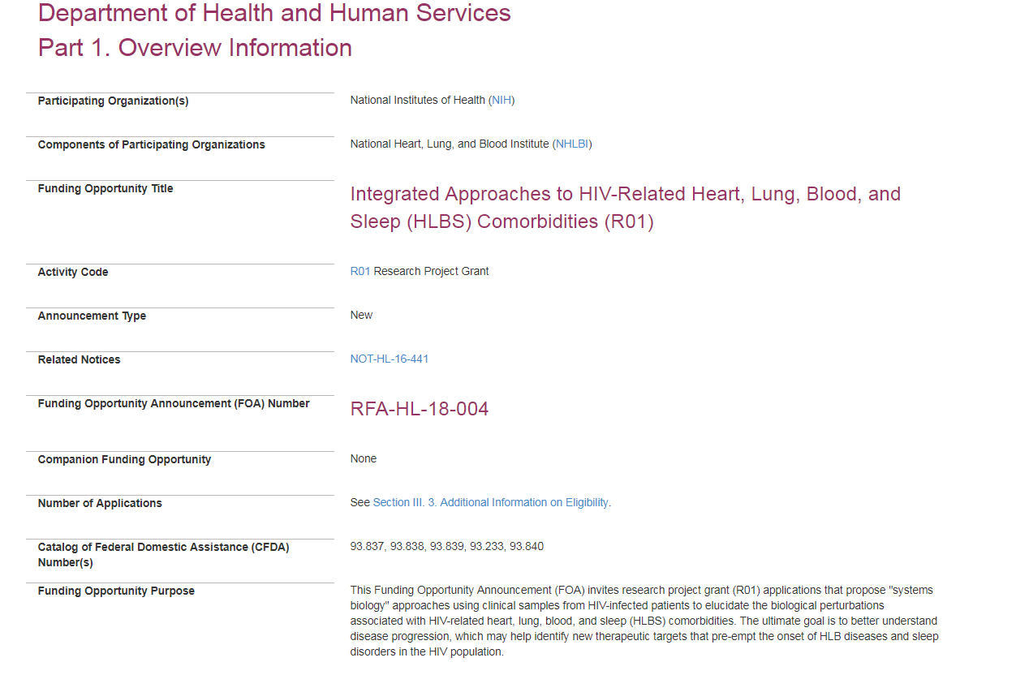
Part 1. Overview Information

Slide 24
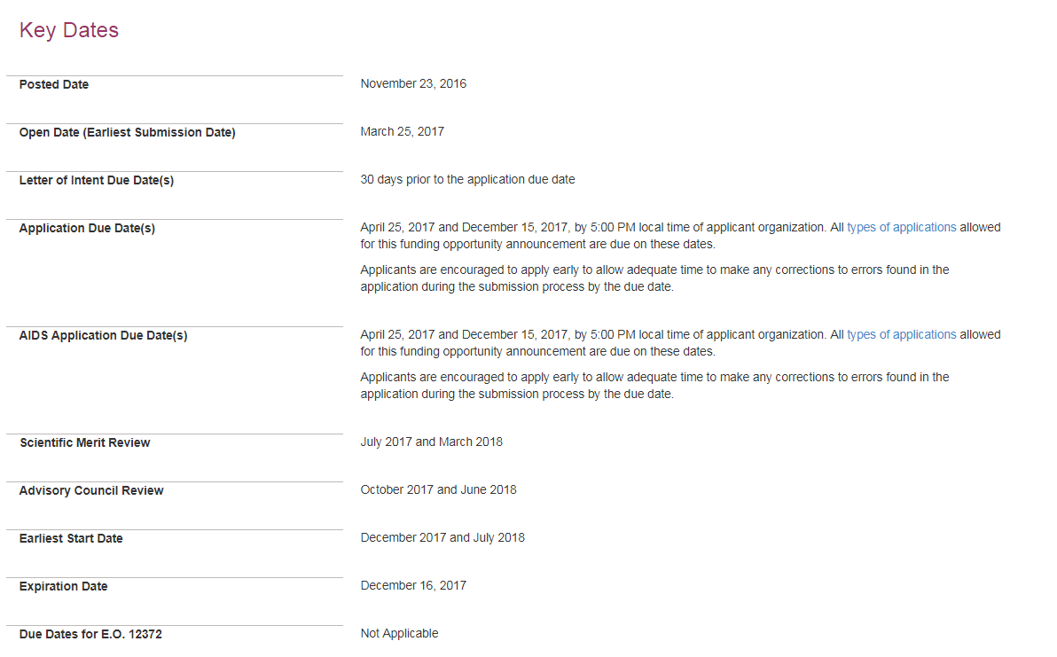
Part 1. Key Dates

Slide 25
Part 2. Section I
Funding Opportunity Description
Purpose: Goals of the funding opportunity
Background: Relevant background information and the importance of the funding opportunity
Research Objectives: Description of specific areas of research interest; examples of targeted research topics and/or and experimental approaches that are being sought to achieve the objectives.

Slide 26
Understanding Responsiveness
Specific Areas of Research Interest
This FOA will support the development of assays, devices, or monitoring tools and clinical studies to validate their use in measuring ARV adherence. Early-stage clinical trials designed to examine feasibility, acceptability, and the preliminary impact on ARV adherence can also be supported.
Applicants are encouraged to test feasibility and acceptability in populations known to be challenged by adherence, such as those with mental health disorders or adolescents. Clinical populations in the United States or international settings may be appropriate for research proposed under this FOA.
Examples of projects of interest under this FOA include:
Development and validation of ARV metabolite assays in clinical specimens followed by feasibility and acceptability testing in a clinic population.
Development and validation of medication taggants followed by feasibility and acceptability testing in a clinic population.
Prospective studies that test feasibility and acceptability of ARV adherence monitoring approaches that provide confirmation of oral medication ingestion through ingestion sensors or other metabolite detection systems………

Slide 27
Understanding Responsiveness
Non-responsive Areas of Research
Applications proposing any of the following research topics will be identified as non-responsive and will not be reviewed.
Clinical trials designed to test efficacy or effectiveness in improving adherence behavior
Research focusing exclusively on self-reported measures of adherence (via questionnaires, text messages, etc.).
Electronic drug monitoring devices that lack wireless capacities.
Use of assays that involve invasive specimen collection (e.g., tissue biopsies, collection of cerebrospinal fluid) that would impact acceptability to patients.
Studies focusing exclusively on clinic- or home-based pill count approaches to adherence assessment.
Applicants are strongly encouraged to contact the Scientific/Research Contact(s), listed in Section VII of this FOA, to discuss the appropriateness of the scope of the proposed project.

Slide 28
Part 2. Section II
Award Information
Funding Instrument | Grant: A support mechanism providing money, property, or both to an eligible entity to carry out an approved project or activity.
Application Types Allowed | New The OER Glossary and the SF424 (R&R) Application Guide provide details on these application types.
Funds Available and Anticipated Number of Awards | Issuing IC and partner component intend to commit an estimated total of $7 million to fund 6-8 awards.
Award Budget | Application budgets are not limited but need to reflect the actual needs of the proposed project.
Award Project Period | The scope of the proposed project should determine the project period. The project period can be 3-5 years.

Slide 29
Application Types
New
Renewal
Resubmission
Revision
Notes:
New
application that has not received prior funding
Renewal
application requesting funding for a period subsequent to that provided by a current award
Resubmission
application that has been previously submitted, but was not funded, and is being resubmitted for new consideration
Revision
application to request an increase in support for expansion of an award’s approved scope

Slide 30
Part 2. Section II
Award Information
Funding Instrument | Grant: A support mechanism providing money, property, or both to an eligible entity to carry out an approved project or activity.
Application Types Allowed | New The OER Glossary and the SF424 (R&R) Application Guide provide details on these application types.
Funds Available and Anticipated Number of Awards | Issuing IC and partner component intend to commit an estimated total of $7 million to fund 6-8 awards.
Award Budget | Application budgets are not limited but need to reflect the actual needs of the proposed project.
Award Project Period | The scope of the proposed project should determine the project period. The project period can be 3-5 years.

Slide 31
Part 2. Section III
Eligibility Information
Eligible institutions
  Application is submitted by institution
Eligible individuals
  Only applicable for PD/PI
  Multiple PD/PI applications: Eligibility requirements apply to all PD/PIs
Number of applications
  Usually only limited to avoid duplicate or highly overlapping applications

Slide 32
Part 2. Section IV
Application & Submission Information
Letters of Intent
  Requested in some FOAs to help with planning the review
  Not required; does not impact review

Slide 33
Part 2. Section IV
Application & Submission Information
Instructions for Application Submission
  Lists of all the forms available in the application package
  Instructs applicant to follow instructions in the SF 424 (R&R) Application Guide in addition to FOA-specific instructions
  An applicant should be able to prepare an application by reading the SF424 (R&R) Application Guide and this section only

Slide 34
Understanding Completeness
PHS 398 Research Plan
All instructions in the SF424 (R&R) Application Guide must be followed, with the following additional instructions:
Research Strategy: As part of the Research Strategy, applicants should clearly describe how the assay, device, or tool for monitoring ARV adherence will address all or most of the following characteristics:
Indicate that oral medication ingestion occurred;
Offer real-time monitoring of adherence behavior in ecological settings;
Allow for discernment of longitudinal patterns of adherence; and
Provide timely feedback on adherence patterns so that HIV preventative and therapeutic outcomes can be optimized.
Applicants must include a Management Plan with milestones and timelines. This plan should outline any pre-clinical development of the bioanalytical adherence assay or monitoring tool, if applicable…..

Slide 35
Understanding Completeness
Is an application complete if the Research Strategy does not describe one of the characteristics outlined in the FOA?
Is an application complete if the Research Strategy does not include a Management Plan?
Is an application complete if the Research Strategy includes a Management Plan with milestones and timelines that are not reasonable?

Slide 36
Part 2. Section V
Application Review Information
Review criteria
  Standard review criteria used to evaluate scientific and technical merit
  Only PARs and RFAs may have non-standard review criteria
  Each additional review question must map to an expectation that has been explained to applicants earlier in the FOA
Review and selection process
  Minimal information about peer review process
  Considerations for funding decisions

Slide 37
Part 2. Section VI
Award Administration Information
Award Notices
  FOA-specific provisions to be included in Notice of Award
Cooperative Agreement Terms and Conditions of Award (only for U activity codes)
Reporting requirements

Slide 38
Part 2. Section VII Agency Contacts
Application Submission Contacts
  eRA Service Desk: ASSIST, eRA Commons registration, submitting and tracking an application, documenting system problems that threaten submission by the due date, post submission issues)
  Grants.gov Customer Support: Grants.gov registration and submission, downloading forms and application packages
  GrantsInfo: Application instructions and process, finding NIH grant resources

Slide 39
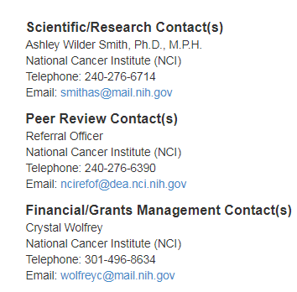
Part 2. Section VII Agency Contacts
FOA-specific contacts
  Scientific/Research
  Peer Review
  Financial/Grants Management

Slide 40
FOA Key Terms
Understanding options and requirements
  Encouraged
  Expected
  Should
  Must and Required
Requirements for successful submission
  Responsiveness: Section I – Scope
    Only applicable to RFAs
  Compliance: Section II – Budget, Project Period
  Eligibility: Section III – Institution, PD/PI, Number of applications
  Completeness: Section IV – Application Instructions

Slide 41
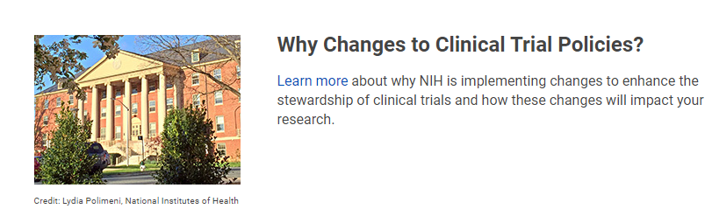
Clinical Trial Requirements for Grants and Contracts
NIH is launching a series of initiatives that are rolling out in 2017-2018 to enhance the accountability and transparency of clinical research. These initiatives target key points along the whole clinical trial lifecycle from concept to results reporting.
https://grants.nih.gov/policy/clinical-trials.htm

Slide 42
Clinical Trial Requirements for Grants and Contracts
Beginning for January 25, 2018 due dates, all applications proposing clinical trials must be submitted through a FOA designated specifically for clinical trials.
New review criteria will be used to evaluate applications proposing clinical trials or clinical trial research experience.
A new Human Subjects and Clinical Trial Information form will be required for all human subjects and/or clinical trial research beginning for January 25, 2018 due dates.

Slide 43

POP QUIZ

Slide 44

How many application types are there?

Slide 45

Where can I find all the active FOAs?
This Photo by Unknown Author is licensed under CC BY-NC-ND

Slide 46

How many types of notices does NIH publish?
This Photo by Unknown Author is licensed under CC BY

Slide 47

Questions?

