Slide 1
UC College of Medicine Center for Addiction Research (CAR)
Summer Speaker Series
Sponsored by: Center for Clinical & Translational Science & Training
August 9, 2023
12:00 – 1:00PM
This event is being recorded.
Participants can enable captions in the taskbar under more.

Slide 2
Center for Addiction Research (CAR)
The CAR was launched in October of 2020
Mission: to support cross-disciplinary collaborations across UC as well as with community partners, governmental institutions, and other academic institutions in order to accelerate scientific progress in addiction prevention and treatment
Twenty-eight faculty from five UC Colleges
CAR Website: https://med.uc.edu/institutes/CAR/home

Slide 3
CAR Website
Publications: https://med.uc.edu/institutes/CAR/publications
Projects:
https://med.uc.edu/institutes/CAR/projects
Communications:
https://med.uc.edu/institutes/CAR/communications
To become an affiliate member:
https://med.uc.edu/institutes/CAR/car-member-registration

Slide 4
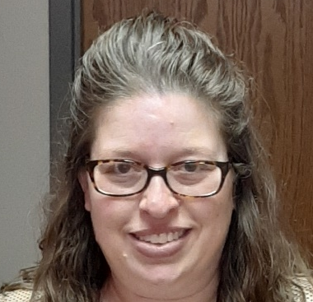
The COM CAR Summer Speaker Series
Supported by an award from the Center for Clinical & Translational Science & Training
Thank you to Jen Rowe for planning assistance.

Slide 5
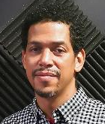
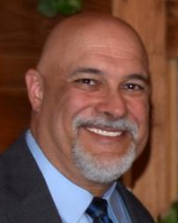
The COM CAR Summer Speaker Series
Special thank you for operational assistance from:
Jermaine Fields – UC IT User Interface and User Experience Developer
Todd Schutter - Multi-Media Coordinator, UC Information Technology

Slide 6
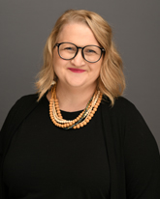
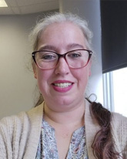
Examining Substance Use Around the Timing of Pregnancy from a Health Equity and Patient-Centered Perspective
Nichole Nidey, PhD
University of Iowa
Tara Cain
EMPOWER

Slide 7
Learning Objectives
Identify why epidemiological research focused on substance use needs a health equity lens.
Describe the relationship between substance use stigma and maternal health outcomes.
Understand the benefits of conducting research in partnership with persons with lived experience of substance use during pregnancy.

Slide 8
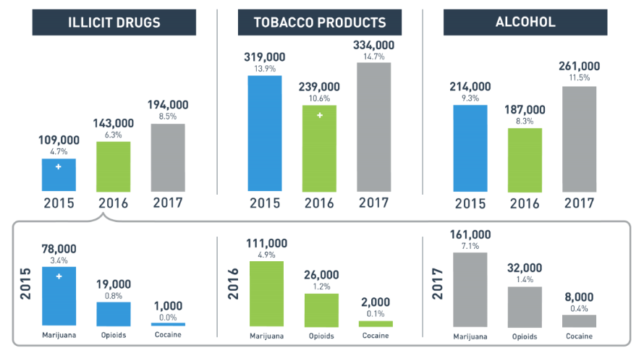

Substance Use in Past Month Among Pregnant People
Persistent and complex public health challenge
Special analysis of the 2017 NSDUH Report.

Slide 9
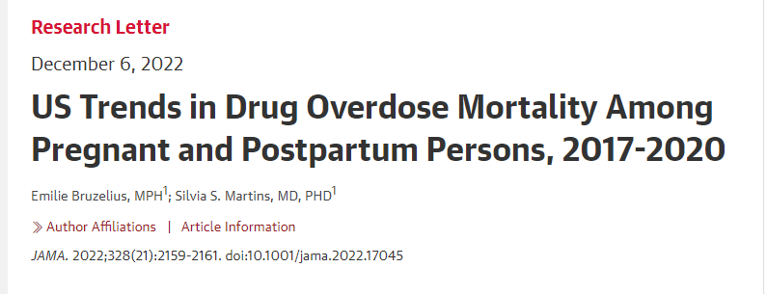

Slide 10

Postpartum Mortality in Cincinnati
45%
16/20 postpartum deaths occurred among those with substance use during pregnancy
Maternal Mortality Among Persons with Illicit Substance Use
Nichole Nidey, Michael P. Marcotte, Laura Kair, Andrea L. Greiner, Mishka Terplan, Karen Tabb and Christine Wilder
American journal of obstetrics and gynecology, Vol.226(1), pp.S386-S386;
01/2022;

Slide 11
How do we support pregnant and postpartum persons with substance use to improve their outcomes?

Slide 12
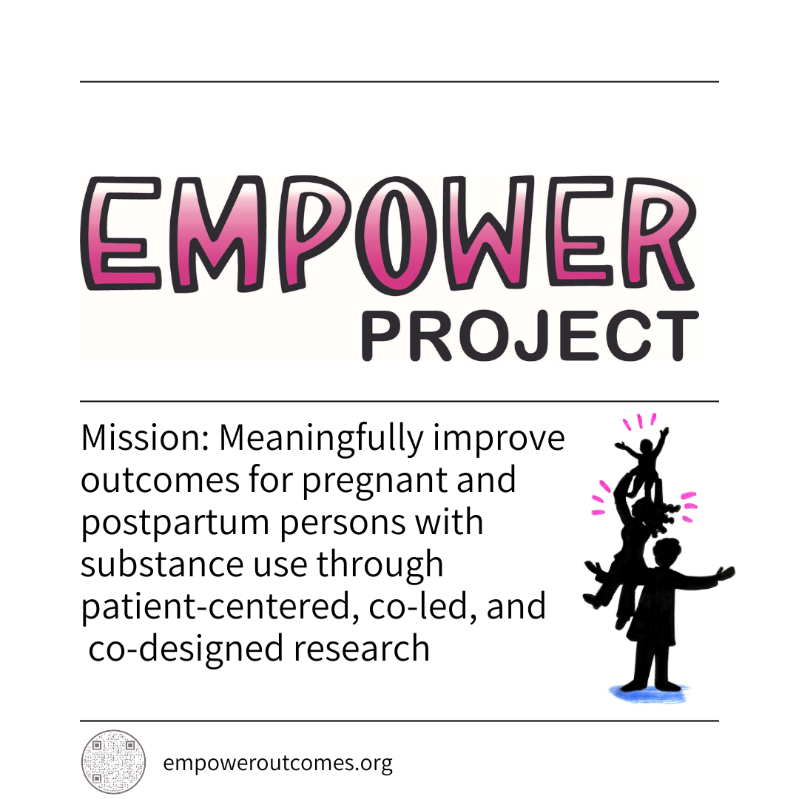
Notes:
Nichole

Slide 13
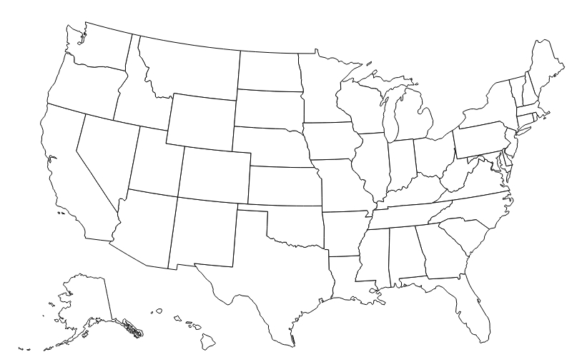

Stakeholder Locations
Groups Represented:
Persons with lived experience
Researchers
OB/GYN
Pediatricians
Neonatologists
Social Work
Peer Support
Nurses
Substance Use Tx Providers
Psychologists
Home Visiting
Harm Reduction
17 stakeholders with lived experience of substance use
Avg. 30 stakeholders join monthly meetings

Slide 14
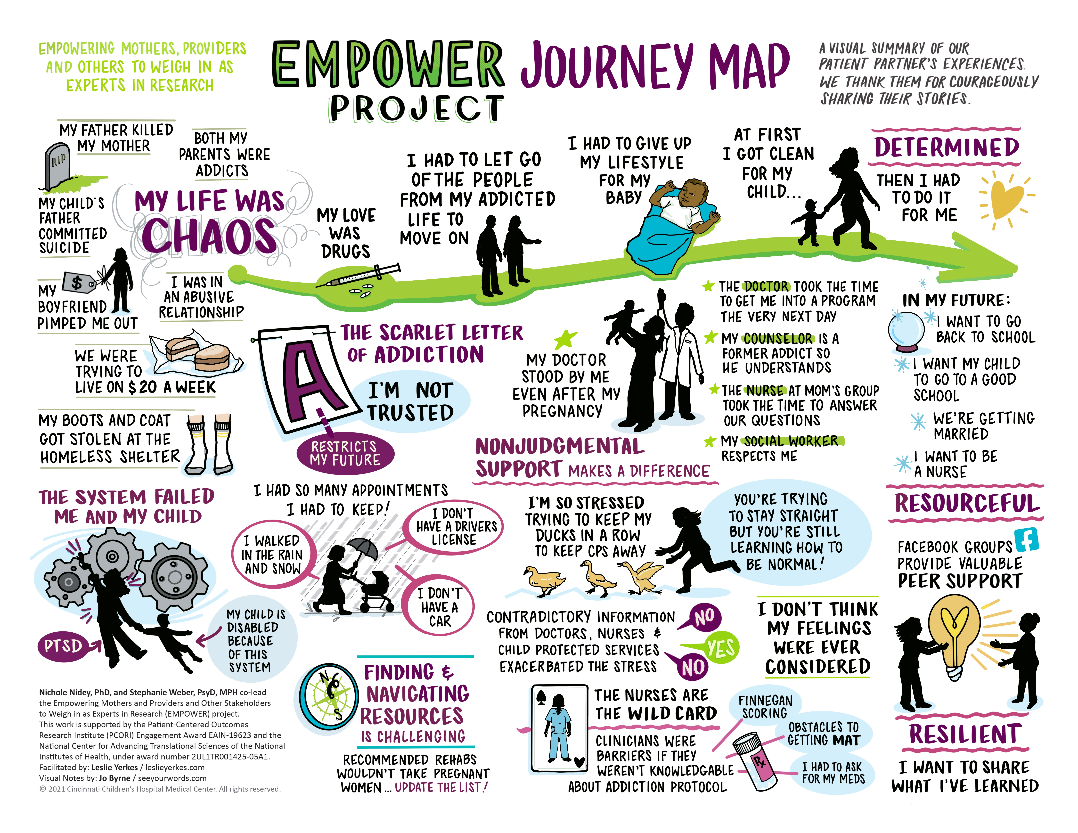
Notes:
Nichole

Slide 15

Meet Tara
*Video not available in PowerPoint

Slide 16
Stigma/Discrimination and Postpartum Outcomes
Notes:
S

Slide 17
Development of Survey
Draft Questions
Patient Stakeholder Edits
Final Survey
Collaborative Review
Pilot

Slide 18
Healthcare Discrimination Tool
Measures perceived discrimination in healthcare settings
  Doctor or nurse not listening to you
“I can’t answer when you ask about both nurse and doctor in the same question”

Slide 19
Participant Characteristics (n = 100)
100% history of Opioid Use Disorder
100% received treatment at least 1 time during pregnancy
Majority of participants from Cincinnati Region
92% White
4% Hispanic/Latina
86% High School Diploma
89% Public Insurance

Slide 20
Table 1: Experiences of Discrimination in Prenatal Care and Substance Use Treatment Settings
Modified Healthcare Discrimination Scale Questions | Prenatal Care Setting (%) | Substance Use Treatment Setting (%)
Doctor not listening to you | 24.2 | 15.2
Nurse not listening to you | 29.3 | 14.1
Treated with less respect than other pregnant people | 41.1 | 18.8
Received poorer service than other pregnant people | 38.2 | 16.7
Doctor acted better than you | 19.2 | 15.0
Nurse acted better than you | 36.0 | 15.0
Doctor acted if he or she was afraid of you | 5.1 | 4.0
Nurse acted if he or she was afraid of you | 7.1 | 3.0
Doctor acted if he or she did not want to touch you | 6.1 | 7.1
Nurse acted if he or she did not want to touch you | 7.1 | 7.1
Judged or treated unfairly because of the type of insurance or your ability to pay | 7.2 | 7.2
Judged or treated differently because of your past or present drug use | 49.5 | 23.0
The doctors providing my care were NOT knowledgeable about caring for a pregnant person with opioid use disorder | 23.5 | 17.2
The nurses providing my care were NOT knowledgeable about caring for a pregnant person with opioid use disorder | 30.2 | 22.2

Slide 21
Table 1: Effect of Discrimination on Postpartum Outcomes
 | Prenatal/Obstetric Care Setting Discrimination RR(CI) | Substance Use Treatment Setting Discrimination RR(CI)
Not using MOUD as prescribed | 2.6 (1.06, 6.40) | 3.26 (1.59, 6.70)
Discontinuation of MOUD | 2.17 (0.86, 5.46) | 2.56 (1.19, 5.54)
Return to use | 1.14 (0.55, 2.37) | 2.36 (1.18, 4.73)
Overdose | 1.44 (0.47, 4.46) | 2.10 (0.74, 5.98)
*BOLD indicates p value >0.05, MOUD = medication for opioid use disorder

Slide 22
EMPOWER stakeholders stories have highlighted the need to examining research data from a health equity approach

Slide 23

Health Equity Lens
Who is affected by processes, policies, and/or structure
How do processes, policies, and/or structure widen existing or create disparities?

Slide 24
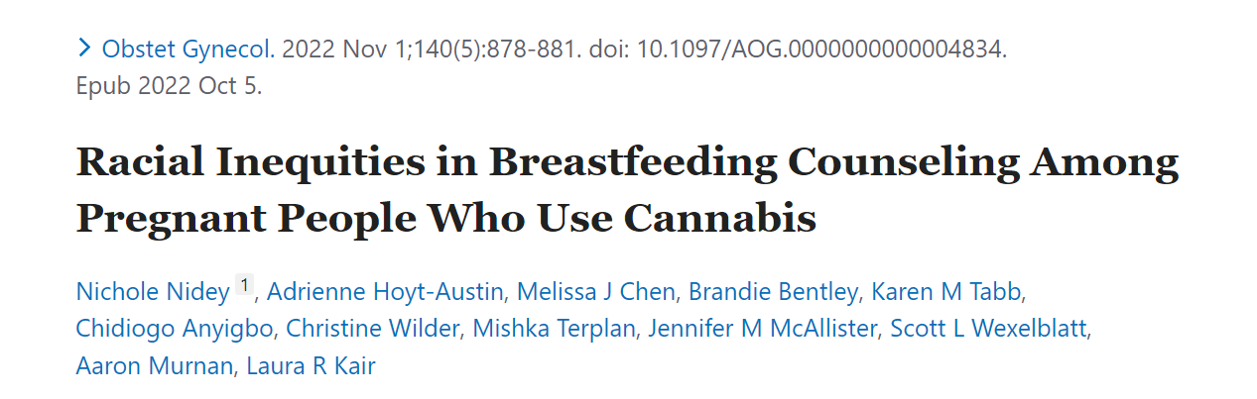
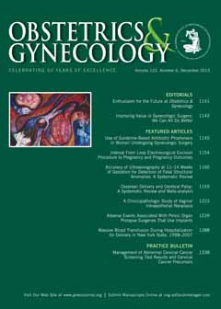
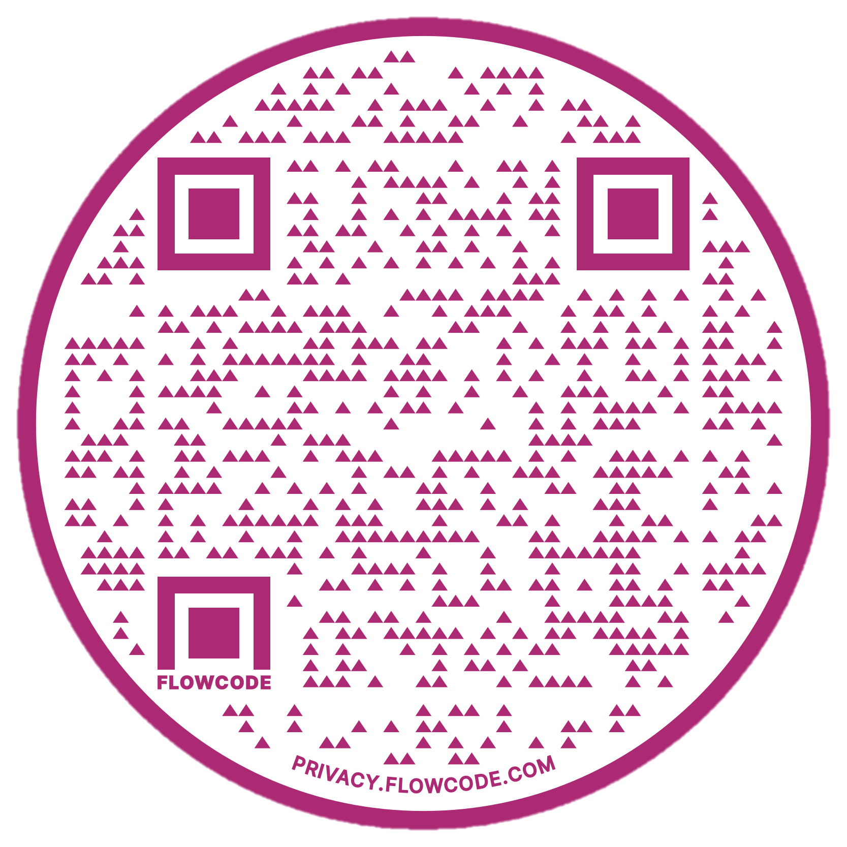

Slide 25

Breastfeeding Recommendations
American College of Obstetricians & Gynecologists (ACOG) advise against cannabis use but DO NOT recommend counseling against breastfeeding if using cannabis

Slide 26
Background
Less known if/how breastfeeding guidance varies by maternal characteristics
Ample evidence of interpersonal and structural racism in the context of breastfeeding support & War on Drugs
Persistent breastfeeding disparities
  Black mother-infant dyads lowest rates

Slide 27
Study Objective
Examine how breastfeeding advice in the context of cannabis use differs by self-reported race
---During any of your prenatal care visits, did a doctor, nurse, or other health care worker do any of the following things…advise me not to breastfeed my baby if I was using marijuana.

Slide 28
Odds of Receiving Prenatal Advice Not to Breastfeed When Using Cannabis Among Pregnant People with Self-Reported Cannabis Use by Self-reported Race & Ethnicity
 | Adjusted† OR (95% CI)
Maternal Race & Ethnicity
Hispanic | 2.0 (1.0, 4.2)
American Indian | 1.3 (0.6, 3.0)
Asian | 0.4 (0.1, 2.6)
Black | 4.1 (2.1, 8.2) ***
Mixed | 2.6 (0.8, 8.3)
White | REF
None of the Above | 0.2 (0.0, 2.0)
  †Insurance type, prenatal smoking, education, age, state, year of delivery, survey weights
PRAMS Total Weighted Sample Size n=51,793, Actual Sample Size n = 1,213

Slide 29
Conclusion
Non-Hispanic Black pregnant people were disproportionately advised against breastfeeding, a non-evidenced based recommendation
Maternal-child health researchers have highlighted the need to address the effects of structural & interpersonal racism on breastfeeding outcomes

Slide 30
EMPOWER stakeholders stories have highlighted the need for peer-support
Notes:
Tara

Slide 31
Peer Support Certification in Ohio
Currently the peer support curriculum does NOT include education on substance use and pregnancy
EMPOWER stakeholders completed the state’s training and became certified
EMPOWER stakeholders have developed a 3-hour training module for the state to provide peer supporters education on how to support this population
Notes:
Tara

Slide 32

Mary’s Story
*Video not available in PowerPoint
Notes:
Tara

Slide 33
Q&A
Please unmute to ask a question OR type your question in the chat box.

Slide 34
Thank you for joining us!
Please take a few moments to complete
the survey form. The survey link is provided
in the chat box and will also be emailed.
The form is required to complete if requesting CE credit for Psychology, Social Work, or Counseling.

Slide 35
All Summer Speaker Series event recordings can be found by visiting
the CAR website.
Thank you for attending!
med.uc.edu/institutes/CAR/summer-speaker-series/speaker-series-2023

