Slide 1
UC College of Medicine Center for Addiction Research (CAR)
Summer Speaker Series
Sponsored by: Center for Clinical & Translational Science & Training
July 12, 2023
12:00 – 1:00PM
This event is being recorded.
Participants can enable captions in the taskbar under more.

Slide 2
Center for Addiction Research (CAR)
The CAR was launched in October of 2020
Mission: to support cross-disciplinary collaborations across UC as well as with community partners, governmental institutions, and other academic institutions in order to accelerate scientific progress in addiction prevention and treatment
Twenty-eight faculty from five UC Colleges
CAR Website: https://med.uc.edu/institutes/CAR/home

Slide 3
CAR Website
Publications: https://med.uc.edu/institutes/CAR/publications
Projects:
https://med.uc.edu/institutes/CAR/projects
Communications:
https://med.uc.edu/institutes/CAR/communications
To become an affiliate member:
https://med.uc.edu/institutes/CAR/car-member-registration

Slide 4
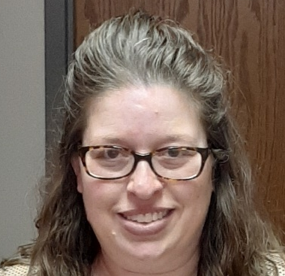
The COM CAR Summer Speaker Series
Supported by an award from the Center for Clinical & Translational Science & Training
Thank you to Jen Rowe for planning assistance.

Slide 5
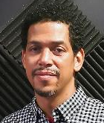
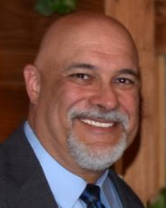
The COM CAR Summer Speaker Series
Special thank you for operational assistance from:
Jermaine Fields – UC IT User Interface and User Experience Developer
Todd Schutter - Multi-Media Coordinator, UC Information Technology

Slide 6
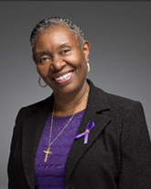
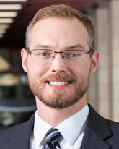
The Perfect Storm: Examining the Associations Among Alcohol Use and Intimate Partner Violence in the Age of COVID-19
Rev. Etta Caver, MSW
DeCoach Recovery Centre
Joel Sprunger, PhD
University of Cincinnati

Slide 7
Rev. Etta Caver, MSW
DeCoach Recovery Centre

Slide 8
Learning Objectives
Summarize the characteristics and complex issues of intimate partner violence (IPV) receipt/perpetration as they relate to alcohol/substance use.
Articulate the decision-making of a person experiencing violence when alcohol is involved.
Describe the leading theory/mechanisms underlying alcohol-facilitated IPV perpetration.
List resources and treatment programs available for those who perpetrate/receive IPV and alcohol/substance use disorders.

Slide 9
Issues of Intimate Partner Violence (IPV)
The National Commission on COVID-19 and criminal justice shows an increase in the U.S. by a little over 8 percent, following the imposition of lockdown orders in 2020. Jun 29, 2022
COVID-19-related stress and alcohol consumption at home, specifically, increased the risk of physical IPV since March 2020 (Chalfin et al., 2021; Parrott et al., 2022).
Rates of disagreement and verbal fighting increased since March 2020 even among couples with strong dyadic coping skills (Lee et al., 2021).
In Butler County, 911 calls to the sheriff’s dispatch center for domestic disturbances increased almost 40 percent, and officials say stay-at-home orders could be a factor (Journal News).
Resources were not readily available because of shutdowns.

Slide 10
Characterizations of IPV
Before exploring the relationship between alcohol use and IPV, it is important to describe what partner violence is…
Characterizations of IPV performed by a current or former intimate partner are physical, verbal, stalking, and sexual violence, forms of dominating and controlling, and psychological aggression (Center for Disease Control and Prevention, 2016).
Compared with men, women are disproportionately exposed to chronic types of intimate partner violence (IPV), (Kessler, Molnar, Feurer, & Appelbaum, 2001; Jones, Hughes, & Unterstaller, 2001).

Slide 11
Characterizations of IPV
The risk of injury from physical aggression is greater for female partners (Cascardi, Langhinrichsen, & Vivian, 1992).
According to the Bureau of Justice Statistics, 1998b, a survey of the victimization experiences of the U.S. population indicated nearly one million female victims of IPV each year.
There is extensive theoretical and empirical evidence linking substance misuse, particularly alcohol misuse, and male-to-female intimate partner violence (Leonard, 1993, 2001).

Slide 12
Alcohol Use in Survivors
Alcohol use in women research, has found significant relationships between coping motives and alcohol consumption (Grayson & Nolen-Hoeksema, 2005; Schuck & Widom, 2001; Ullman, Filipas, Townsend, & Starzinski, 2005).
Alcohol use by a victim of IPV appears to increase blame directed toward her (Home, 1994; Stewart & Maddren, 1997).
The victim may have increased her vulnerability by drinking alcohol which may increase her inability to escape or defend herself.
Afraid of seeking help, not knowing available resources, believing
abuser’s threats, having been in the relationship too long.

Slide 13
Survivors’ Decision Making
The criminal justice system of mandating perpetrators to traditional domestic violence treatment has little or no effect
Participation in programs/treatments by perpetrators may give survivors a false sense of security, only participating because they were mandated
  Could create a context for increased danger for survivor
The strongest predictor of women's decisions was whether or not their partners were in domestic violence and alcohol treatment
More than half of women victimized returned to their abusers if abusers had been involved in treatment (Gondolf, 2004; Babcock, Green, & Robie, 2004; Dunford, 2000).

Slide 14
Diversity Needed in Treatment
It is also important to gain a greater understanding of the role of alcohol and other drugs in both perpetration and victimization of IPV to guide intervention policies and treatment programs.
Treatment programs for batterers are standardized and uniformly applied to all violent men, treatment programs may not be addressing the needs of particular constituents. (Babcock et al, 2004; Eckhardt et al., 2013)
It is imperative to find means of improving batterer intervention outcomes.

Slide 15
Treatment Resources
DeCoach Recovery Center UC Health Addiction Sciences Clinics
www.decoachrehabctr.com/about-us/ Addiction Sciences | UC Health
3130 Dixie Hwy. 3131 Harvey Ave, Suite 101
Hamilton, Ohio 45015 Cincinnati, Ohio 45229
513-892-4673 513-585-8227
Other locations in the greater Cincinnati and Dayton areas
Modern Psychiatry and Wellness Community Behavioral Health
www.modernpsych.com www.Community-First.org/CBH
513-299-4053 513-887-8500
513-737-4603 FAX 513-737-8196 FAX
ACCESS Ohio Pathways for Life
www.acscounseling.com www.pathwaysohio.org
513-649-8008 513-591-9832
513-649-8004 FAX 513-297-7277 FAX

Slide 16
Resources for Victims
National Domestic Violence Hotline
1-800-799-7233
Women Helping Women
513-381-5610
Hamilton YWCA
1-800-618-6523
Butler County Courts Victim Assistance Program
513-887-3430
Ohio Domestic Violence Network: Home

Slide 17
Joel Sprunger, PhD
University of Cincinnati

Slide 18
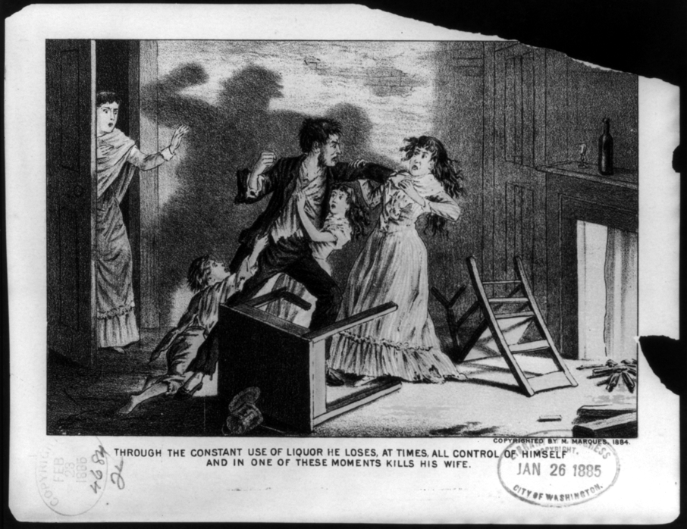

Slide 19
Acute Effects of Alcohol
Meta analysis:
Pooled data from 2566 participants in 22 studies involving experimental manipulation of alcohol on male-to-female aggression (d-units)
Crane, Godleski, Przybyla, Schlauch, & Testa, 2016

Slide 20

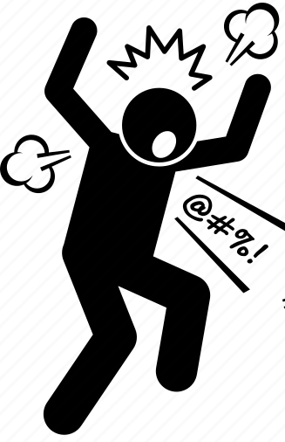
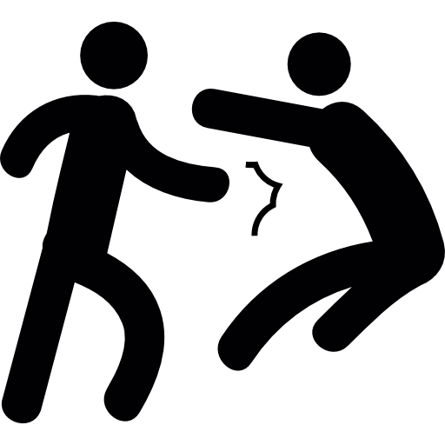

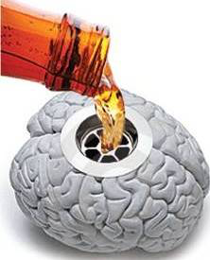


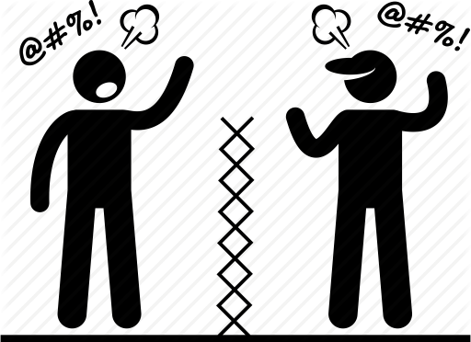

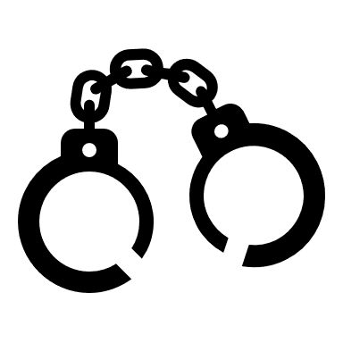

Alcohol & Behavior
Alcohol Myopia Theory
  Alcohol => attentional bias on salient cues
Eckhardt, Parrott, & Sprunger, 2017; Eckhardt, Parrott… & Sprunger, 2021; Giancola, Josephs, Parrott, & Duke, 2010; Steele & Josephs, 1990

Slide 21
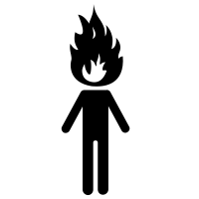
Attention Biases and IPV
Beach
Table
Hate
Love
Chair
Eckhardt, Parrott… & Sprunger, 2021; Birkley & Eckhardt, 2015; Cohen, Eckhardt, & Schagat, 1998; Eckhardt & Cohen, 1997; Smith & Waterman, 2004

Slide 22



AMT-informed Intervention
Intoxicated, self-aware people were less aggressive than intoxicated control
β = -0.29, p < .01
Gallagher & Parrott, 2016

Slide 23
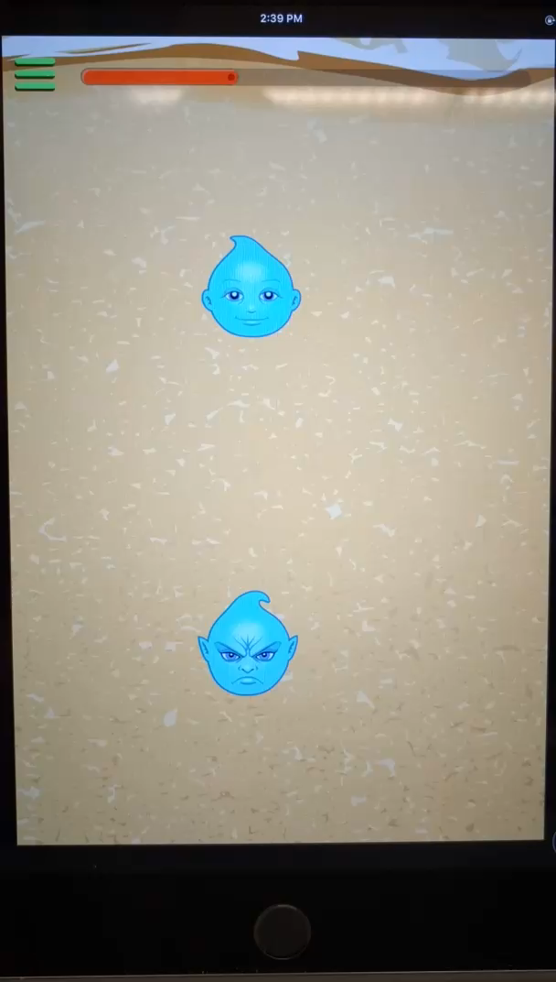
AMT-informed Intervention
Dennis & O’Toole, 2014

Slide 24
Hypotheses
H_{1:} ABMT will reduce the anger-related aggression bias as indicated by:
    Lower response latency
    Reduced dwell time on aggressive cues
H_{2:} ABMT will reduce the influence of an aggression bias on IPV as indicated by:
    Sound blast intensity & duration
    Aggressive statements toward partner

Slide 25
Variable | Index | Partner
Mean (SD) Age | 24.07 (5.09) | 24.68 (6.26)
Male (%) | 57.1 | 42.9
Race (%)
African American Asian White More than one race | 3.6 5.8 82.1 7.1 | -- 7.4 92.6 --
Non-Hispanic or Non-Latino (%) | 96.3 | 92.9
Marital Status (%)
Single (never married) Not married/living with partner Married | 67.9 25.0 7.1 | 82.1 7.1 10.7
Mean (SD) Months in Relationship | 28.37 (23.48) | 28.93 (23.28)
Mean (SD) Years of education | 16.57 (1.92) | 16.54 (1.41)
Annual Income (%)
$0 - 20,000 $20,001 - 50,000 $50,001+ | 14.3 35.7 49.9 | 7.1 28.6 64.3

Slide 26
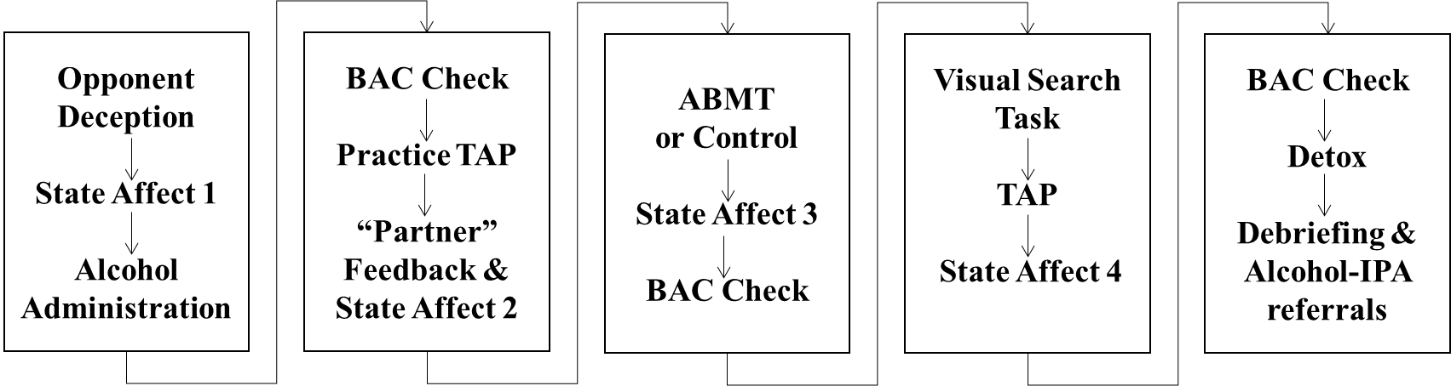
Overview of the Study Sessions
Session 1: Confirm eligibility; baseline attention bias assessment & questionnaires on IPV risk factors; determine “Index” participant
Session 2: Randomly assign to condition (ABMT = 11; Control = 17)

Slide 27
Visual Search Task – Aggressive Trial
WOUND
ATTACK
TABLE
X
TABLE
INSULT
Notes:
1920 x 1080 pixels with 120 Hz refresh rate. Target for 800 ms then disappeared for 16.7ms followed by presentation of the target. This was the same execution as Cohen et al., 1998.
Four blocks:
Practice – neutral target word + three neutral distractors (10 trials)
Neutral – neutral target word + three neutral distractors (50 trials)
Aggressive – neutral target word + three aggressive distractors (50 trials)
Positive – neutral target word + three positive distractors (50 trials)

Slide 28
Visual Search Task – Neutral Trial
BATON
MONTH
TABLE
TOOTH

Slide 29
Visual Search Task – Positive Trial
HAPPY
LUCKY
TABLE
SMILE

Slide 30

Visual Search Task – Example
Notes:
Quick example of the eye tracking version used

Slide 31
Overview of Study Procedures
Session 1: Confirm eligibility; baseline attention bias assessment & questionnaires on IPV risk factors; determine “Index” participant
Session 2: Randomly assign to condition (AMBT = 11; Control = 17)

Slide 32
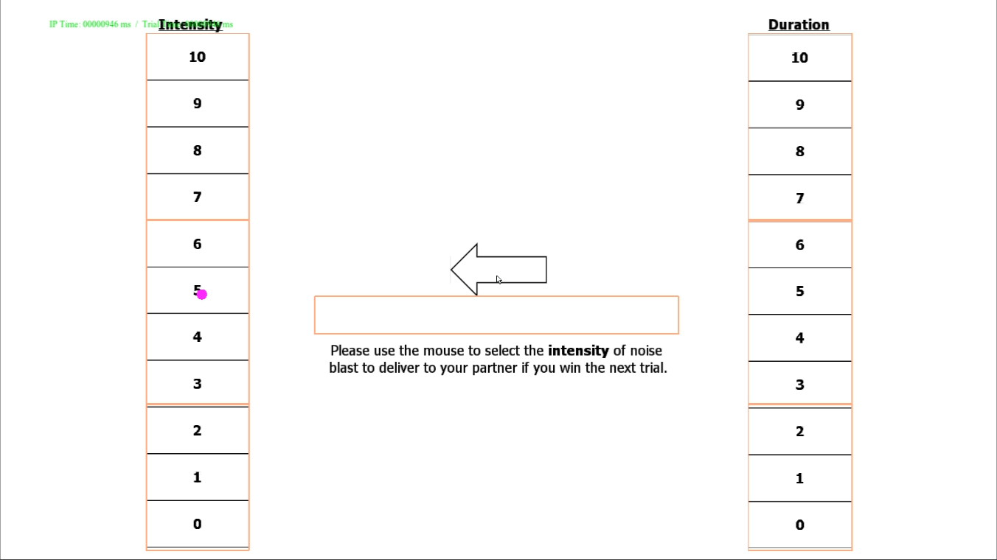
Physical Aggression Paradigm

Slide 33
Overview of Study Procedures
Session 1: Confirm eligibility; baseline attention bias assessment & questionnaires on IPV risk factors; determine “Index” participant
Session 2: Randomly assign to condition (ABMT = 11; Control = 17)

Slide 34
Results
H_{1:} ABMT will reduce the anger-related aggression cue bias as indicated by:
    Lower response latency
    Reduced dwell time on aggressive cues
  Hypothesis was supported

Slide 35
ABMT Reduces Anger-related RT Aggression Bias
(+) = is slower response with aggressive distractors
Anger-ABMT simple slope:
B = -15.83, SE = 6.33, 95% CI [-28.95, -2.70], t (22) = 2.50, p = .020

Slide 36
ABMT Reduces Anger’s Influence on Aggression Dwell Bias
(-) = greater % dwell on aggressive distractors
Anger-ABMT simple slope:
B = 0.20, SE = 0.35, 95% CI [-0.53, 0.93], t (24) = 0.57, p = .570
Anger-Control simple slope:
B = -0.91, SE = 0.27, 95% CI [-1.46, -0.35], t (24) = 3.35, p = .003

Slide 37
Results
H_{2:} ABMT will reduce the influence of an aggression attention bias to result in less IPV perpetration as indicated by:
    Sound blast intensity & duration
    Aggressive statements toward partner
  Hypothesis was not supported with pilot sample
  Physical IPV
  Condition r = .22, 95% CI [-.11, .54], p = .284
  Verbal IPV
  Condition r = -.07, 95% CI [-.41, .36], p = .753

Slide 38
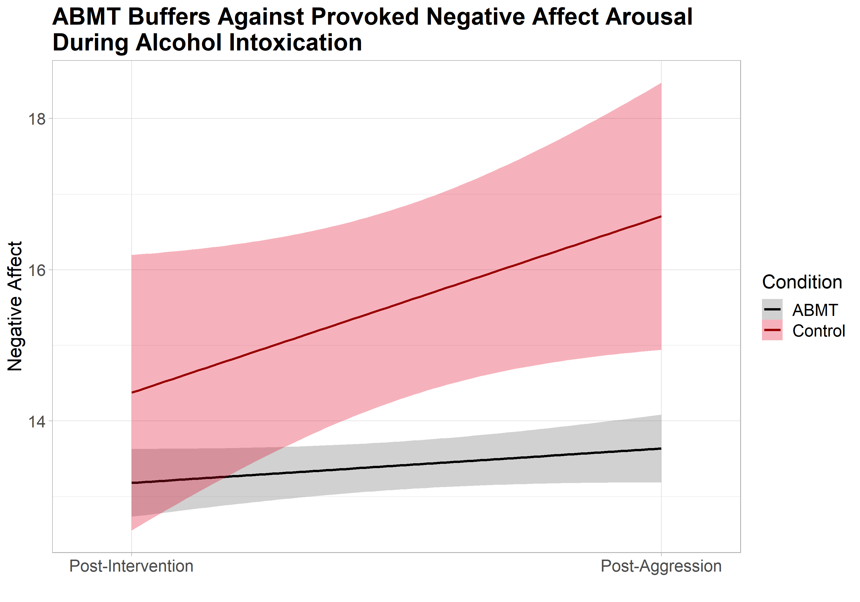
ABMT Buffers Against Provoked Negative Affect Arousal
Post-Intervention
Post-Aggression
ABMT effect at post-aggression:
B = -3.57, SE = 1.24, 95% CI [-6.13, -1.01], t(23) = 2.89, p = .008, ƞ² = .27

Slide 39
Discussion
The ABMT received support for reducing anger-related aggression biases:
  Reduced latency-based aggression bias for those high in anger problems
    Appears to be most effective for those at highest risk
  Eliminated the relationship between anger problems and time spent dwelling on aggressive distractors
    Suggests that the ABMT interrupts anger-related cognitive processes that direct attention toward aggression-related stimuli
  Buffered against provoked negative affect arousal during alcohol intoxication
The ABMT was not yet supported as an intervention for alcohol-facilitated intimate partner aggression—more data to come!
Dennis & O’Toole, 2014; Hakamata et al., 2010

Slide 40
Limitations
Study design omitted “no-alcohol” or “placebo” conditions
Recruited sample may not be “highest-risk”
  Certainly, at-risk for IPV perpetration
To understand the role of cognitive biases and attention toward aggression cues in IPV perpetration, a high-risk sample is necessary
  May have fewer protective factors that may alleviate the need for biased information processing

Slide 41
Thanks!
National Institute for Alcohol Abuse and Alcoholism
  F31-AA-024051 (PI Sprunger) Randomized controlled trial of an attention-based interventions for alcohol-facilitated intimate partner violence

Slide 42
Q&A
Please unmute to ask a question OR type your question in the chat box.

Slide 43
Thank you for joining us!
Please take a few moments to complete
the survey form. The survey link is provided
in the chat box and will also be emailed.
The form is required to complete if requesting CE credit for Psychology, Social Work, or Counseling.

Slide 44


Examining Substance Use Around the Timing of Pregnancy from a Health Equity and Patient-Centered Perspective
Wednesday, August 9, 2023: 12:00 – 1:00 PM
Nichole Nidey, PhD & Tara Cain
Registration website: med.uc.edu/institutes/CAR/summer-speaker-series/speaker-series-2023

