Slide 1
UC College of Medicine Center for Addiction Research (CAR)
Summer Speaker Series
Sponsored by: Center for Clinical & Translational Science & Training
June 14, 2023
12:00 – 1:00PM
This event is being recorded.
Participants can enable captions in the taskbar under more.

Slide 2
Center for Addiction Research (CAR)
The CAR was launched in October of 2020
Mission: to support cross-disciplinary collaborations across UC as well as with community partners, governmental institutions, and other academic institutions in order to accelerate scientific progress in addiction prevention and treatment
Twenty-nine faculty from five UC Colleges
CAR Website: https://med.uc.edu/institutes/CAR/home

Slide 3
CAR Website
Publications: https://med.uc.edu/institutes/CAR/publications
Projects:
https://med.uc.edu/institutes/CAR/projects
Communications:
https://med.uc.edu/institutes/CAR/communications
To become an affiliate member:
https://med.uc.edu/institutes/CAR/car-member-registration

Slide 4

The COM CAR Summer Speaker Series
Supported by an award from the Center for Clinical & Translational Science & Training
Thank you to Jen Rowe for planning assistance.

Slide 5


The COM CAR Summer Speaker Series
Special thank you for operational assistance from:
Jermaine Fields – DTS User Interface and User Experience Lead
Todd Schutter - Multi-Media Coordinator, UC COM Information Technology

Slide 6



Addressing Substance Use Among Youth in Foster Care: Implementation and Evaluation of Screening, Brief Intervention, and Referral to Treatment (SBIRT) in a Foster Care Clinic
Shauna P. Acquavita, PhD
University of Cincinnati
Mary Greiner, MD, MS
CHECK Foster Care Center
Sarah Beal, PhD
CHECK Foster Care Center

Slide 7
Shauna P. Acquavita, PhD, MSW
Professor
Director of the School of Social Work
College of Allied Health Sciences
University of Cincinnati

Slide 8


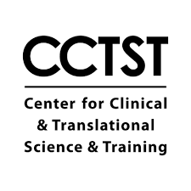







Acknowledgments
Colleagues
Jackie Unkrich, MSW
Katie Nause, BS
CHECK Lab
Grant Number 1H79TI084035-01
The views and opinions contained in the presentation do not necessarily reflect those of SAMHSA or the U.S. Department of Health and Human Services and should not be construed as such.

Slide 9
Learning Objectives
Understand the unique considerations of the SBIRT program for adolescents in foster care.
Describe the process for integration of a new substance use program into an existing medical clinic, including challenges and solutions to improve workflow and clinical care delivery.
Recognize the impact of integration of SBIRT on the population of youth in foster care receiving medical care at a foster care clinic.

Slide 10
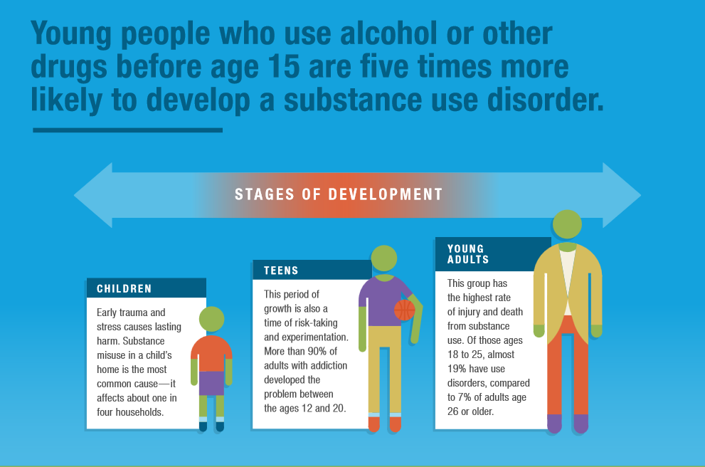
Source: Adapted with new prevalence estimates from: Identifying Early Warning Signs: Addressing youth substance use, Conrad Hilton Foundation. Retrieved from https://www.hiltonfoundation.org/learning/substance-use-prevention-infographic
This group has the highest rate of injury and death from substance use. Of those ages 19 to 25, 24.% have a substance use disorder in the past year, compared to 14% of adults 26 or older.
This period of growth is also a time of risk-taking and experimentation. More than 90% of adults with substance use disorder developed the problem between ages 12 and 20.
Notes:
Alcohol is the drug of choice among youth; often first tried and used the most.
Adolescent drinking often results in unintentional injuries & death; suicidality; aggression and victimization, STDs & pregnancies, academic & social problems.
Drinking in adolescence is associated with increased risk for alcohol dependence later in life.
2020 Monitoring the Futures Data
25.6% of 8th graders, 46.4% of 10th graders, and 61.5% of 12th graders used alcohol in their lifetime
New 2020 NSDUH Data:
8.2% (or 2.1 million) adolescents ages 12-17 drank alcohol in the past month
4.1% (or 1.0 million) adolescents aged 12-17 binge drank in the past month
6.3% of adolescents aged 12-17 had a substance use disorder in the past year (2020)
Reference: https://www.samhsa.gov/data/sites/default/files/reports/rpt35325/NSDUHFFRPDFWHTMLFiles2020/2020NSDUHFFR1PDFW102121.pdf
INFOGRAPHIC REFERENCES
Teens- https://www.addictioncenter.com/addiction/addiction-statistics/
Young Adults- https://www.samhsa.gov/data/sites/default/files/reports/rpt35325/NSDUHFFRPDFWHTMLFiles2020/2020NSDUHFFR1PDFW102121.pdf

Slide 11
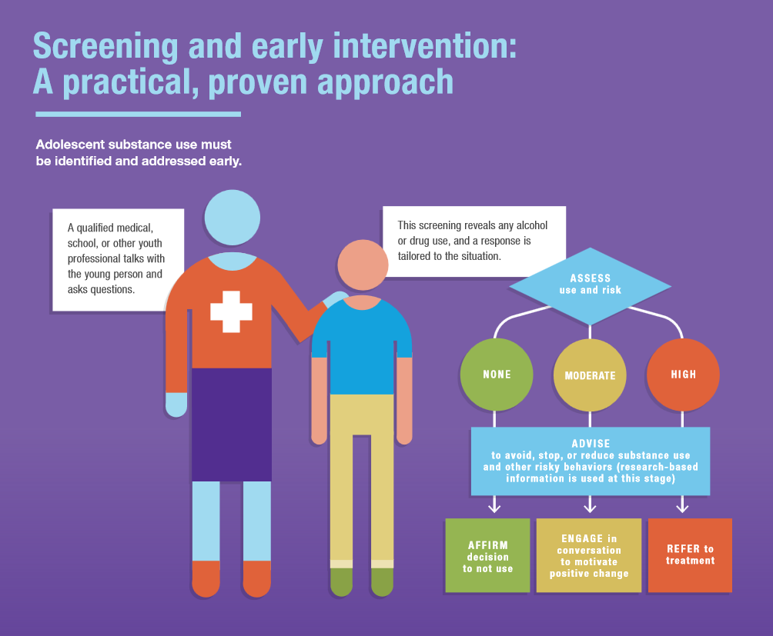
Source: Identifying Early Warning Signs: Addressing youth substance use, Conrad Hilton Foundation. Retrieved from https://www.hiltonfoundation.org/learning/substance-use-prevention-infographic

Slide 12

What is SBIRT?
SAMHSA defines SBIRT as a comprehensive, integrated, public health approach to the delivery of early intervention and treatment services for persons with substance use disorders, as well as those who are at risk of developing them.
SBIRT stands for:
  Screening
    Assess degree of risk
  Brief Intervention
    Brief clinical encounters using motivational interviewing
  Referral to Treatment
    Warm hand-off and linkage to care
Image source: ttp://cdn1.theodysseyonline.com/files/2015/12/04/6358485971345819511687691775_package.jpg
Notes:
SBIRT is an evidence-based practice used to identify, reduce, and prevent risky, excessive, unhealthy and harmful use of alcohol, tobacco and other substances. The Substance Abuse and Mental Health Services Administration (SAMHSA) defines SBIRT as “a comprehensive, integrated, public health approach to the delivery of early intervention and treatment services for persons with substance use disorders, as well as those who are at risk of developing these disorders.”¹ Through this practice, practitioners work to identify substance use that increases the risk of physical and emotional health problems, disease, and injury as well as school, work, family and social problems, and help to reduce its impact. SBIRT practice involves quickly screening people and using this information to assess degree of risk, conducting a brief intervention designed to help motivate them to change their behavior, typically organized around Motivational Interviewing (MI), and referring them to treatment or other services, if necessary.
SBIRT is an effective and efficient set of services, which can be integrated into a range of health care and related settings beyond substance use specific services . Though individuals may not self-identify or are not seeking treatment for substances specifically, alcohol and other drugs may still play a role in other issues and should be addressed.
SBIRT is used in integrated primary and behavioral health care settings (e.g., patient-centered medical homes); outpatient primary care clinics; hospital emergency departments, trauma centers, and inpatient psychiatric units; federally qualified health centers; community mental health centers; criminal and juvenile justice settings; college/university counseling and health centers; school-based health clinics; dental clinics; HIV clinics; homeless shelters; peer and recovery support programs; faith-based settings; military healthcare and the Veterans Administration; addiction and mental health counseling; employee assistance programs; and other settings.

Slide 13
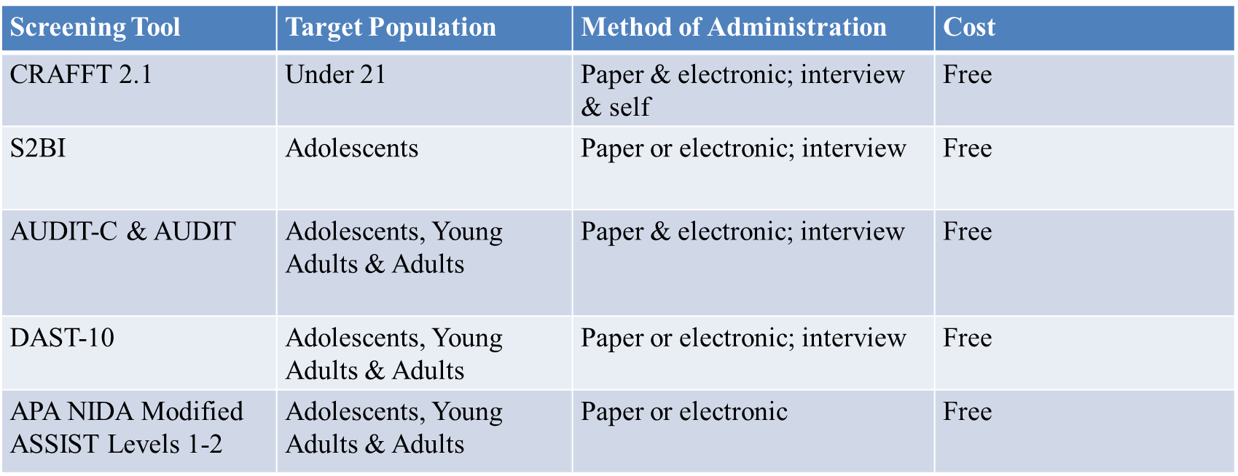
Adolescent Screening Tools (NORC, 2021)
Notes:
Here are some of the most common screening tools that are free to use and can be administered in multiple formats.
With self-administered screening, it is important to inform the adolescent and parent/caregiver (if present) that the adolescent should complete the form on their own. The clinician would then review and verify self-administered responses during the visit.
Adolescents may feel more comfortable and provide more accurate responses using self-administered brief screening due to the sensitive nature of the topic.
Electronic screening may be especially ideal because of the sense of privacy it confers, the widespread use of digital communication, and the tendency of adolescents to self-disclose quite freely via digital communication.
When an adolescent is responding to screening questions in a language other than English, self-administered screening may also be more feasible and efficient. However, when there is concern about reading comprehension or literacy, staff or clinicians must be more involved to assist the adolescent and may need to administer the screening verbally.

Slide 14
CRAFFT 2.1
The CRAFFT family of tools are the most popular substance use screening tools for youth.
  American Academy of Pediatrics’ Bright Futures Guidelines recommends the CRAFFT for use in preventive care screenings and well-visits.
  Designed to ask age-appropriate questions related to alcohol, drug, and nicotine use, and screens for lifetime substance use disorder.
Notes:
The CRAFFT family of tools have been extensively validated and are the most popular substance use screening tools for adolescents age 12-21.
The tool is designed to ask age-appropriate questions about problems related to alcohol, drug, and nicotine use.
It also screens for lifetime substance use disorder.
It is brief so that it can be easily integrated into routine care.

Slide 15
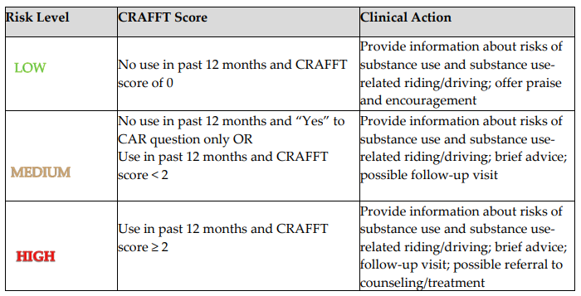
Determining Risk Level & Next Step
Notes:
2018- https://crafft.org/wp-content/uploads/2018/08/FINAL-CRAFFT-2.1_provider_manual_with-CRAFFTN_2018-04-23.pdf
Low Risk : Adolescents who report no use of tobacco, alcohol, or other substances in the past 12 months and report that they have not ridden in a car with a driver who has been using any substances.
Medium Risk: Adolescents who report no use in past 12 months AND report only that they have ridden in a car with a driver who has been using any substances (i.e., the CAR question) OR they report they have used in the past 12 months and CRAFFT score < 2.
High Risk: Adolescents who report use of substances in the past 12 month and CRAFFT score ≥2.

Slide 16
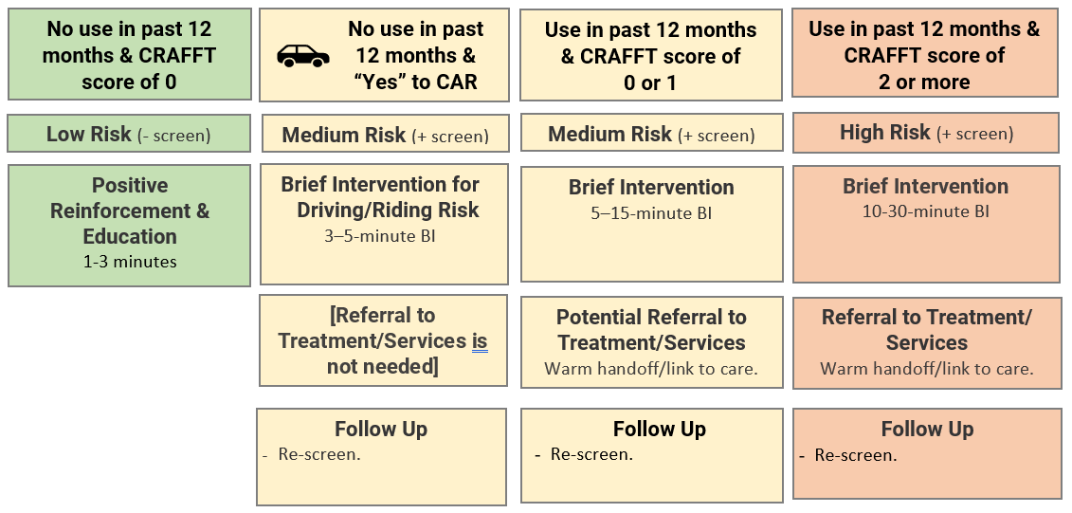
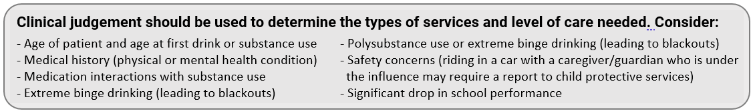
Screening Workflow & Response:
Substance Use Risk Level Based on the CRAFFT+N 2.1 HONC:
A full version of the SBIRT Workflow diagram is available here
Notes:
This diagram provides a high-level overview of the response workflow based on the screening results. A full version of this workflow diagram is available on the CHECK Foster Project webpage: https://www.sbirteducation.com/CHECKfostercare
Here is a direct link to the workflow diagram: https://uploads.documents.cimpress.io/v1/uploads/eb15636e-5740-4597-9219-649389cf444e~110/original?tenant=vbu-digital

Slide 17
Brief Intervention: The Next Step
Short conversation or counseling session (5-15 minutes), rooted in motivational interviewing
Often focuses on barriers and benefits to changing behavior
Assesses readiness to change behavior
CHECK uses the Brief Negotiated Interview (BNI) model used by BNI-ART Institute at the Boston University School of Public Health.
The BNI-ART Institute website (www.bu.edu/bniart) offers supplemental resources in the public domain.
Notes:
Brief Intervention is defined as: a behavioral change strategy that is short in duration and that is aimed at helping a person reduce or stop a problematic behavior.
Motivational Interviewing is defined as: a communication method that is focused on the adolescent or young adult’s concerns and perspectives and works to enhance their internal desire, willingness and ability to change by exploring and resolving co-existing and opposing feelings about changing.
For those of you who are familiar, you’ll see that the elements of MI are infused in the Brief Negotiated Interview Model (BNI) of Brief Intervention which we will discuss next. It can take as little as 1 minute for someone at no or low risk; range from 5-30 minutes for those at moderate or high risk; or stretch to one or several full-length sessions for those at high-risk. Usually, brief interventions (BIs) immediately follow screening. Multiple BIs may be more effective than a single BI.
The BNI model has a specific algorithm that is followed.

Slide 18
Refer to Treatment
A small percentage of adolescents will require treatment beyond a brief intervention (or a few brief interventions).
Younger → Shorter histories of substance use → adverse consequences of use less likely → Less incentive to change or begin treatment
Adolescents have a harder time recognizing their behavior patterns than adults and are less likely to seek treatment on their own compared to adults.
  They must agree to participating in treatment for it to be successful.
Motivational Interviewing strategies are key to encouraging acceptance of a referral to treatment.
Notes:
Let's begin by talking about general issues pertaining to referring adolescents for treatment of a substance use problem?
A small percentage of adolescents will require a level or intensity of treatment beyond that of which the practitioner may be able to provide from a brief intervention.
Those adolescents may be referred to a specialty treatment facility that offers residential and/or outpatient treatment programs. Adolescents who enter treatment are referred from a variety of sources.
Unless under a court-ordered mandate, the adolescent must be agreeable to participating in treatment. How the practitioner broaches and discusses referral contributes to the likelihood of successful treatment.
In contrast to adults, adolescents are less likely to feel that they need help or seek treatment on their own.
Developmentally, adolescents have a harder time recognizing their own behavior patterns than adults. Adolescents have shorter histories of substance use and therefore are unlikely to have experienced as many adverse consequences from their substance use, compared to adult users. Fewer adverse consequences can mean less of an incentive to change or to engage in any type of intervention or treatment.
Engaging adolescents requires patience, and an open and empathetic therapeutic stance. Whereas these are important facilitator skills when working with all clients, the challenges of building rapport with an adolescent client are such that patience is a most vital principle.

Slide 19
Mary Greiner, MD, MS
CHECK Foster Care Center

Slide 20
On any given day, ~390,000 children in foster care in the US
  0.5% of the US population of children
Over 1 year, count is ~606,000 children
  1% of the US population
Children’s Bureau, 2021

Slide 21
Youth in foster care are known to face greater health and social risk than the general population
Multiple federal, state, and local policies manage administration of child welfare, supporting child health
Specific to health, children are federally required to interact with healthcare systems at entry, annually thereafter
  States and counties can further expand these requirements
  Compliance audited through review process
Healthy Foster Care America, 2021; Children’s Bureau, 2020

Slide 22
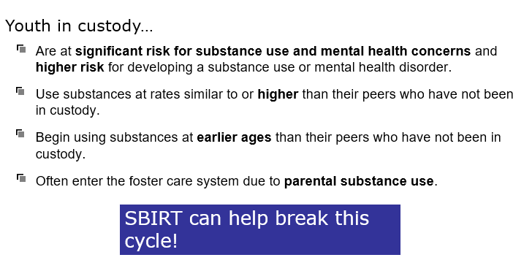

Slide 23



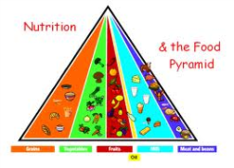




Comprehensive Health Evaluations for Cincinnati’s Kids
A center of community collaboration to meet the multi-disciplinary needs of children in or at risk for child welfare involvement
Mission: To optimize the wellbeing of all children and youth with child welfare involvement, in the areas of medical, dental, developmental, and mental health from birth to transition to adulthood.
Contractual partnership with Children’s Services
Use research to identify risks for this population, evaluate solutions, and make evidence-based recommendations

Slide 24



Screening, Brief Intervention and Referral to Treatment (SBIRT) is one of the leading ways to help reduce the impact of alcohol, marijuana, tobacco/vaping, and other substance use.
Referral to Treatment and Follow-up
Linking the youth to specialized substance use disorder treatment and other services, resources, and supports and regularly checking in to facilitate sustained access.
Screening
Process of identifying youth who are at risk of negative consequences due to their substance use, including risk of a substance use disorder.
Brief Intervention
A conversation that is
intended to prevent, stop, or reduce substance use.
Notes:
Screening, Brief Intervention, and Referral to Treatment (SBIRT) is an evidence-based practice used to identify, reduce, and prevent any use of alcohol, marijuana, tobacco/vaping, and other substances.
The Substance Abuse and Mental Health Services Administration (SAMHSA) defines SBIRT as “a comprehensive, integrated, public health approach to the delivery of early intervention and treatment services for persons with substance use disorders, as well as those who are at risk of developing these disorders.”
SBIRT is one of the leading ways to help reduce the impact of alcohol and other substance use and identifies potentially problematic substance use quickly. It can also be implemented in a variety of settings.
There are three core components of youth SBIRT.
Screening - the process of identifying youth who are at-risk of negative consequences due to their substance use, including risk of a substance use disorder.
Brief Intervention - a conversation that is intended to prevent, stop, or reduce substance use and increase motivation for behavior change. Brief intervention is typically organized around Motivational Interviewing (MI) principals and methods.
Referral to Treatment and Follow-up – linking youth to specialized substance use disorder treatment and other services, resources, and supports and regularly checking in to facilitate sustained success.

Slide 25
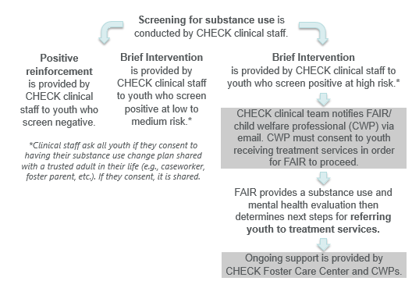
When providing ongoing support and care management, consider:
Age of the patient/age of first drink or substance use
Medical history (physical and mental health)
Safety concerns (history of driving or riding in a car with someone under the influence of alcohol/drugs)
Significant drop in school performance
Notes:
This slide highlights the back of the pocket card for child welfare professionals. It includes information about “What is SBIRT?” as well as the CHECK Foster Care SBIRT workflow and how child welfare professionals can support youth in custody and provide ongoing care in this process.
At the bottom of the pocket card, a link to the SBIRT CHECK Foster Care Project webpage is included for child welfare professionals to access, which houses a variety of SBIRT, and other substance use prevention resources for the CHECK Foster Care team.

Slide 26
Implementation Learnings
Understand risks
Plan intervention
Implement intervention
Evaluate outcomes
Refine
Repeat
Car question for children
who have experienced maltreatment
Missing nicotine
Confidentiality

Slide 27
Why SBIRT with youth in custody?
1. Promotes health and wellbeing both in the short- and long-term as youth transition to adulthood and/or out of foster care.
2. Promotes placement stability.
Preventing substance use before it begins or motivating youth to reduce or stop their use increases their chance of remaining at their current placement.
Prevents or reduces risk of:
Harmful effects on the developing brain
Alcohol, tobacco, or other substance use disorders
Social problems
Physical & mental health concerns
Risky sexual behaviors
Injuries and accidents
Financial and legal issues
Job challenges
3. Promotes educational outcomes and employment stability in the long-term.
Increases the likelihood of:
Remaining in and finishing high school as well as attending or graduating from college
Job opportunities and employment stability
Notes:
Why use SBIRT with youth in custody?
Through SBIRT, practitioners identify and intervene to prevent, reduce, or stop substance use which can decrease the risk of physical and emotional health problems, disease, and injury as well as school, work, family, and social problems.
1. SBIRT promotes youth health and wellbeing in both the short- and long-term as youth transition to adulthood and/or out of custody.
SBIRT prevents or reduces risk of:
Harmful effects on the developing brain
Substance use can have lasting effects on the developing brain of youth, therefore, all use is considered “at risk.” Youth who drink heavily experience impaired memory, attention and quick importation processing, and executive functioning. Youth who use marijuana may exhibit decreases in cognitive functioning, particularly learning and sequencing. Even though individuals over 18 are considered legal adults, it is important to remember that their brain, including the prefrontal cortex, which is responsible for making decisions, is not fully developed until age 25. When the prefrontal cortex is not fully developed, adolescents and young adults may make riskier choices which can be confounded by substance use. Asking about substance use through screening and discussing its impact can prevent many harmful effects to the youth’s developing brain and potential future.
Alcohol, tobacco, or other substance use disorders
According to the American Academy of Pediatrics, any amount of alcohol and/or drug use by youth is considered at-risk use because they are particularly vulnerable to developing substance use disorders. The younger one is when they initiate substance use, the more likely they are to develop a substance use disorder in their lifetime.
Social problems (problems at school and with relationships with peers, family, friends)
Physical health concerns (learning and memory problems, weakened immune system, high blood pressure, development of chronic diseases like cancer)
Mental health concerns (anxiety and depression, increased risk for suicide)
Risky sexual behaviors (unprotected sex, unintended pregnancy, or sexually transmitted diseases)
Injuries and accidents (motor vehicle accidents, falls, drowning)
Financial and legal issues (driving under the influence)
Job challenges (job loss, unemployment, decreased productivity)
2. SBIRT promotes placement stability for youth in custody.
Behavioral challenges among youth in custody are often the main reasons for placement changes. Other challenges like criminal law involvement/legal issues, clinical diagnoses of emotional disturbance, diagnoses of Fetal Alcohol Spectrum Disorder (FASD), and other additional medical diagnosis have also been shown to lead to greater placement instability. All of which can be exacerbated and negatively influenced by substance use. By preventing substance use before it begins or motivating a youth in custody to reduce or stop their use, they will have a better chance of remaining at their current placement.
For children and youth who enter out-of-home care with special physical, behavioral, and emotional needs, a focus on placement stability is critical. One study found that children with multiple placements had between 36-63% greater risk of developing behavioral challenges than children in stable placements. On the other hand, placement instability is also a contributor to substance use and risky sexual behaviors in young adulthood. As the number of placements increases, the more likely it is that a child will experience future placement disruptions.
3. SBIRT promotes education achievement and employment stability in the long term and as youth age out of being in custody.
We know that youth who delay or do not use alcohol and other substances have more positive experiences and success in school and are more likely to graduate from high school and/or college. In addition, they are also likely to have more job opportunities and long-term employment stability.
References:
Centers for Disease Control and Prevention (CDC). Alcohol Use and Your Health. Retrieved from: https://www.cdc.gov/alcohol/fact-sheets/alcohol-use.htm
Julia Wedeles. Practice and Research Together (PART): Placement in Stability in Child Welfare. Retrieved from https://www.oacas.org/wp-content/uploads/2016/08/PARTicle-Placement-Stability-in-Child-Welfare-FINAL.pdf
Barth., R. P., Lloyd, E. C., Green, R. L., James, S., Leslie, L. K. & Landsverk, J. (2007). Predictors of placement moves among children with and without emotional and behavioral disorders. Journal of Emotional and Behavioral Disorders, 15(1): 46-55.
Stott, T. (2012). Placement instability and risky behaviors of youth gaining out of foster care. Journal of Child and Adolescent Social Work, 29: 61-83.
Wells, R. & Chuang, E. (2012). Does formal integration between child welfare and behavioral health agencies result in improved placement stability for adolescents engaged with both systems? Child Welfare, 91(1): 79-100.
US Department of Education. 2016. Students in Foster Care. Retrieved from: https://www2.ed.gov/about/inits/ed/foster-care/index.html
Casey Family Programs. (2018). What impacts placement stability? Retrieved from: https://www.casey.org/placement-stability-impacts/#:~:text=Children's%20behavioral%20challenges%20are%20often,being%20separated%20from%20their%20families.

Slide 28
Sarah Beal, PhD
CHECK Foster Care Center

Slide 29
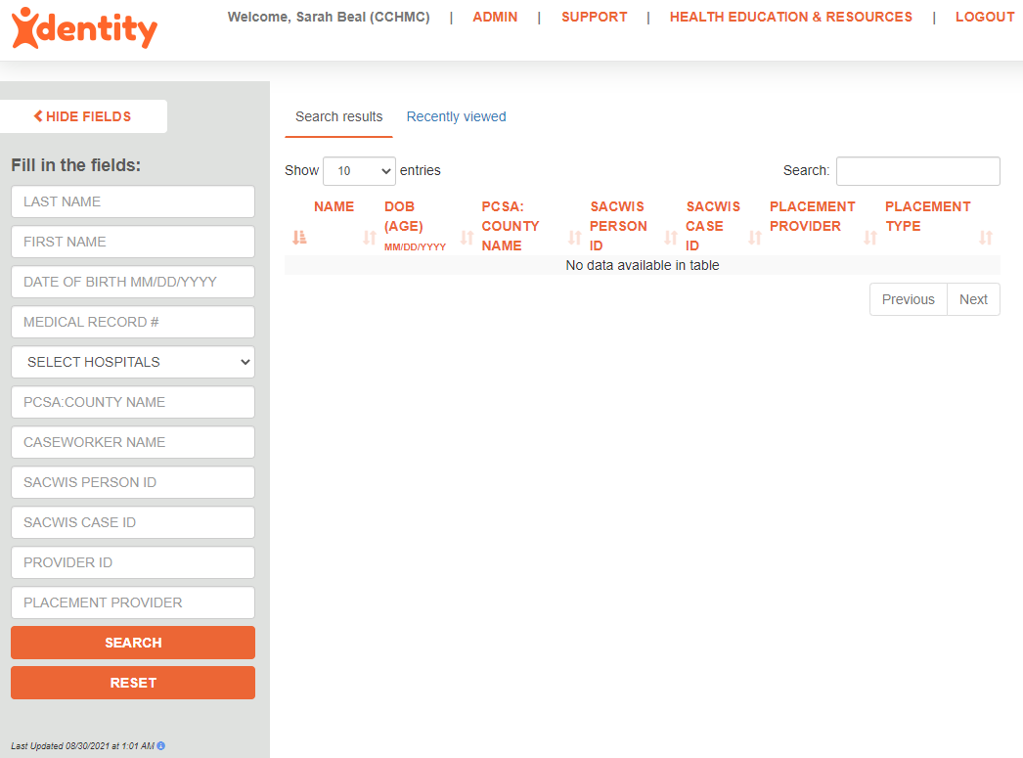
The CAREFul Study
Context
Child welfare
  County-administered
  ~2k children in custody
  Foster care to age 21
Healthcare
  Foster care consultation clinic
  Only inpatient provider
  Primary outpatient provider for specialty care, primary care

Slide 30
The CAREFul Study
Participants (N = 5574)
Foster Care (n = 2787)
In foster care > 1 day between 2012 and 2017
Linked medical record
  N = 25; 0.90% excluded
Ages 10-20, inclusive (M=15.3y, SD=2.7)
49% female
65% African American
Comparison (n = 2787)
Never in foster care
Seen for primary care ≥1x between 2012 and 2017
Medicaid Insurance
Ages 10-20, inclusive (M=15.3y, SD=2.7)
49% female
65% African American

Slide 31
The CAREFul Study
Measures
Child welfare database
In foster care during healthcare encounter
Age of first entry into foster care
Reasons for entry into foster care
Placement type
Placement stability
Electronic Medical Record
Healthcare encounters
  Type, Age
Diagnoses
Demographic data
Sexual risk behavior*
Substance use*
*Indicates unstructured and structured data were used

Slide 32
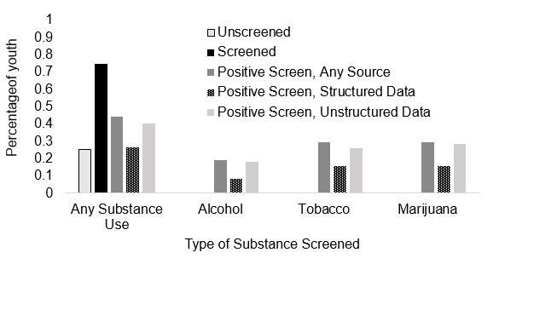
The CAREFul Study:
Screening for Substance Use
***
***
***
***
*** χ² value with p < .001

Slide 33
The CAREFul Study
Youth in the foster care cohort were 3x more likely to be screened for substance use than youth in the comparison cohort
  Most screening occurred at mandated visits
  No screenings at mandated visits resulted in treatment referral, diagnosis

Slide 34
The CAREFul Study
Similar patterns observed for alcohol and tobacco use
Model included other demographic, health, and mental health covariates

Slide 35
The CAREFul Study
Model included other demographic, health, and mental health covariates

Slide 36
The CAREFul Study
For youth ever in foster care:
Number of placements increased risk for any past year substance use (OR = 1.04, p < .01) and past year marijuana use (OR = 1.05, p < .01)
Placement in nonfamily settings increased risk for any past year substance use (OR = 1.12, p < .01) and marijuana use (OR = 1.14, p < .01)
Model included other demographic, health, and mental health covariates

Slide 37
The CAREFul Study
Substance use emerges earlier in adolescence, at higher frequency, more substances used for youth in foster care
  For younger adolescents, placement in foster care is protective in delaying substance use initiation
  For older adolescents, current foster care status is no longer relevant
  Placement stability and non-family settings are also differentially associated with risk for initiation of substance use, current substance use

Slide 38
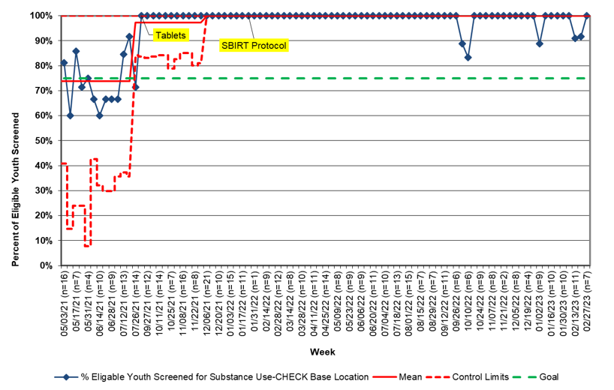
Early outcomes - screening
Goal: Increase the capacity of the CHECK Foster Care Center to screen youth in foster care for substance use and provide intervention and/or referral for treatment when appropriate.
Objective: 80% of all youth 10 and older presenting to the CHECK Center will be screened for substance use and risk for substance use disorder with the CRAFFT
Baseline (May 1 - July 31, 2021): 73% (N=85) of eligible patients were screened for substance use by a clinician. Since February 2022, 98% (N=580) of eligible patients were screened with the CRAFFT.

Slide 39
Standardized screening also reduces bias
With unstandardized screening, young people of color had 2x higher odds of screening for substance use than young people who were white. OR = 2.07, 95% CI = 1.43-2.99
  With standardized screening, odds of screening did not differ for young people of color and young people who were white. OR = 0.64, 95% CI = 0.12-3.53
Older adolescents were screened more often when screening was unstandardized
  OR = 1.34, 95% CI = 1.24-1.45
Unstandardized screening detected 99.2% less substance use than standardized screening
  OR = 0.008, 95% CI=0.004-0.020

Slide 40
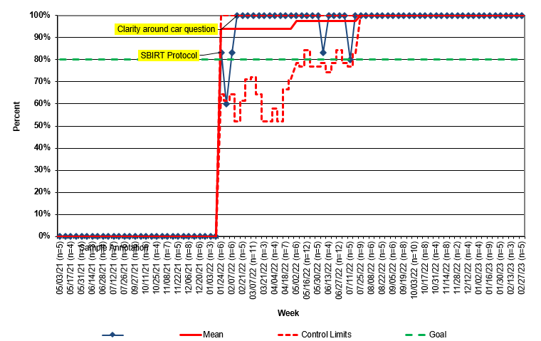
Early outcomes – brief intervention
Objective: 80% of all youth 10 and older presenting to the CHECK Center who screen positive on the CRAFFT or indicate substance use to a provider during their clinic visit will receive a brief intervention and/or referral to treatment.
93% (N=253) of eligible patients who screened positive on the CRAFFT or indicated substance use during their clinic visit received a brief intervention and/or referral to treatment.

Slide 41
Early outcomes –
Decrease substance use: Project EASY
Youth receiving SBIRT and in Hamilton County custody
78.3% enrollment rate (N = 141)
89.2% retention in follow-up at 30-day, 60-day, and 6-months

Slide 42
Project EASY
Young people report an average reduction of 3.6 days of use per month (n = 74 enrolled for 6 months)
  Number of days of use in the past 30 days is reduced from 13.5 at enrollment to 9.9 at the 6-month follow-up
65% of young people report abstaining from use at 6 months (n = 48) increased from 42%.

Slide 43
Substance Use Screening Resources

Slide 44
Screening Resources for Youth Substance Use
CHECK Foster Care Project Webpage
NORC at the University of Chicago SBIRT
  Adolescent SBIRT Curriculum
  4-Part On Demand Learning Series: Using SBIRT to Talk to Adolescents about Substance Use
Screening and Assessment Tools (NIDA)
Prevention Technology Transfer Center (PTTC) Great Lakes (HHS SAMHSA Region 5)
State specific resources:
  Ohio Mental Health and Addiction Services
  Ohio Minds Matter

Slide 45
Q&A
Please unmute to ask a question OR type your question in the chat box.

Slide 46
Thank you for joining us!
Please take a few moments to complete
the survey form. The survey link is provided
in the chat box and will also be emailed.
The form is required to complete if requesting CE credit for Psychology, Social Work, or Counseling.

Slide 47


The Perfect Storm: Examining the Associations Among Alcohol Use and Intimate Partner Violence in the Age of COVID-19
Wednesday, July 12, 2023: 12:00 – 1:00 PM
Joel Sprunger, PhD & Rev. Etta Caver, MSW
Registration website: med.uc.edu/institutes/CAR/summer-speaker-series/speaker-series-2023

