Slide 1
UC College of Medicine Center for Addiction Research (CAR)
Summer Speaker Series
Sponsored by: Urban Health Pathway of Next Lives Here
July 20, 2022
12:00 – 1:00PM
This event is being recorded.

Slide 2
Center for Addiction Research (CAR)
The CAR was launched in October of 2020
Mission: to support cross-disciplinary collaborations across UC as well as with community partners, governmental institutions, and other academic institutions in order to accelerate scientific progress in addiction prevention and treatment
Twenty-eight faculty from four UC Colleges
CAR Website: https://med.uc.edu/institutes/CAR/home

Slide 3
CAR Website
Publications: https://med.uc.edu/institutes/CAR/publications
Projects:
https://med.uc.edu/institutes/CAR/projects
Communications:
https://med.uc.edu/institutes/CAR/communications
To become an affiliate member:
https://med.uc.edu/institutes/CAR/car-member-registration

Slide 4
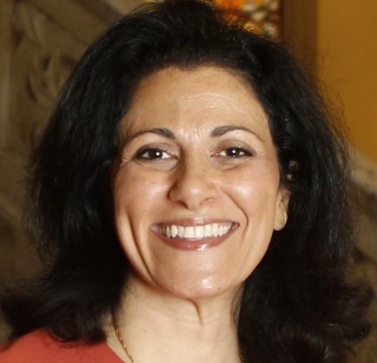
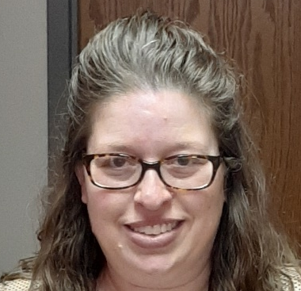
The COM CAR Summer Speaker Series
Sponsored by Urban Health Pathway of Next Lives Here
Thank you to the Planning Committee:
Dena Cranley
Jen Rowe

Slide 5
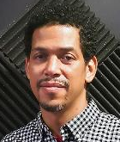
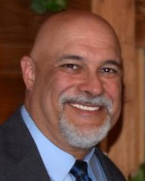
The COM CAR Summer Speaker Series
Special thank you for operational assistance from:
Jermaine Fields – UC IT User Interface and User Experience Developer
Todd Schutter - Multi-Media Coordinator, UC Information Technology

Slide 6
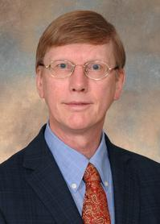
Development of a Recombinant Humanized Anti-Cocaine Monoclonal Antibody
Andrew B. Norman, Ph.D.
Professor
Pharmacology & Systems Physiology

Slide 7
Learning objectives
Understand the pharmacology of cocaine relevant to its abuse.
Identify the milestones necessary to complete a translational research project in the field of substance use disorders.
Understand the regulatory environment in which a translational research project must operate.
Learn how interactions with the FDA are vital for the transition from pre-clinical to clinical development of a drug.

Slide 8
Conflict of interest disclosure:
Dr. Norman is a co-inventor on US patents 9,758,593, 9,957,332 and 10,501,556 entitled “Compositions and Methods for Treating Cocaine-Related Disorders”

Slide 9
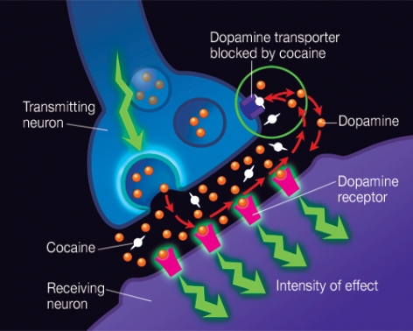
The mechanism of action of cocaine

Slide 10
Mechanism of antibody suppression of cocaine’s CNS effects
dopamine
transporter
dopamine
dopamine
receptor
mAb h2E2
Blood-Brain
Barrier
cocaine

Slide 11
Requirements for an Investigational New Drug (IND) application for a monoclonal antibody
Structural characterization.
Pharmacological characterization.
Lack of human tissue cross-reactivity in vitro.
Evidence for in vivo efficacy (decreases brain cocaine concentrations)
Establish a production system complying with Good Manufacturing Practices (GMP) regulations.
Lack of toxicity in animals.

Slide 12
Required properties of the antibody for use in relapse prevention
Safe:
  Not targeting an endogenous protein.
  Low immunogenicity.
Efficacious:
  High affinity for cocaine: K_{D} ~1 - 5 nM
  Specificity for cocaine over its inactive metabolites.
  Slow clearance (whole antibody).

Slide 13

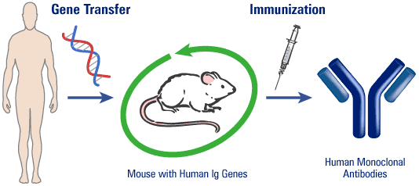
Generation of a human anti-cocaine monoclonal antibody
GenPharm International (owned by Medarex since 1998, acquired by Bristol-Meyers Squibb in July, 2009) developed proprietary HuMab-mouse™ transgenic lines containing the genes for the human γ1 heavy chain and κ light chain immunoglobulin proteins and the corresponding mouse genes deleted.

Slide 14
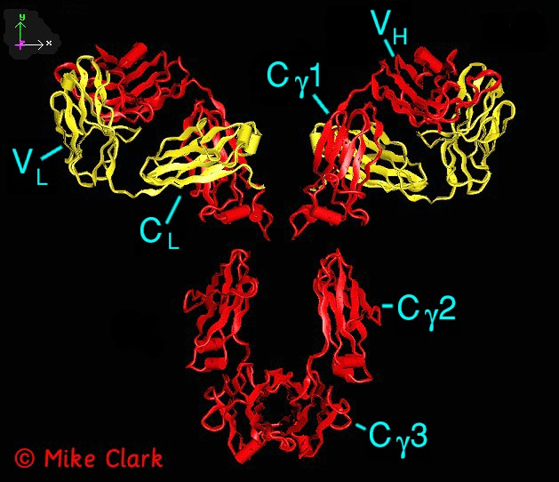
Structure of the reengineered anti-cocaine monoclonal antibody, h2E2.
HEAVY CHAIN (red):
Human γ1, VH3-07, DP-50 gene family.
Product of the HuMab transgene.
100% human sequence.
LIGHT CHAIN (yellow):
Human λ constant region (C_{L}) and murine variable region (V_{L}).
h2E2 has 95% overall sequence homology/identity with human IgG1.

Slide 15
Cocaine and its metabolites
H
C
H
O
3
N
+
CH₂CH₃
H
C
H
O
3
N
+
H
O
ethanol
O
O
O
O
O
cocaethylene
benzoylecgonine
H
+
O
N
CH₃
O
H
C
H
O
3
N
+
O
O
H
O
H
ecgoninemethylester
O
ecgonine
norcocaine

Slide 16
Relative binding affinity of h2E2 for cocaine and it’s metabolites
Metabolite | Relative Binding Affinity
Cocaine | 1
Cocaethylene | 0.6
Norcocaine | 8
Benzoylecgonine | 7
Ecgoninemethylester | 1,900
Ecgonine | 18,000

Slide 17
Pharmacokinetics of h2E2 (120 mg/kg or 1.6 µmol/kg i.v.) in mouse blood

Slide 18
The effect of h2E2 (1.6 µmol/kg) on the pharmacokinetics of cocaine (1.6 µmol/kg) in mice
Vehicle:
t_{1/2α} = 0.7 min; t_{1/2β} = 14.4 min
Vdss = 3.7 L/kg
h2E2:
t_{1/2α} = 3.4 min; t_{1/2β} = 10.3 min
Vdss = 0.1 L/kg
Vehicle:
AUC: 12100 (ng/g)·min
h2E2:
AUC: 660 (ng/g)·min (94% decrease)

Slide 19
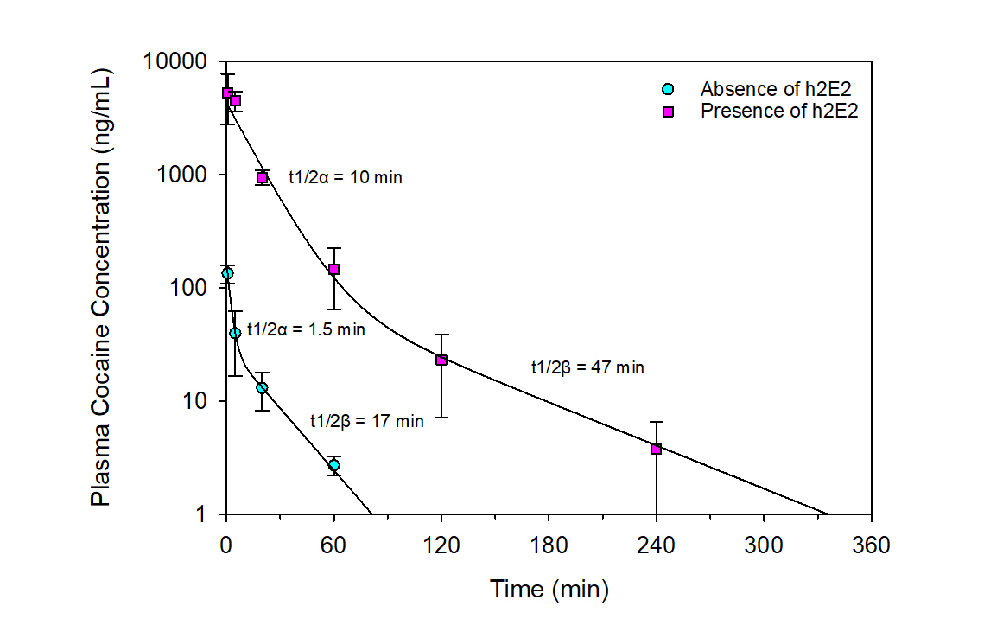
The effect of h2E2 on the pharmacokinetics of cocaine in rats

Slide 20
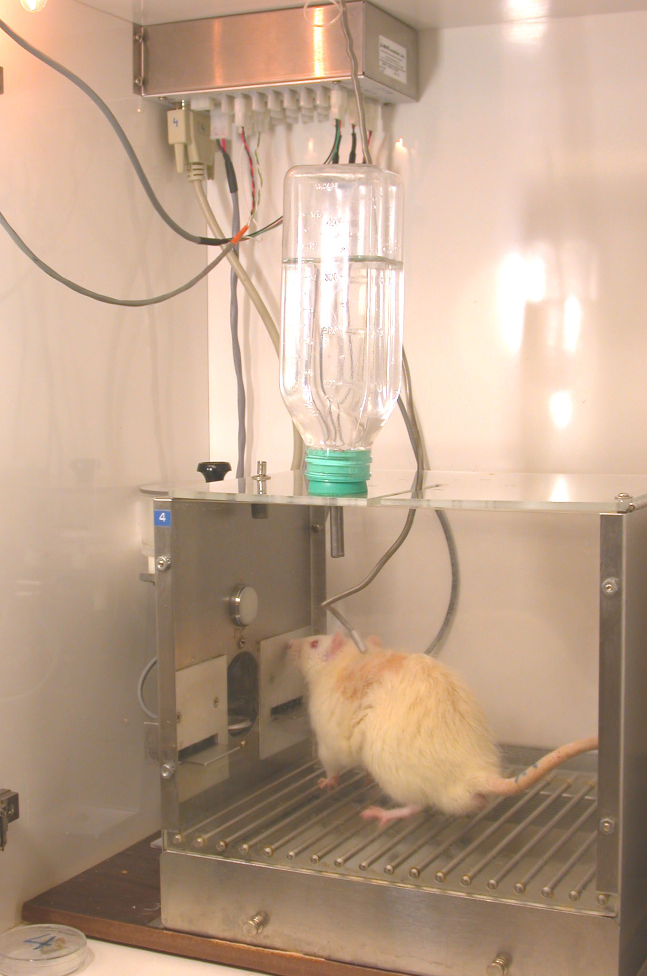

Slide 22
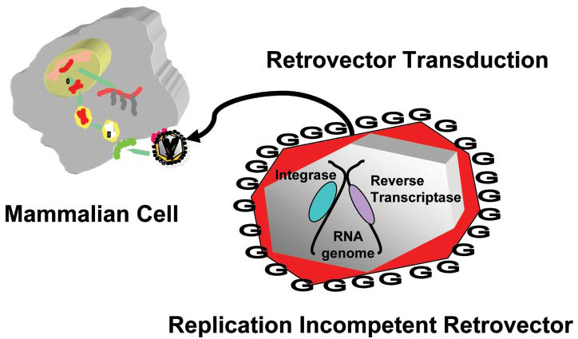
GPExTM (gene product expression) cell line engineering
From: Bleck, GT. An alternative method for the rapid generation of stable, high-expressing mammalian cell lines. Bioprocessing Journal September/October 2005; 1-7.

Slide 23
Overview of GPEx®: Catalent’s Antibody Production Platform Technology
LC Retrovector
Transduction
of Cells
HC Retrovector
Transduction
of Cells
Repeat
Transductions
to Increase
Gene Copy #
Limited Dilution
Cell Cloning
Clonal
Cell Line
Mammalian
Cell
Line
Pool of LC
Expressing
Cell Lines
Pool of Antibody
Producing
Cell Lines
Clonal
Cell Line
Selection
Process Development
and Optimization
Antibody
Production for
Screening (mg-grams)

Slide 25
Establishment of a Master Cell Bank and GMP production:
produced 65 grams of recombinant h2E2 for in vitro and animal toxicology studies.
2019. 50 L Engineering run:
>65 grams for additional high-dose (1,200 mg/kg) animal toxicology studies.
2019-2020. 250 L cGMP production:
325–500 grams for first-in-human clinical trials.

Slide 26
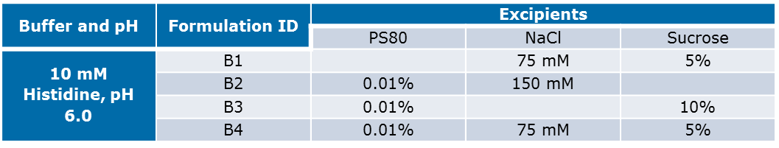
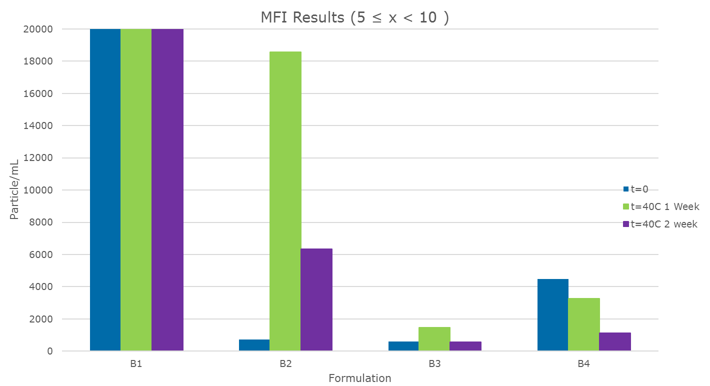
Formulation and stability testing
Fig. 2. The effect of different formulations on h2E2 aggregate particle formation after storage at 40ºC. The particles between 5 and 10 μm were measured by Micro-flow Imaging (MFI) after storage in the formulations shown in Table 2. Formulation B3 was selected for clinical use. It is anticipated that h2E2 will be stable in this formulation at a concentration of 100 mg/mL.

Slide 27
In vitro safety testing of mAb h2E2
Objective: Ascertain whether there is any cross-reactivity of 2E2 with cryosections of human tissues from three individuals.
Methods: Pathology Associates (Charles River Laboratories) using Good Laboratory Practices (GLP) protocols tested biotinylated h2E2 for binding to tissue cryosections.
Conclusion: Immunopathology report:
“No test article-reactivity or cross-reactivity was observed in the human tissue panel examined.”
Indicates low potential for toxicity in humans.
A major milestone in the pre-clinical development of h2E2.

Slide 28
IND-enabling animal toxicology studies with recombinant h2E2
All studies and assays conducted by an independent laboratory under GLP protocols.
Single species, rat.
Males and females.
Escalating doses (0, 40, 120, 360 mg/kg i.v.)
Pathology at 2 and 28 days.
Pharmacokinetics.
Conclusions:
No evidence of h2E2-associated pathology at any dose.
Pharmacokinetic parameters were consistent with our studies in mice and rats.
Pharmacokinetics were independent of dose and gender.

Slide 29
Milestones for an Investigational New Drug (IND) application for mAb h2E2
Structural characterization.
Pharmacological characterization.
Evidence for in vivo efficacy (decreases brain cocaine concentrations and increases cocaine priming threshold).
Establish a high capacity and scaleable production system.
Establish Master Cell Bank for GMP production.
Stability studies and a clinical formulation.
Lack of human tissue cross-reactivity in vitro.
Lack of toxicity in animals.

Slide 30
Pre-IND meeting with the FDA
February 20, 2019.
First-in-human study in 36 healthy volunteers.
Maximum Tolerable Dose and dose-dependent pharmacokinetics.
Single, escalating dose (4, 12, 40 & 120 mg/kg i.v.).
FDA response:
Rat toxicology studies (360 mg/kg) will permit human doses up to 40 mg/kg.
FDA requested rat toxicology studies at 1,200 mg/kg.
FDA requested multiple doses in rats to mimic duration of exposure in humans.

Slide 31
IND application filed with the FDA
Completed the additional studies requested by the FDA at our pre-IND meeting.
Electronic filing, not paper filing.
Electronic documents installed on a server outside of the UC firewall.
Populated electronic documents.
Established a secure account with the FDA .
Filing completed on 6/30/2021.
Clinical Hold imposed: Documentation 9/9/2021.

Slide 32
Technology Strengths
No approved pharmacotherapy for cocaine use disorder.
If effective, h2E2, will represent the first effective pharmacotherapy.
Humanized mAbs last a long time, so infrequent dosing and long-lasting protection optimizes treatment compliance.
The mAb h2E2 will likely be well-tolerated.
A cocaine vaccine was tested, but only partially effective because of low antibody titers.
The mAb h2E2 can be used along with a cocaine vaccine.
The mAb h2E2 has been used as a standard to measure cocaine vaccine effectiveness.
A cocaine hydrolase enzyme has been tested, but not effective. The h2E2 mAb could be used with the enzyme.
Patent protection is until at least 2032.

Slide 33
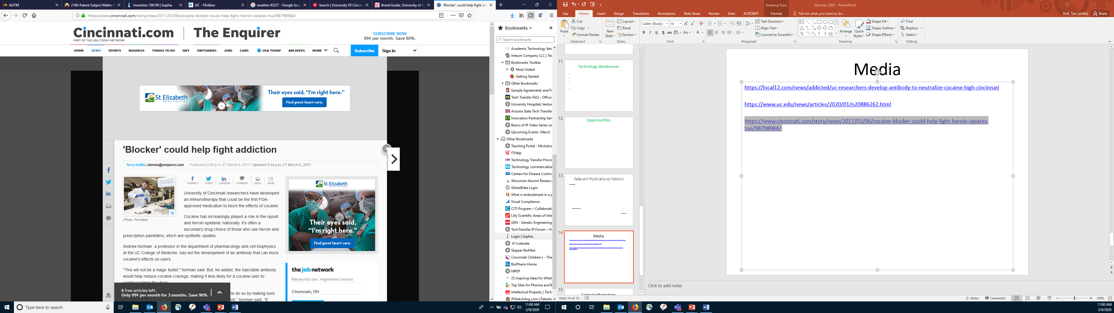
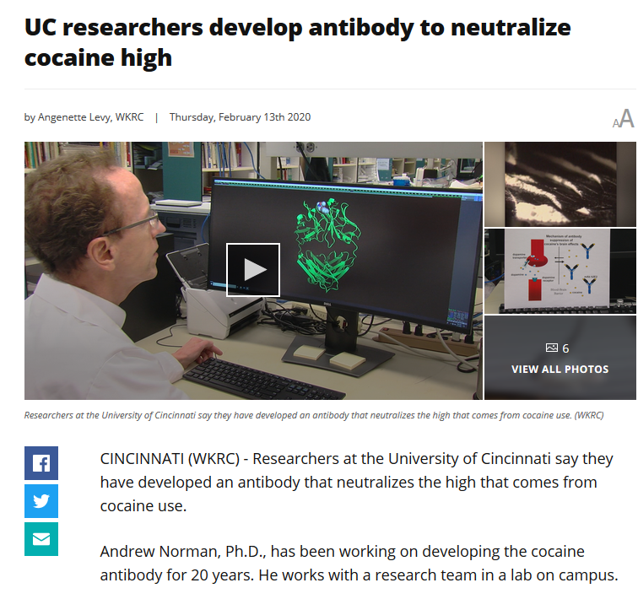
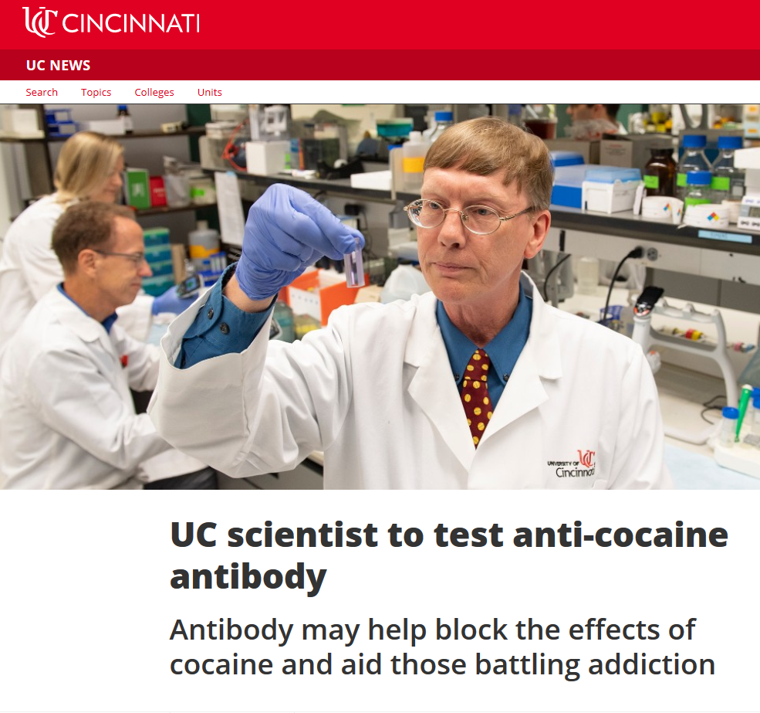
Media
https://www.uc.edu/news/articles/2020/01/n20886262.html
https://www.cincinnati.com/story/news/2017/03/06/cocaine-blocker-could-help-fight-heroin-opiates-too/98798984/
https://local12.com/news/addicted/uc-researchers-develop-antibody-to-neutralize-cocaine-high-cincinnati

Slide 34
Acknowledgements
GenPharm/Medarex
Dianne Fishwild, Ph.D.
Nils Lonberg, Ph.D.
Pathology Associates, Inc.
Catalent Pharma Solutions, Inc.
Greg Bleck, Ph.D.
Sarah Jerome.
National Institute on Drug Abuse
Grants to Dr. Norman:
SPIRCAP U19DA12043.
SBIR R44DA018538.
Translational Avant-Garde Award DP1DA031386.
“Grand Opportunity” U01DA039550
“Grand Opportunity” U01DA048525
Grand Opportunity” U01DA050330
University of Cincinnati
Jim Ball, Ph.D.
Mantana Norman, B.S.
Terry Kirley, Ph.D.
William Buesing, B.S.
Hanna Wetzel, Ph.D.
Jordan Marckel, B.S.
Vladimir Tsibulsky, Ph.D.
Hassane Amlal, Ph.D.
Michelle Nieman, B.S.
Christopher Crutchfield, Ph.D.
Felicia Gooden, M.S.
Purabi Dey, B.S.
Hamilton County Coroner’s Office
Ernie Chaffin, Ph.D.
Robert Topmiller, Ph.D.
Katie Gabbard, B.S.

Slide 35
Q&A
Please unmute to ask a question OR type your question in the chat box.

Slide 36
Thank you for joining us!
Please take a few moments to complete
the survey form. The survey link is provided
in the chat box.
The form is required to complete if requesting CE credit for Psychology, Social Work, or Counseling.

Slide 37
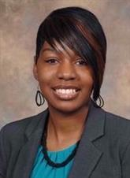
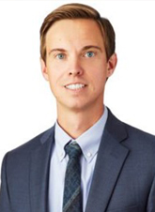
Understanding and Impact of Medical
Marijuana in Ohio
Wednesday, August 17, 2022: 12:00 – 1:00 PM
LaTrice Montgomery, PhD & Brian Higgins, JD
Registration website: med.uc.edu/institutes/CAR/summer-speaker-series/speaker-series-2022

